Slide 1
STF 576 Final activity report
MTS #81
ETSI Specialist Task Force 576
08.09.2020

Slide 2
Background
Motivations
REST API specifications more and more relevant in ETSI Groups
ISG Multi-access Edge Computing, ISG Network Function Virtualisation, ISG Zero-touch Service Management, ISG Cross-cutting Information Management, 3GPP CT & SA, OneM2M
Guidelines, methodologies and conventions needed
Led to development of MEC 009, NFV-SOL 013 & 015, …
Objective
DEG/MTS-203647: Methods for Testing and Specifications (MTS) Methodology for RESTful APIs specifications and testing
Scope: The present document provide guidance and methodology for RESTful API specification and testing based on analysis of methods, languages and best practices used in the industry and in ETSI groups
Benefits: Consolidation of efforts, Shorter delivery time , Quality of Standards (specification, testability, interoperability)
More information available here

Slide 3
ETSI Specialist Task Force 576
“Survey of current work and definition of a methodology for specification and testing of RESTful APIs”
Experts:
Martti Kaarik, Elvior
Philip Makedonski, University Goettingen
Sana Zulfiqar, xFlow Research
Michele Carignani, ETSI Technical Expert

Slide 4
Tasks and Time plan
Phase 1
Early Draft on 31/01/2020
Phase 2
Stable Draft on 15/05/2020
Phase 3
Final Draft on 30/06/2020

Slide 5
Activity since May
9 Remote meetings held
Individual drafting and review of the document
Stable Draft
MTS #80
MTS #81
Weekly confcalls
May
June
July
August
September

Slide 6
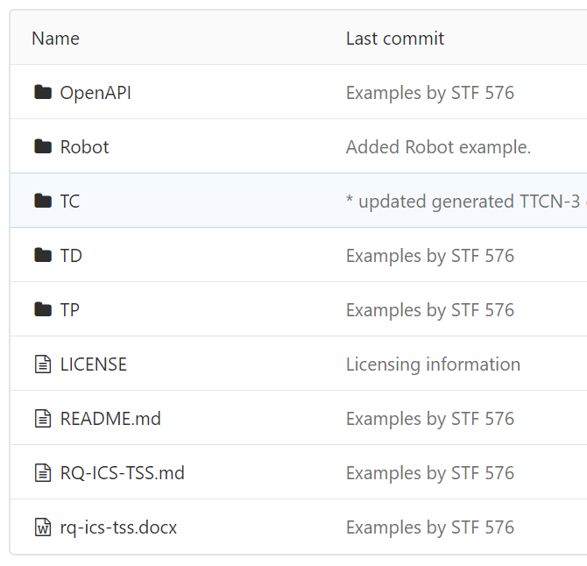
Achievements
Deliverable finalized
Clause 4: Specification methodologies for REST APIs
Clause 5: Testing Methodology for REST APIs
Clause 6: Tooling recommendation
An extensive set of examples delivered
In OpenAPI, TDL-TO, TDL, Docx, TTCN-3, Robot Framework
Available as code at https://forge.etsi.org/rep/mts/eg-203647-restful-api-guide
Calendar of dissemination meetings (4 confirmed, 4 TBC)

Slide 7
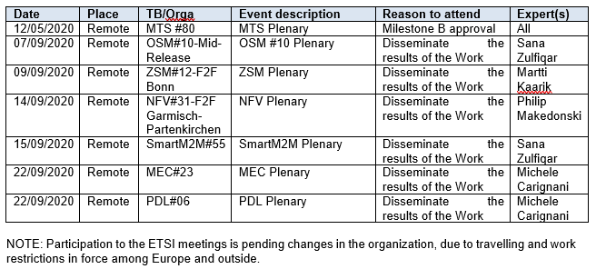
Next steps
EG 203 647 currently on ETSI Membership vote (Link)
Don’t forget to vote! Ask the official ETSI Contact of your organization
Poll closes on November 6
Publication and dissemination (Milestone D) [July => November 2020]
Postponed to allow review period for EG (60 days)
ETSI Meetings planned to be attended

Slide 8
Thanks to the experts! Great job
Get in contact: https://portal.etsi.org/STF/STFs/STF-HomePages/STF576
Email: stf576@groups.etsi.org
Thank you

Slide 9
Backup slides

Slide 10
Ways of working
MS Team for coordination and general document sharing
Teams, Sharepoint, OneNote
Drafting coordinated on ETSI Forge
https://forge.etsi.org/rep/stf/stf-576/mts-203647-methodology-for-restful-apis-specifications-and-testing
Sources in Markdown

Slide 11
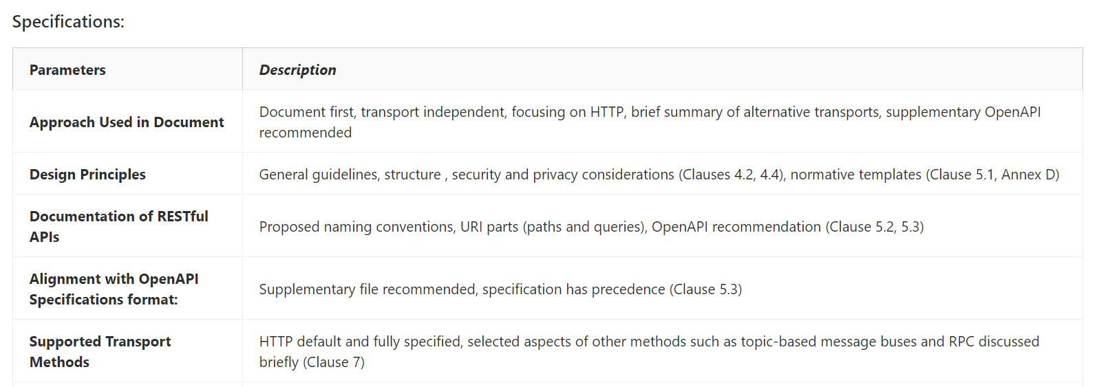
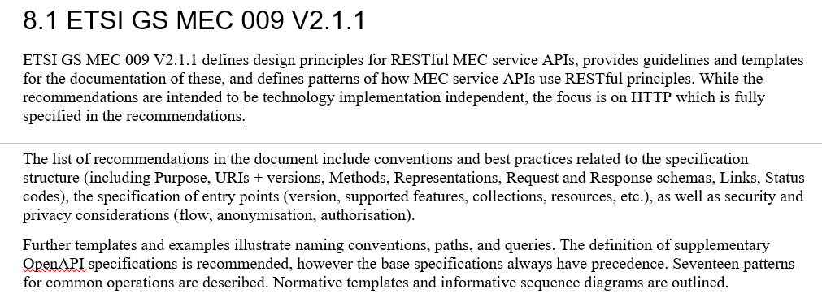
Achievements of “Phase 1”
Definition of methodology to collect info on the base documents
Analysis of base docs
Brief report in the draft
Structure of the document and indications on the content of each clause
Key decisions on the methodology

Slide 12
Highlights of the Survey
Contributed as
MTS(20)079029
Major challenges in the specification of REST API
Inconsistency of and between documents
Growing size of documents
Important Topics to be covered in RESTful API Guide
Validation of API specifications
Selection and usage of tools
Examples of standard deliverables (TPs, TDs, ATS)
Importance of Interoperability and Conformance testing

Slide 13
Key decisions from Phase 1
Focus on the “standardization” use cases more than industry applicable practices
Serve as a “starting point” and a “collection of other guides and conventions”
Propose a methodology with a medium/long-term vision
With some innovative choices
Keep Testing and Validation parts as first class citizens
Specification methodology to enable sound testing
Testing methodology and examples to enable reuse and speed-up testing specification development

Slide 14
Achievements from Phase 2
Clauses drafted in stable drafts (minor changes pending)
Clause 4: Specification methodologies for REST APIs
RESTful APIs specification in a staged standardization approach,
Introduction on RESTful interfaces,
API specification process, Common Patterns, Naming conventions, Versioning
Clause 5: Testing Methodology for REST APIs
Testing Frameworks and Methodologies
Conformance and Interoperability Testing
Test Specification Development
Clause 6: Tooling recommendations
Design and drafting, Coordination and collaboration, Validation and quality check, Post processing

Slide 15
MTS Feedback and STF proposals
Guidance and feedback from MTS is most welcome
On the draft as well as on the activities for dissemination
Proposal (for decision)
Opening a rest.etsi.org portal to allow collaboration
Screenshot
Recommendation on sending LSs

Slide 16
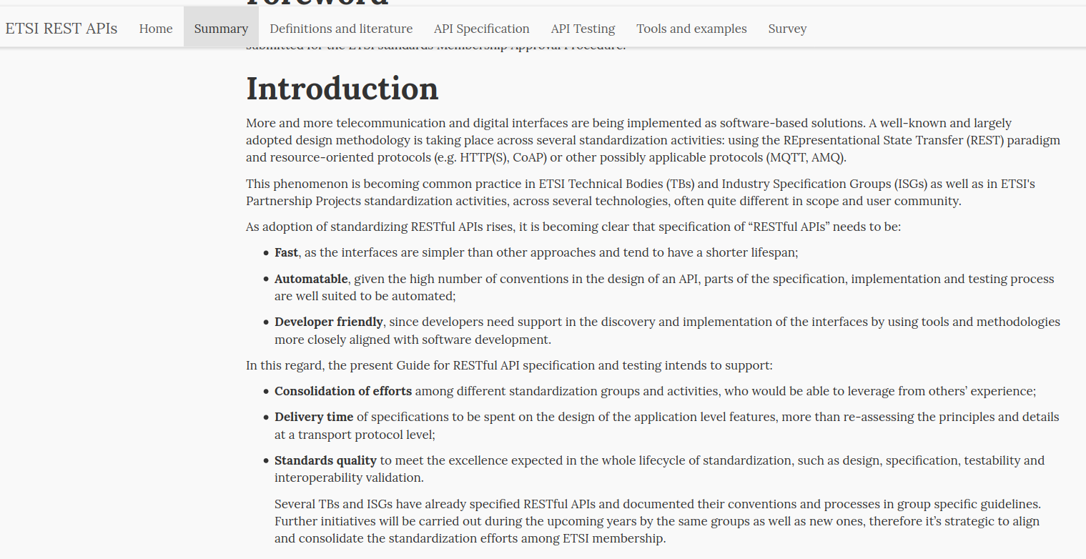
Proposed API wiki at (rest.etsi.org) 1/2
Easy to find and consume documentation
Contains the text from the EG, automatically transformed
May be expanded with more content, in preparation for future versions

Slide 17
Proposed API wiki at (rest.etsi.org) 2/2

