Slide 1
Joint MTS/INT Working Meetings on Testing of and with AI
Andreas Ulrich
MTS#82
27-Jan-2021

Slide 2
Work Items (Technical Reports) of TC INT
INT(20)000007: Use and benefits of AI technologies in testing
https://portal.etsi.org/ngppapp/ContributionCreation.aspx?primarykeys=197421
INT(20)000008: Testing of AI with a definition of quality metrics
https://portal.etsi.org/ngppapp/ContributionCreation.aspx?primarykeys=197423
Rapporteur for both TRs: Tayeb Ben Meriem

Slide 3
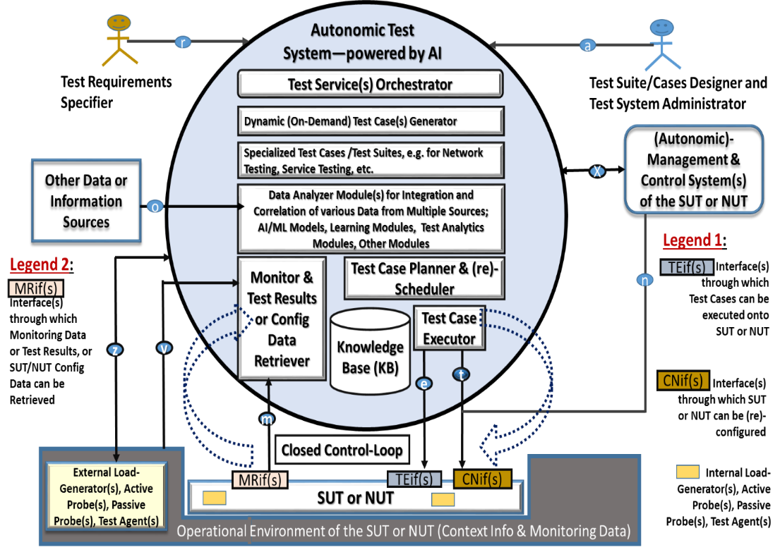
INT’s AI-enabled Autonomic Test System

Slide 4
Timeframe for first TR on Use/Benefits of AI in testing
Current: Completion of missing sections
19-Feb-2021: Start of reviews
05-Mar-2021: Submission to INT#48 plenary for approval
INT#48 plenary on 15-18 March ← Target
Afterwards: start on second TR on Testing AI systems

Slide 5
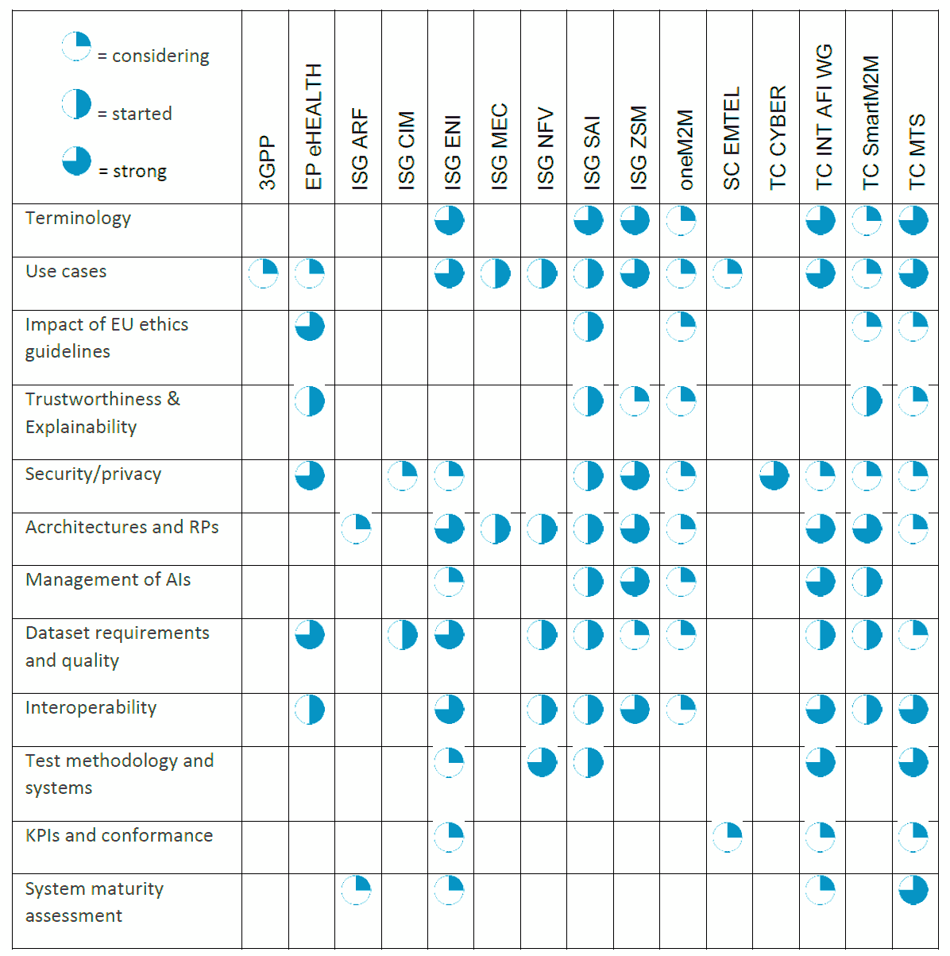
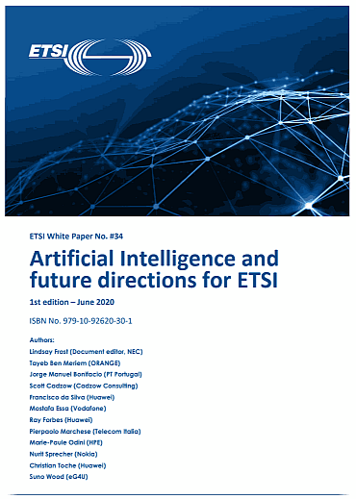
Artificial Intelligence and future directions for ETSI (WP#34)
OCGAI(21)000003r1
ETSI aims to handle specific needs for AI:
• to harness AI for optimization of ICT networks,
• to include ethical requirements in AI usage e.g. for eHealth, privacy/security
• to ensure reliability through appropriate testing of systems using AI,
• to overcome some AI-related security issues, and
• to better manage and characterize data, including from IoT systems, that is used by AI.
https://www.etsi.org/images/files/ETSIWhitePapers/etsi_wp34_Artificial_Intellignce_and_future_directions_for_ETSI.pdf
Notes:
NO animations

Slide 6
OCG AI #6 meeting and activities
Request for a “one-pager” highlighting AI related activities in each ETSI group
ETSI needs to be prepared for EC standardisation requests
Specific regulatory needs can be expected to require ETSI responses during 2021
Legislation proposal on AI ethical requirements, Mar/Apr 2021
Specific proposal on AI liability rules, 2H 2021
Additional topics likely (e.g. trust, explainability, data bias)

Slide 7
AI and Trustworthiness
Trustworthiness of AI covers at least the three aspects [AI2019]:
It should be lawful, complying with all applicable laws and regulations;
It should be ethical, ensuring adherence to ethical principles and values; and
It should be robust, both from a technical and social perspective.
[AI2019] High-Level Expert Group on Artificial Intelligence: Ethics Guidelines for Trustworthy AI, 2019;
Contributions from MTS?

Slide 8
Suggested NWIs on AI and Testing
NWI: AI-enabled testing in standardisation
Deals with AI-enabled testing for use in standardisation contexts, including supporting and adapting existing processes and methodologies for conformance and interoperability testing.
It explores new approaches to streamline the test specification processes enabled by the use of AI in testing.
NWI: Test methodology and test specification for AI-enabled systems
Deals with testing of AI-enabled systems for the purpose of standardisation and elaborates on test methodologies and methods for test specification.
It identifies requirements for testing and comes forward with proposals to tackle the technical aspects of certifying trustworthiness of AI in standardisation contexts.
What are standardisable assets?

