Slide 1
MTS TST Status
Axel Rennoch
MTS#83
10.05.2021

Slide 2
TST publications

Slide 3
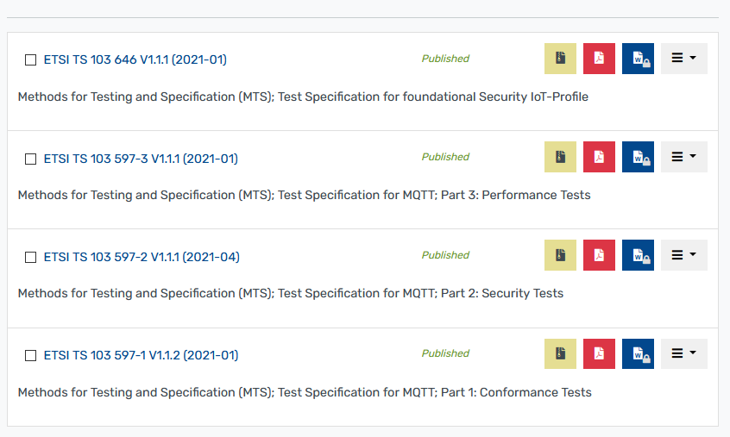
MTS TST documents published

Slide 4
MTS TST documents in progress

Slide 5
TST future

Slide 6
Possible topics
Restart of previous (stopped) TST WI?
LoRaWAN
New test catalogs for further relevant IoT protocols
OASIS Advanced Message Queuing Protocol (AMQP)
ETSI TS 103 357, Short Range Devices; Low Throughput Networks (LTN); Protocols for radio interface A (e.g. MIOTY)
Support for the formalization/refinement
Draft ETSI TS 103 701 Cyber Security for Consumer IoT conformance assessment

Slide 7
Possible resources
Within ETSI
MTS STF/TTF
Other TC/ISG?
Outside ETSI
Research project (like IoT-T.de in the past)

Slide 8
Conclusions
TST working program successfully completed
TST run out of resources
TST to be subject for (temporally) closing
Thanks to rapporteurs/contributors and TST participants:
Bostjan Pintar, Sascha Hackel, Ilie-Daniel Gheorghe-Pop, André Wardaschka
Philip Makedonski, Finn Kristoffersen, Andreas Ulrich, György Réthy, Martti Käärik, Dirk Tepelmann, Emmanuelle Chaulot-Talmon, Michele Carignani, Dieter Hogrefe, Anthony Wiles, Frank-Walter Jäkel, Jens Stomber, Alexander Kaiser, Abbas Ahmad, and many more

