Slide 1
Joint MTS/INT Working Meetings on Testing of and with AI
Andreas Ulrich
MTS#83
11-May-2021

Slide 2
Work Items (Technical Reports) of TC INT
INT(20)000007: Use and benefits of AI technologies in testing
https://portal.etsi.org/ngppapp/ContributionCreation.aspx?primarykeys=197421
INT(20)000008: Testing of AI with a definition of quality metrics
https://portal.etsi.org/ngppapp/ContributionCreation.aspx?primarykeys=197423
Rapporteur for both TRs: Tayeb Ben Meriem

Slide 3
Timeframe of the TRs (as presented by Tayeb, INT)

Slide 4
Current status
TR1: Benefits that AI brings to testing
Editor is Andreas; still some gaps in the text, but closing
Additional review required before finalising draft
TR2: Testing of AI-empowered systems and metrics for certification
Editor changed to be Ranganai
Initial input available; further discussion on scope and structure required

Slide 5
Promotion of the joint INT/MTS activities on AI
Steps Required Towards Building Standards-based Testbeds and Frameworks for Certifications of AI Models / Components / Systems
ITU ETSI IEEE Joint SDOs Brainstorming Workshop on Testbeds Federations for 5G & Beyond, 16-Mar-2021
GANA: Standardizing Test and Certification Framework for AI Models & Autonomic/ Autonomous Networks
ETSI Perspective Day at Layer123 Europe: 360° Network Automation Congress, 12-Apr-2021
ETSI Standardization Perspectives on Frameworks Using AI in Test Systems and Testing and Certification of AI-Enabled Systems
Submitted to UCAAT 2021, 19/21-Oct-2021

Slide 6
OCG AI-related activities
MTS is covered by Philip
Request for a “one-pager” highlighting AI related activities in each ETSI group ← MTS needs to prepare this
EC draft regulations on AI published ← Who contributes?
Briefing meeting on 20-May
Request for providing comments and feedback; highlight points where standards exist or are needed (gaps) for the regulations
Draft regulations are available here (after ETSI Portal login)

Slide 7
MTS’s role at ETSI on AI topics
Goal → Positioning ETSI TC INT and MTS to jointly become the home for activities related to testing and certification of AI models and autonomous networks
Achieving the goal through the definition of NWIs and related TTF
Consider EC funded STF
Further collaborate with INT

Slide 8
WIs on AI and Testing
Not started yet
WI: AI-enabled testing in standardisation
The document covers AI-enabled testing for use in standardisation contexts, including supporting and adapting existing processes and methodologies for conformance and interoperability testing, robustness testing and other testing types.
It explores new approaches to streamline the test specification processes enabled by the use of AI in testing.
WI: Test methodology and test specification for AI-enabled systems
The document covers testing of AI-enabled systems for the purpose of standardisation and elaborates on test methodologies and methods for test specification.
It identifies requirements for testing and comes forward with proposals to tackle the technical aspects of certifying trustworthiness of AI in standardisation contexts.

Slide 9
Backup

Slide 10
EC draft documents on AI (external sources)
EC overview of trust in AI
Communication on Fostering a European approach to Artificial Intelligence, 21 April 2021
Regulation on a European approach for Artificial Intelligence, 21 April 2021
New Coordinated Plan on Artificial Intelligence, 21 April 2021,
Regulation on machinery products, 21 April 2021
EC released the Draft Regulations
PDF draft
PDF annex

Slide 11
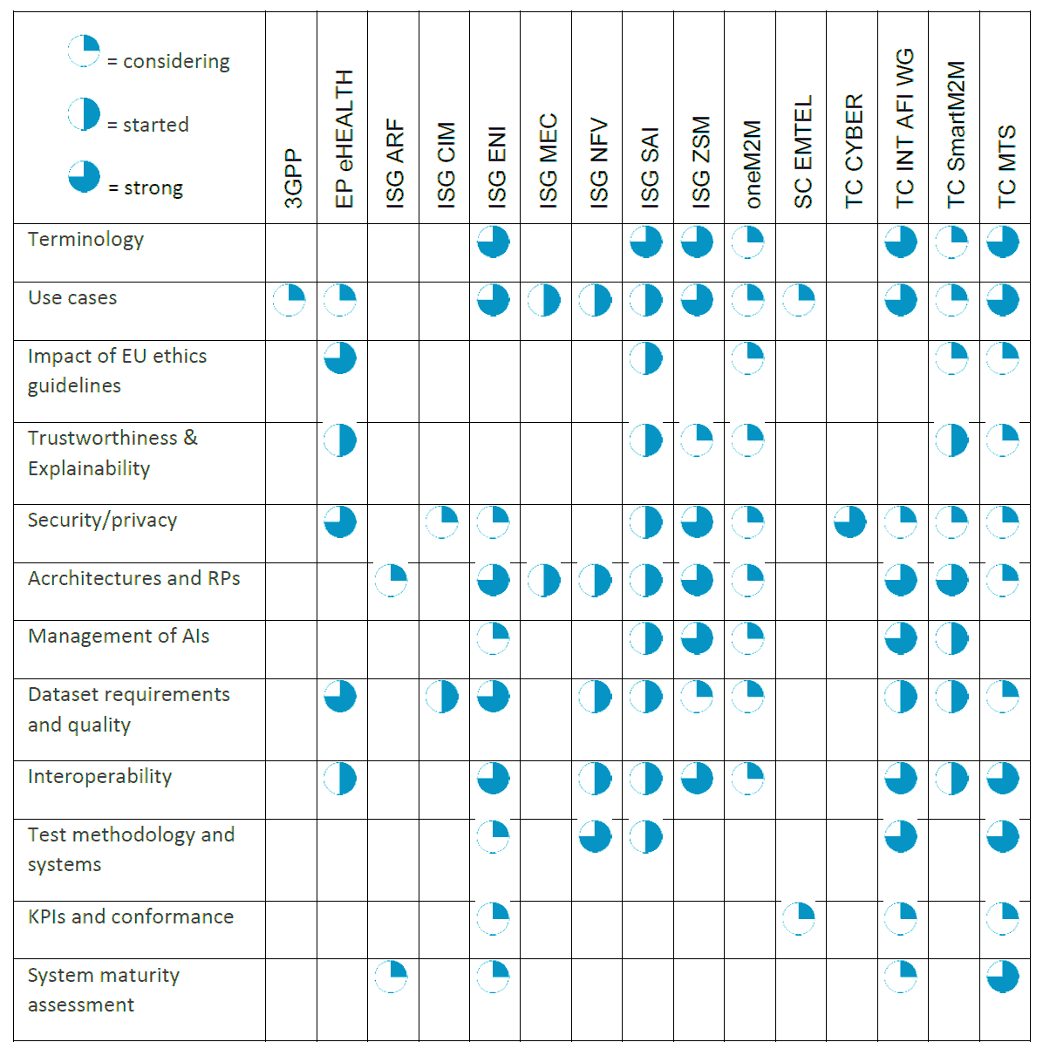
Artificial Intelligence and future directions for ETSI (WP#34)
OCGAI(21)000003r1
ETSI aims to handle specific needs for AI:
• to harness AI for optimization of ICT networks,
• to include ethical requirements in AI usage e.g. for eHealth, privacy/security
• to ensure reliability through appropriate testing of systems using AI,
• to overcome some AI-related security issues, and
• to better manage and characterize data, including from IoT systems, that is used by AI.
https://www.etsi.org/images/files/ETSIWhitePapers/etsi_wp34_Artificial_Intellignce_and_future_directions_for_ETSI.pdf
Notes:
NO animations

Slide 12
INT’s AI-enabled Autonomic Test System

