Slide 1
ICT-Standardization Innovative Communication Systems, IT-Security and Numbering
18.01.2021

Slide 2
Recent Activities
ITU – T:
Environmental Efficiency for Artificial Intelligence
and other Emerging Technologies
Machine Learning for Future Networks including 5G
Quantum Information Technology for Networks
SG2 (Numbering), SG13 (Future networks), SG17 (Security), SG20 (IoT)
ETSI:
Operational Coordination Group AI
TC SmartM2M
ISG ENI (Experiential Network Intelligence)
EP eHEALTH
TC Cyber
DIN:
Mirror committee of ISO / IEC / JTC / SC 42: Artificial Intelligence
Standardization Council Industry 4.0

Slide 3
AI Standardization: Focus
Future networks: Application scenarios
Use Cases
Requirements on AI and semantics
ML – Techniques for communications
Classification of AI – Applications
ML – Architectures

Slide 4
Artificial Intelligence in ICT
Knowledge Representation
Ontologies, semantic networks
Machine Learning
Neural networks,
graph-based learning,
dynamic programming
Decision Making
Decision networks,
iteration models,
expert systems
Weather
Spectral efficiency
Transmission power
Data flow classification
Traffic forecasting
Radar
LIDAR
Camera
Aldebaro Klautau: ML5G applications using Raymobtime

Slide 5
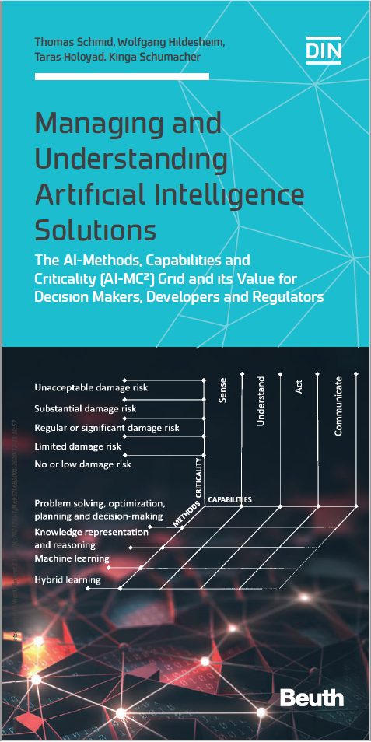
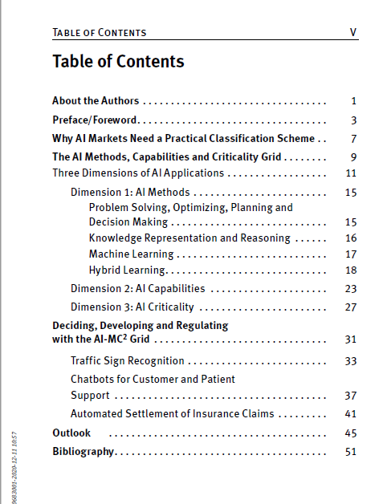
Current Activities
Source: Schmid et al.: Managing and Understanding Artificial Intelligence Solutions

Slide 6
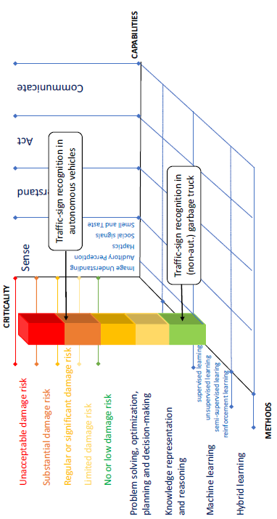
Current Activities
Source: Schmid et al.: Managing and Understanding Artificial Intelligence Solutions

Slide 7
Current Activities
Pepper from DFKI: Vision
Source: Schmid et al.: Managing and Understanding Artificial Intelligence Solutions

