Slide 1
UCAAT 2022 Summary

Slide 2
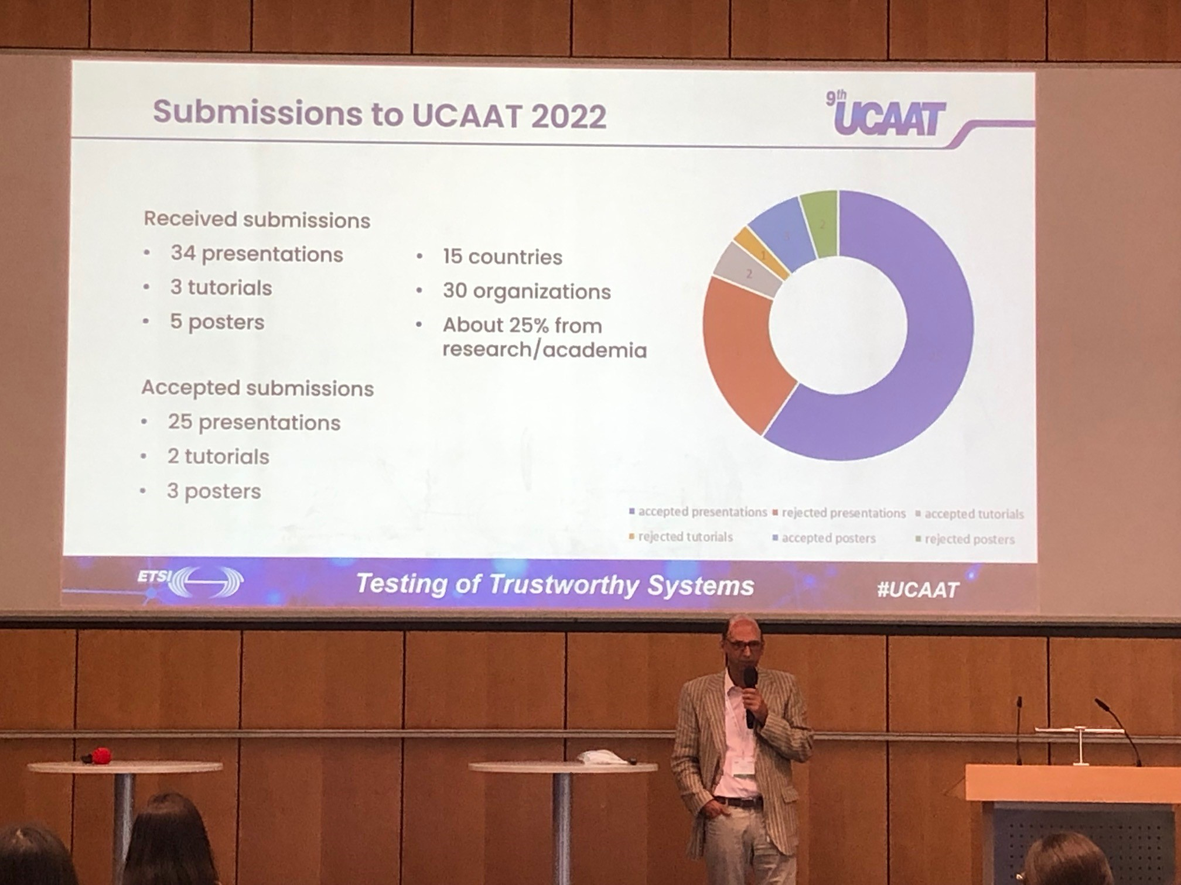
UCAAT Opening

Slide 3
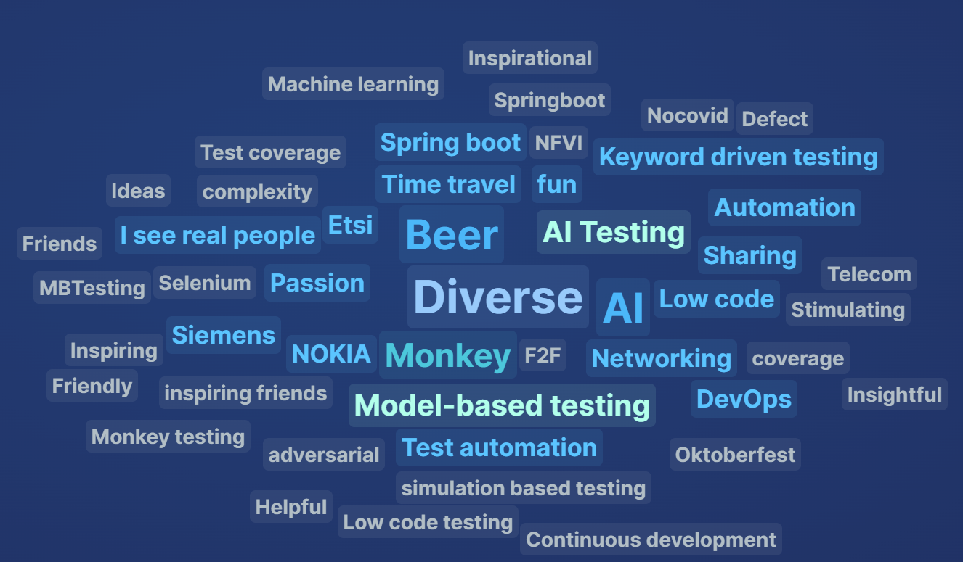
UCAAT Summary
3 days program
2 keynote speakers
25 international speakers
5 exhibition stands
84 participants
2 tutorials

Slide 4
Program Committee
Program Committee Chair:
Andreas Ulrich, Siemens AG
Program Committee Members:
Jorge Asensio, ARHS Developments
Sergio Borghese, NetResults Srl
Carlos Cárdenas, Dekra
Rémi Caudwell, Sogeti
Tibor Csöndes, Ericsson Hungary
Zhen Ru Dai, Hamburg University of Applied Sciences (HAW)
Alexis Despeyroux, Testing Solutions and Services
Muslim Elkotob, Vodafone
Baris Güldali, S&N Invent
Raquel Jimenez, MTP
Martti Käärik Elvior, LLC
Philip Makedonski, University of Göttingen
Ultan Mulligan, ETSI
Dejan Ničković , AIT
Jorge Pascal, Audi
Axel Rennoch, Fraunhofer FOKUS
Stephan Schulz, Giesecke + Devrient
Matthias Simon, Nokia
Szilard Szell, Eficode Oy
Dirk Tepelmann, Spirent
Peter Zimmerer, Siemens AG

Slide 5
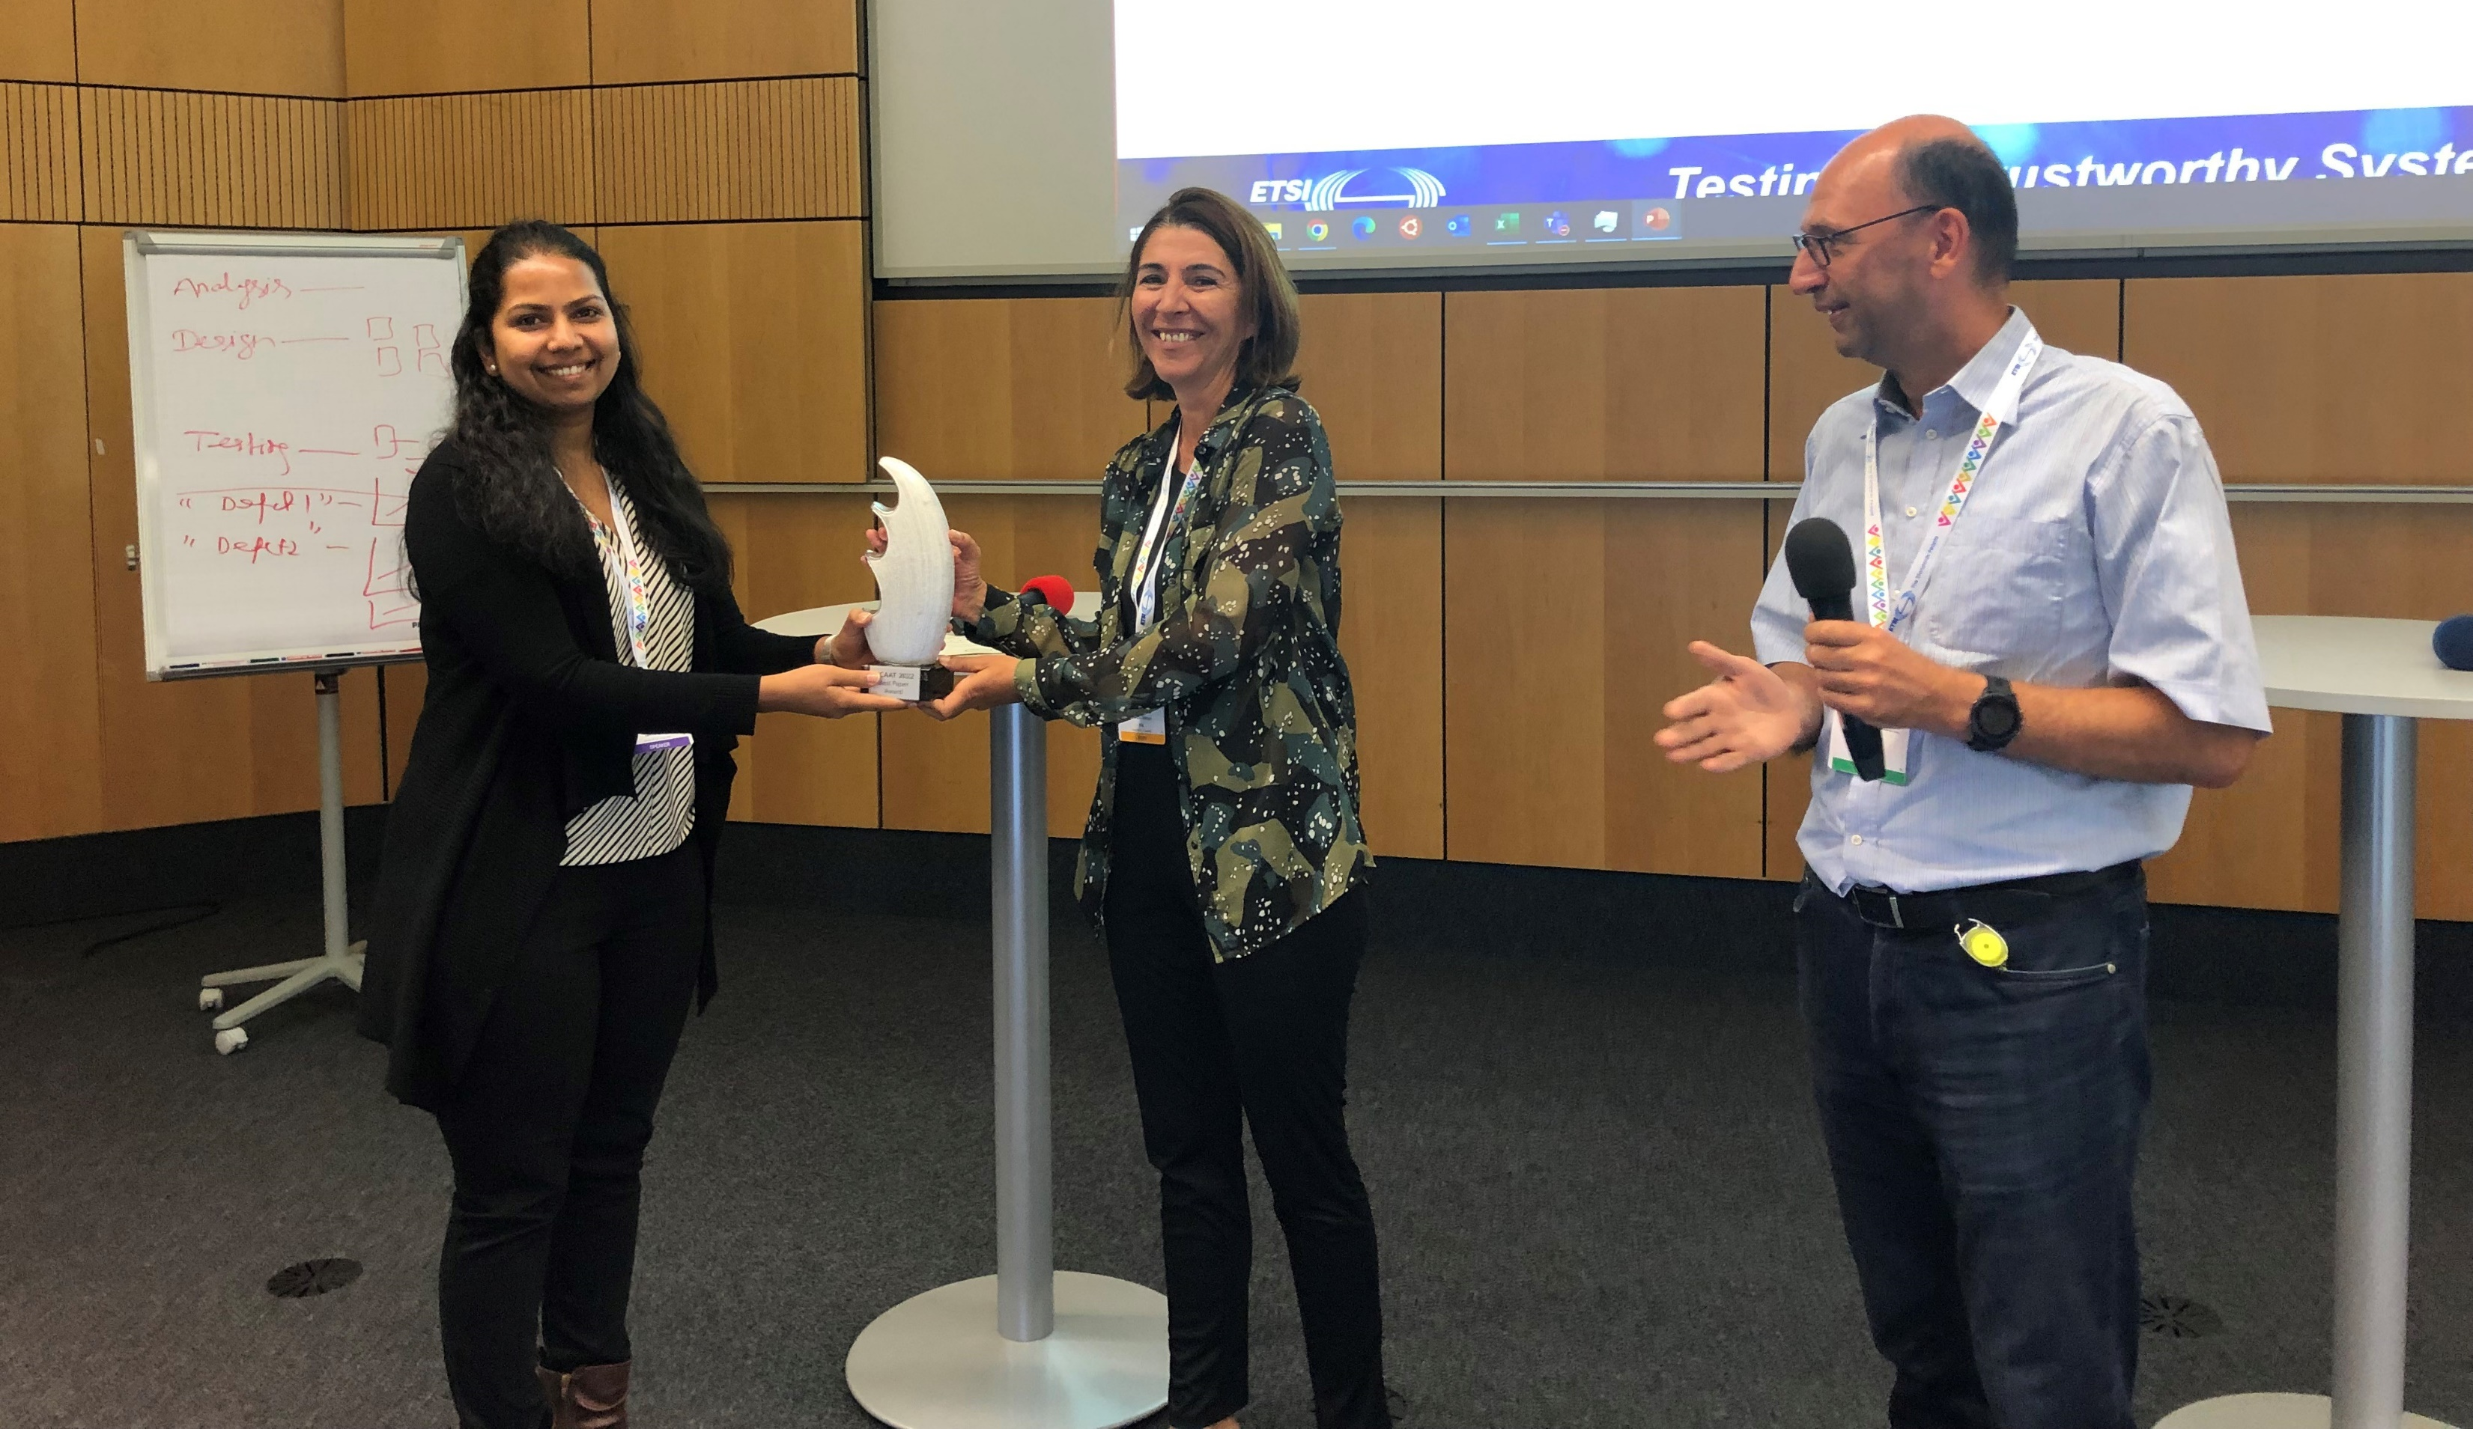
Best Presentation Award
Shreyasi Warunkar, S&N CQM GmbH has been awarded by the #UCAAT Program Committee with the best presentation award for her talk on “Systematic Selection of Testing Methodology for Low-Code Development”

Slide 6
Some Insights from the Survey (1/4)
24 answers

Slide 7
Some Insights from the Survey (2/4)
Main reasons for attending
Present my research idea
Innovate
To publicise ideas on AI and testing. To learn about the current state of test automation practice.
Working in the field of testing AI systems for trustworthiness
Wanted to share my experience around time travel testing with larger community. Also wanted to learn about the direction in which test automation industry is heading and why need to learn in order to survive and succeed for next 5 years.
Hearing about advanced automation and approaches in automation testing.
Learning new ways for testing and automation
See different approaches in testing Learn something new
Meeting community, learning about trends, presenting own work
Presenting my work and as well as seeing what others do
Meeting the people I missed in 2021
get inspiration share experience
To learn about current challenges and practices in automated testing, and to present our company and our vision on the automated testing approaches.
I attended the event to be informed about the "state of art" of Test activity
Discover new practises/tools/concept and sharing
Learn more about the current research and work in the field of software testing/test automation, meet experts, make new contacts, make contribution through the presentation.
getting back into software testing, meeting people I know from previous conferences and talking with them about software testing and related topics
To take away some more information on test automation that i have not applied to my current situation yet.
Presenting our findings on testing AI robustness in our organisation
Change my experiences and learn from the community
Give presentation; looking what's happening in the test automation world; networking.
Promoting TDL standards and tool. Learn about new trends in software testing

Slide 8
Some Insights from the Survey (3/4)

Slide 9
Some Insights from the Survey (4/4)
Suggestions for improvement
Some additional controlled networking opportunities.
Try to get more senior presenters with higher presentation quality
Find a way to make the exhibitions more visible, for instance directly visible from or even within the break and lunch area.
Maybe give more time/attention to hands-on experience for existing tools and methods.
the time dedicated to each talk could be increased
ensure good quality for remote presentations
more real life code examples of pipeline setups etc similar to Nokia - more to bring back to the company to implement etc
If possible a more visible location for the tools exhibition

Slide 10
Promotion on LinkedIn

Slide 11
LinkedIn Numbers
Analytics (last 30 days)
150 Page views +1150%
56 Unique visitors +833.3%
13 new followers +550%
4 posts
-> 1076 post impressions
-> 86 button clicks

Slide 12
LinkedIn demographics

Slide 13
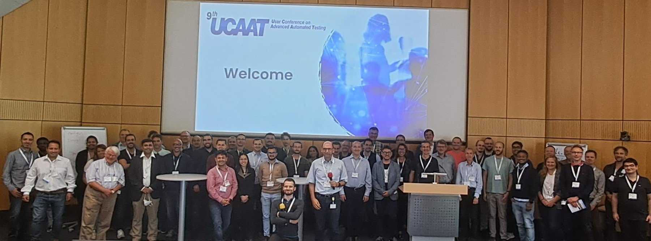
Group Picture

