Slide 1
MTS TDL Working Group Status + TDL Roadmap
Andreas Ulrich, Siemens AG (WG Chair)
MTS#91
25-Jan-2024

Slide 2
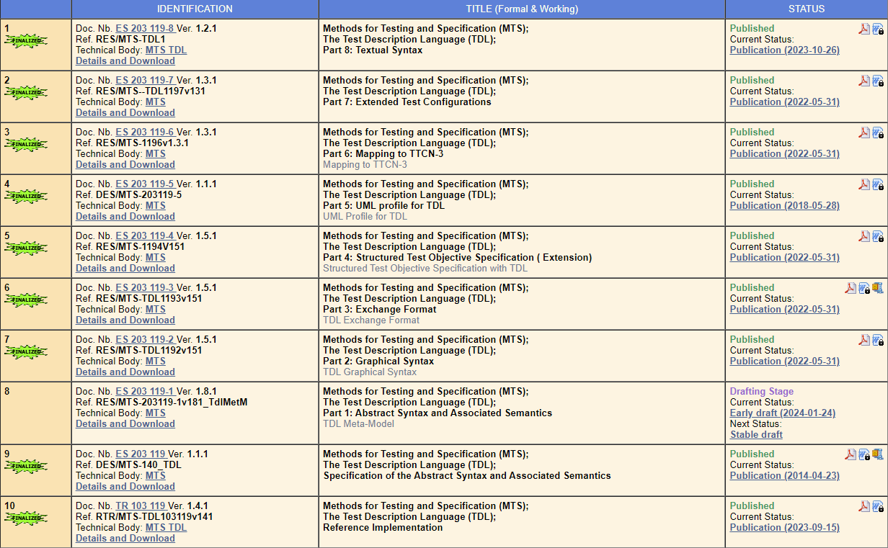
Status of TDL documents

Slide 3
Open TDL meetings
Setup to discuss and coordinate work with TTF 034
Status of TOP
Application cases of TOP/TDL
Documentation, wiki, training
Each first Tuesday of a month
Past meetings
TDL#1 2023-11-07
TDL#2 2023-12-05
TDL#3 2024-01-09
Upcoming meeting
TDL#4 2024-02-06

Slide 4
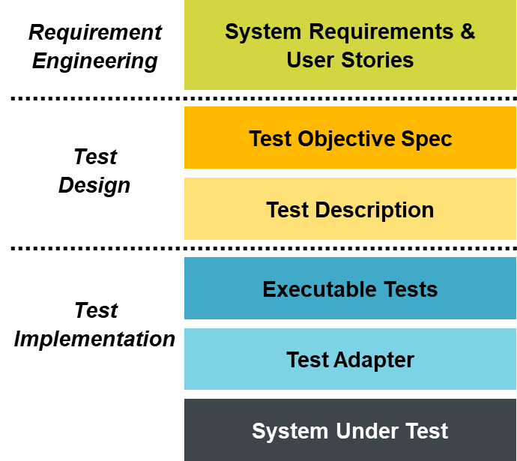
The TDL approach to (conformance) testing
Import protocol data type definitions, e.g. ASN.1, OpenApi
Generate TDL data types
Write Test Objectives (TOs) using the new TDL syntax
Generate TO documentation
Evolve TOs into Test Descriptions (TDs)
Generate TD documentation using Graphical TDL-GR
Generate executable test code, e.g. in TTCN-3, Java
Compile and run the executable tests

Slide 5
TDL/TOP application cases
Purpose
Demonstrate the use of TDL and TOP for the specification of Test Purposes and Test Descriptions (continuous refinement using new syntax)
Demonstrate the use of TOP for test execution of TDs
Candidates for the usage of TDL/TOP
mWT (Millimeter Wave Transmission) testing TTF T029 (until end of 2024)
YANG data types
NGAP protocol testing (in discussion with MTS TST)
ASN.1 data types
Projects driven by CTI
Apply TDL on projects that are already completed to derive show cases
Project using OpenAPI

Slide 6
TDL/TOP roadmap
Documented and kept updated on ETSI-labs
https://labs.etsi.org/rep/groups/top/-/epic_boards
Topics on TDL/TOP/Methodologies captured as “epics”
Every ETSI delegate can propose topics
Login required
Access needs to be requested (to enter a new epic)
Pending issues
Detail each epic description, including expected outcome
Make roadmap available on TDL website
Define process of handling new epic requests → prioritized backlog

Slide 7
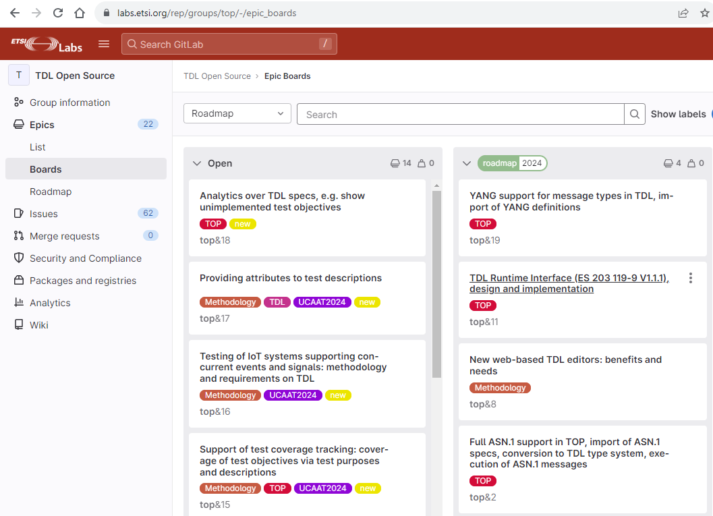
Covered by current TTF 034
New topics to be processed

