Slide 1
Activities of ARIB - Standardization and IPR -
Document No: | GSC-IPR-
Source: | Association of Radio Industries and Businesses
Contact: | Tadaaki YOKOO
GSC Session: | IPR Working Group
Agenda Item: | 3.1
Tadaaki YOKOO
Executive Director, ARIB
Sophia Antipolis, 20 April 2015

Slide 2
About ARIB
Standardization Activities
IPR Activities
Sophia Antipolis, 20 April 2015

Slide 3
About ARIB
Sophia Antipolis, 20 April 2015

Slide 4
Outline of ARIB
Organization
A general incorporated association and non-profit standards development organization (SDO), based in Tokyo, Japan.
Dealing with radio technologies in the fields of both telecommunications and broadcasting.
Establishment
15 May 1995 as a public service corporation
By merging two organizations, RCR and BTA, who had worked on standardization from 1985 to 1995.
RCR ： Research & Development Center for Radio Systems
BTA : Broadcasting Technology Association
Members (as of 1 April 2015)
Regular members : 200
Telecom Operators : 8
Broadcasters : 21
Manufactures :143
Others : 28
Supporting members: 4
Sophia Antipolis, 20 April 2015

Slide 5
Standardization Activities
Sophia Antipolis, 20 April 2015

Slide 6
ARIB Standard Assembly
Establishment
May 1995
Membership
Open to any entity, organization and person
Independent from ARIB membership
Members : 163 (as of 1 April 2015)
・Telecom Operators : 6 ・Broadcasters : 17 ・Manufactures : 124 ・Others : 16
Holding period 3 - 4 times a year
Sophia Antipolis, 20 April 2015

Slide 7
ARIB’s R&D and Standardization
Demands for radio systems
Committees and subordinate groups for standardization inside ARIB
Technical Committee
Advanced Wireless Communications Study Committee
Electromagnetic Environment Committee
R&D Group
• • • •
R&D Group
MIC
Results of R&D
Considerations on Technical Requirements
Draft Standard
Rule making by the Ministry (Mandatory)
Standard Assembly
Other Organization
ARIB Standard (Voluntary)
Draft Standard
MIC : Ministry of Internal Affairs and
Telecommunications
Sophia Antipolis, 20 April 2015

Slide 8
Outcome from Standard Assembly
ARIB Standard (STD)
technical regulation for radio systems
Including “government technical regulation” for users’ convenience
ARIB Technical Report (TR)
operational guidelines for radio systems
Number of STD and TR *
Free Download
http://www.arib.or.jp/english/html/overview/index.html
As of 1 April 2015 (1 April 2014)
 | STD | TR
Telecommunications | 90 (90) | 23 (23)
Broadcasting | 69 (67) | 39 (39)
General | 0 ( 0) | 1 ( 1)
* Not including suppressed STD/TR
Since 21 April 2008
Sophia Antipolis, 20 April 2015

Slide 9
IPR Activities
Sophia Antipolis, 20 April 2015

Slide 10
IPR and Standardization
Technical Committee
Study of radio systems
Study Groups for
various themes
Study Phase
R&D of radio systems
Agreement on IPR to join R&D Groups: RF or RAND only
R&D Phase
R&D Groups for
various themes
①
Draft ARIB Standard
IPR submission for adoption: Confirmation form or Comprehensive confirmation form
Standardization Phase
③
The Standard Assembly
Draft Standard from other bodies
① Standardization based on the draft by R&D Groups
② Standardization based on the draft by Subcommittees
③ Standardization based on the draft by other bodies
②
Subcommittees
Establishment of
the ARIB Standard
Sophia Antipolis, 20 April 2015

Slide 11
IPR Policy
Document: IPR Guidelines and IPR Working Guidelines
IPR is defined as “Industrial Property Rights”
Treatment for Essential IPR
Selection : Option 1 (Royalty Free), Option 2 (Reasonable And Non-Discriminatory) or Option 3 (Others) should be selected.
Essentiality: No responsibility of ARIB to confirm essentiality
Liability: No liability of ARIB for any dispute
Procedure
Submission form: “Confirmation form” or
“Comprehensive confirmation form”
Submission date: Before or on the decided date
Sophia Antipolis, 20 April 2015

Slide 12
IPR Treatment
 | License Grant | Submission |  | Standardization
 |  | Confirmation Form | Attachment
Option 1 | Free | Mandatory * | Patent No. / holder | Yes
Option 2 | RAND | Mandatory * | Patent No. / holder | Yes
Option 3 | No | Mandatory | Patent No. / holder + Detailed Info. | No
* Comprehensive Confirmation Form can be an alternative without specifying
patent No. / holder
Sophia Antipolis, 20 April 2015

Slide 13
Submission of IPR (1/3)
ARIB IPR ( 2000 – 2015)
Sophia Antipolis, 20 April 2015

Slide 14
Submission of IPR (2/3)
Number of ARIB IPR ( 2011 – 2015)
 |  | 2011 | 2012 | 2013 | 2014 | 2015
Tele- communication | IPR | 5,201 | 7,247 | 8,136 | 9,432 | 9,658
 | （comprehensive） | （305） | （322） | （345） | （377） | （381）
Broad- casting | IPR | 588 | 610 | 620 | 677 | 833
 | （comprehensive） | （115） | （118） | （120） | （167） | （173）
TOTAL | IPR | 5,789 | 7,857 | 8,756 | 10,109 | 10,491
 | （comprehensive） | （420） | （440） | （465） | （544） | （554）
Sophia Antipolis, 20 April 2015

Slide 15
Submission of IPR (3/3)
ARIB Standard with numbers of IPR (As of 1 April 2015)
 | Code | Standard Name | IPR * (comprehensive)
Tele- communication | STD-T63 | IMT-2000 DS-CDMA and TDD-CDMA System | 3,840 (168)
 | STD-T104 | LTE-Advanced System | 1,437 (32)
 | STD-T64 | IMT-2000 MC-CDMA System | 1,348 (81)
 | STD-T95 | OFDMA/TDMA TDD Broadband Wireless Access System (XGP) | 1,079 (16)
 | STD-T94 | OFDMA Broadband Mobile Wireless Access System (WiMAXTM applied in Japan) | 1,001 (14)
Broadcasting | STD-B32 | VIDEO CODING, AUDIO CODING AND MULTIPLEXING SPECIFICATIONS FOR DIGITAL BROADCASTING | 225 (23)
 | STD-B24 | DATA CODING AND TRANSMISSION SPECIFICATION FOR DIGITAL BROADCASTING | 73 (19)
 | STD-B21 | RECEIVER FOR DIGITAL BROADCASTING (DESIRABLE SPECIFICATIONS) | 67 (11)
 | STD-B31 | TRANSMISSION SYSTEM FOR DIGITAL TERRESTRIAL TELEVISION BROADCASTING | 39 (9)
 | STD-B29 | TRANSMISSION SYSTEM FOR DIGITAL TERRESTRIAL SOUND BROADCASTING | 37 (3)
* All IPRs have RAND, including potentially Essential IPRs declared by “Comprehensive Confirmation Forms”.
Sophia Antipolis, 20 April 2015

Slide 16
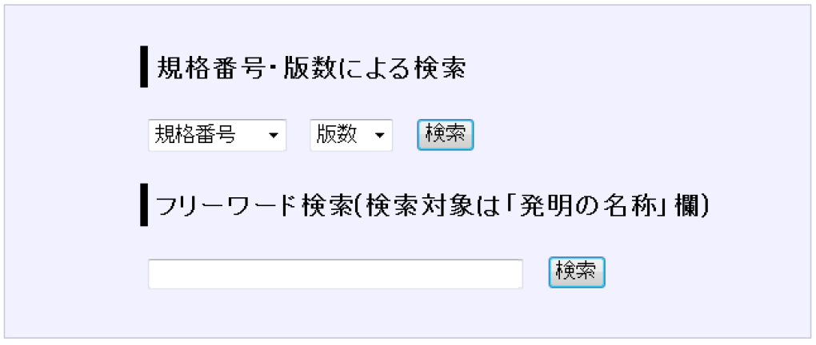
IPR Database Service
Search
Search by standard number and its version
Search by free words
Currently available in Japanese only
http://www.arib.or.jp/tyosakenkyu/sakutei/IPR/index.php
Number of Access Total: 1,748 (1 April 2014 - 28 February 2015)
A)
version number pull-down
standard number pull-down
Search
B)
free words
Search
Sophia Antipolis, 20 April 2015

Slide 17
Further Actions
Providing information to ARIB members
Gathering and analyzing information on IPR policy
Common Patent Policy for ITU-T/ITU-R/ISO/IEC
Patent Policies for SDOs
Discussions at ITU IPR Ad-Hoc/ ETSI IPR-SC
Cooperation with TTC
Studying IPR Policy to respond to new trends and member needs
Sophia Antipolis, 20 April 2015

Slide 18
Thank you for your attention.
Sophia Antipolis, 20 April 2015

Slide 19
Supplementary Slides
Sophia Antipolis, 20 April 2015

Slide 20
Organization of ARIB
Members
General Assembly
Auditors
Board of Directors
Chairman
Secretariat
[STD]
Secretary General
Standard Assembly
[R&D]
Standard Council
Technical Committee
[MGT]
Management Strategy Committee
Advanced Wireless Communications Study Committee
Management Committee
Electromagnetic Environment Committee
[PMT]
Promotion Strategy Committee
Sophia Antipolis, 20 April 2015

Slide 21
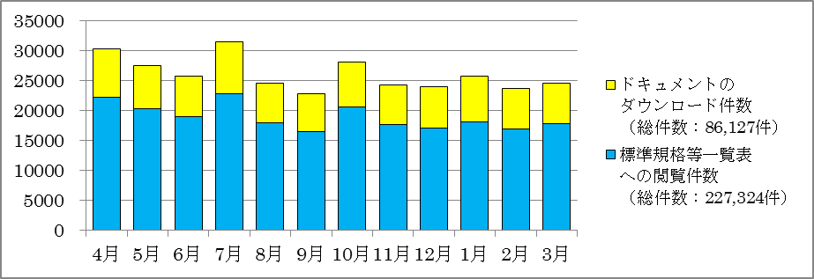
ARIB STD / TR Download
Free Download
http://www.arib.or.jp/english/html/overview/index.html
Total Downloads: approx. 227,000 (1 April 2013 - 31 March 2014)
Since 21 April 2008
April 8
Development &
Revise
July 19
Development &
Revise
October 9
Revise
December 26
Development &
Revise
Number of Downloads
Total:86,127
Number of Access
Total:227,324
Apr May Jun Jul Aug Sep Oct Nov Dec Jan Feb Mar
Sophia Antipolis, 20 April 2015

Slide 22
History of Activities on IPR
Month Year | Activity
Sep 1995 | IPR Guidelines established “Guidelines for Treatment of Industrial Property Rights in connection with the ARIB Standard”
 | IPR Working Guidelines established “Working Guidelines for Treatment of Industrial Property Rights in connection with the ARIB Standard”
Mar 2000 | IPR Working Guidelines Revised (“Comprehensive Confirmation Form” added)
Mar 2011 | Copyright Guidelines established “Guidelines for Treatment of Copyrights in connection with the ARIB Standard”
Sep 2011 | Copyright Guidelines revised (Ownership of material copyright clarified)
Apr 2012 | IPR Database launched
Jul 2012 | IPR Guidelines Revised (Confirmation Form simplified)
Sophia Antipolis, 20 April 2015

Slide 23
IPR Documents (1/2)
IPR Guidelines
http://www.arib.or.jp/english/html/overview/implement_order/IPRguideline2012July.pdf
Specify basic principles for handling IPR
IPR is defined as “Industrial Property Rights”.
Treatment
Selection for Essential IPR: Option 1 (Royalty Free), Option 2 (Reasonable And Non-Discriminatory) or Option 3 (Others) should be selected.
Inclusion of IPRs in Standards: No responsibility of ARIB
Dispute regarding IPRs: No liability of ARIB
Procedure
Submission of “Confirmation Form”
Submission date
Sophia Antipolis, 20 April 2015

Slide 24
IPR Documents (2/2)
IPR Working Guidelines
http://www.arib.or.jp/english/html/overview/implement_order/working_guideline.pdf
Essential IPR shall be treated as provided in the IPR Guidelines with no other terms and conditions.
Treatment of “Non-Essential IPR” is excluded in the IPR Guidelines.
A potential holder of Essential IPR who is not able to submit a “Confirmation Form” by the submission date can submit a “Comprehensive Confirmation Form”.
The submitter of the “Comprehensive Confirmation Form” should submit the “Confirmation Form” within six months to declare the Essential IPR.
Sophia Antipolis, 20 April 2015

Slide 25
Copyright Guidelines
http://www.arib.or.jp/english/html/overview/implement_order/working_guideline.pdf
The author of the Standard (STD) and the Technical Report (TR), including translation, is ARIB. ARIB can use STD/TR and sublicense them to any third party.
Members shall acknowledge the above condition in (i) when submitting the material, such as texts and graphics excluding software, to the Standard Assembly. The ownership of copyright shall be retained.
Non-Members should submit the material on the condition that they agree with provision (i).
When a quotation from a third party is made regarding the material, the origin should be notified.
Sophia Antipolis, 20 April 2015

