Slide 1


Document No: | GSC-21_035 (R2)
Source: | TTA
Contact: | Kate HyeJin
Agenda Item: | 2.11
Priorities of TTA
Jaemoon Park
President
TTA
26-27 September 2017
HOSTED BY

Slide 2







Organization
President
Employee : 439
Internal Audit Office (4)
Founded in Dec. 1988
Management
&
Planning
Department
(42)
ICT Testing
&
Certification
Laboratory
(138)
SW Testing
&
Certification
Laboratory
(176)
TTA
Academy
(12)
Standardiz.
Department
(64)
Currently 205 members
Including private companies, R&D institutes, and Broadcasting companies

Slide 3
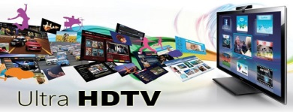
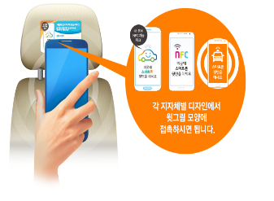

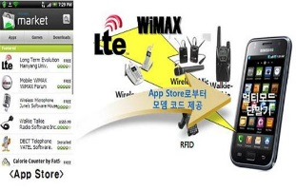
Recent Achievements - Standards Development
TTA Standards
Telecommunication
1,748
11.2%
21.3%
15,531
Radio &
Broadcasting
10,479
ICT Application
3,304
67.5%
TTA developed 395 standards including UHDTV, PS-LTE in 2016
ICT technology·service standards (386)
Standards for customer protection (9)
UHDTV
PS-LTE
NFC Safe Taxi Service
E-Book Accessibility Guideline for People with Visually Disability

Slide 4









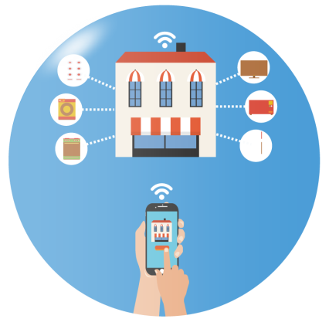

TTA ICT Standardization Issues (2017)
Hyper-connected Society Platform
IoT
5G
Cloud/BigData
A.I.
Security
Smart Convergence Service
Realistic Media
Smart Device
Health ICT
Smart Home
Autonomous vehicle

Slide 5












TTA ICT Standardization Issues (2017)
ICT Standardization Issues
IoT
5G
Cloud
BigData
Smart
Device
Information
Security
Intelligent
Information
Realistic
Media
Health ICT
Smart
Home
Autonomous
Vehicle
Strategic Direction
ITU/ISO/IEC/JTC1
Standardization Support
ICT Standardization
Forum
ICT Standardization Committee
Promotion /
Dissemination
Activity support
Cooperation
Operation of
Leading Standards
Consultation/
Education/Guidebook
International
Domestic
Establishing standards and preemptive strategy on market-demand IoT, health, autonomous vehicle etc in converged ICT area
Presenting consistent strategic direction in operating TTA Project Groups, selecting/operating Forum, supporting Experts and Consultation

Slide 6
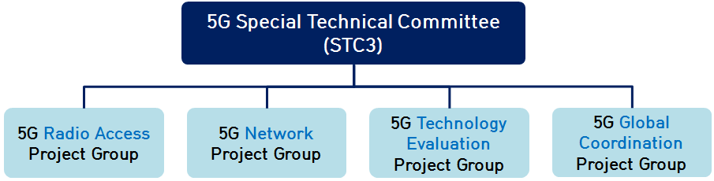
★ Major progress (5G, UHDTV)
Jun. 2017
5G
5G Technology Evaluation PG is registered to ITU-R IMT-2020 Evaluation Group
UHDTV
Terrestrial UHDTV Standard based on ATSC3.0 developed
In June 2016
By 2021 Broadcasting service coverage will expand nationwide!
Terrestrial Broadcasters launched commercial broadcasting service in May 2017

Slide 7
GSC-21 Strategic Topics-related activities
Autonomous Vehicle
Smart City
WAVE System and LTE V2X
Frequency – 5.855~5.925
Pilot Projects based on oneM2M platform
- Busan(Transportation)
- Daegu(Medical), and
- Goyang(Environment)
ITU-T SG20, TTA STC1, Smart city forum
AI
(Autonomous System)
Data Aggregation
Data Analysis
Deep Learning
Planning and Executing complex function
with Safety, Privacy

Slide 8




Verticals(non-ICT) focus on their own standards, not used to cooperating with ICT industries in convergence area
It may cause delays in Innovative convergence solutions and conflicts in Standardization
②
Accelerated spread of
de facto standardization
& Open Source
①
Challenges
Accelerated convergence of ICT technologies and services
(vertical industries)
Short of harmonization policies on standards with de facto and open source fora/consortia
Insufficient networking among vertical experts in ICT convergence

Slide 9
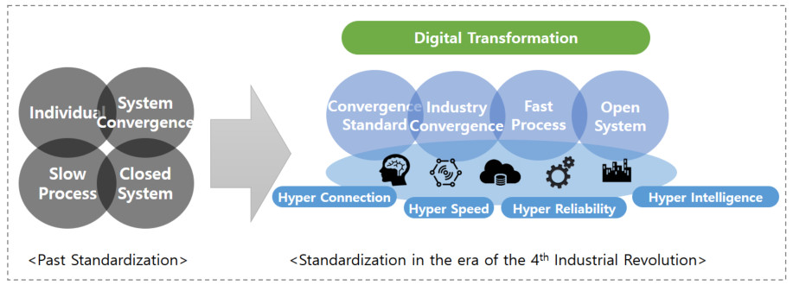
ICT-based CONVERGENCE in all industries
way forward for cooperation…
- To accelerate development of convergence
standards through mutual relationship with
various non-ICT (Energy, Car, Factory, etc.) industries
- To analyze different views and requirements from
non-ICT companies, and cooperate to make
consensus for standards in convergence services
Directions for ICT Industry
Roles of SDOs

Slide 10
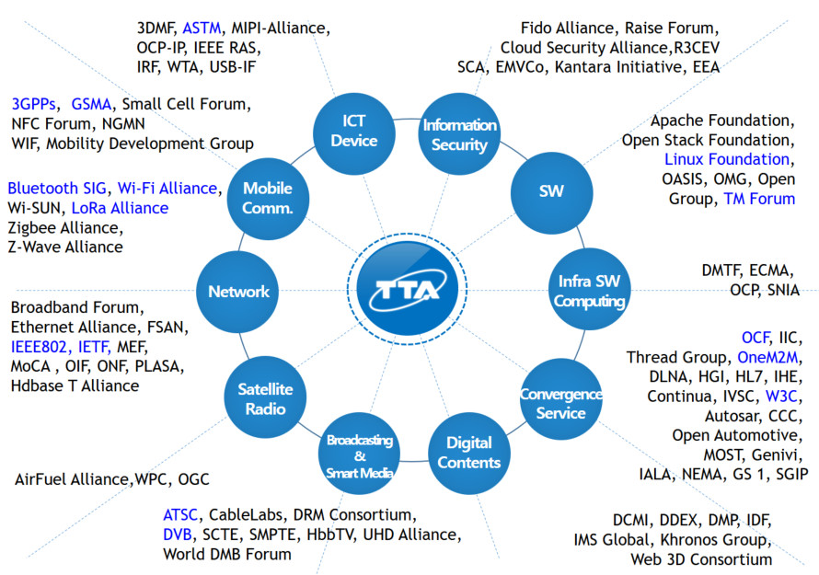
Joint Activities with Global Fora/Consortia
way forward for harmonization…
To minimize conflicts
To maximize harmonization
- SDOs are taking the lead of oneM2M for IoT, and
3GPP for mobile communication with various
industries to prevent standards fragmentation
- To Provide opportunities for harmonization such as
Forum Workshops for specific services and
combine best solutions for standardization

Slide 11
Thank you
For more information,
please contact: Jaemoon Park
kccpark@tta.or.kr
Affiliation Name: TTA
www.tta.or.kr

