Slide 1
ETSI SmartM2M Smart lift Workshop
24 November 2022

Slide 2
Agenda
Meeting opening
  Welcome & participant introduction
Objectives:
  potential timing and content of a second release of TS 103.735, Smart Lifts IoT system?
  And for TS 103 849 Smart Escalators IoT Syste,?
  SAREF4lift evolution?
  SAREF4Escalators?
Warm up: Introduction to the context and content of the Smart Lift System Specification
Discussion, conclusion and recommendations

Slide 3

ETSI and OneM2M standards for lift and escalators sector.
Dr. Enrico Scarrone
TC SmartM2M Chair
oneM2M Steering Committee Chair
ETSI SmartM2M Smart lift Workshop
24 November 2022

Slide 4


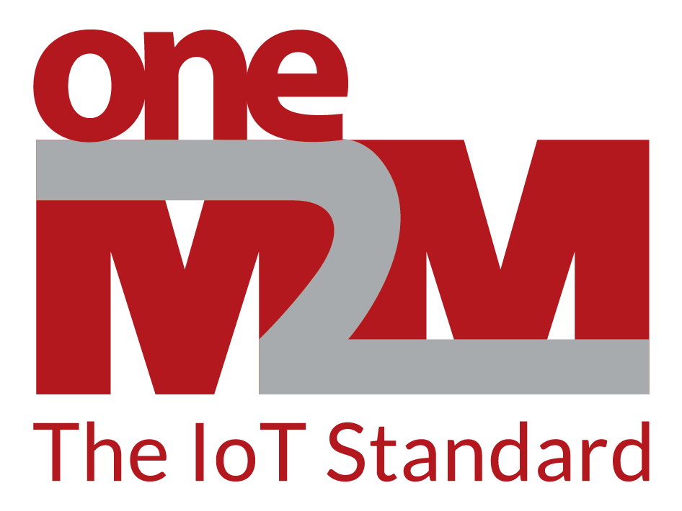

ETSI: The open, global ICT standards organization…
Open, inclusive environment
  To support the development and testing of globally applicable standards
  For ICT systems and services across all sectors of industry and society
Independent, non-profit organization with fair IPR policy
30-years track record of technical excellence in the ICT sector
Available to all, our standards are free of charge (www.etsi.org ->standards)
Officially recognized by the European Union to support EU regulation and policies https://www.etsi.org/standards/types-of-standards
over 50 000 standards published to date
Over 2 600 standards published annually
17.5 million downloads annaully

Slide 5


The power of global and local partnerships…
Over 100 strategic partnership agreements
  With other fora and consortia
  With international and regional Standards Developing Organizations around the world
Driving global standardization on ITC and telecommunication
3GPP
  Over 700 members from worldwide telecommunications SDOs
  Provides system specifications for cellular telecommunications network technologies up to 5G www.3gpp.org
  oneM2M
  Over 220 players from worldwide telecommunications SDOs
  Provides a horizontal layer of functions to support applications and services for the Internet of Things www.oneM2M.org

Slide 6

VALUE: From Connectivity to Information sharing
VALUE
Semantic support
Information
Service Enablement
Service Enablement
Data
Data
Management
Services
Management
Services
Management
Services
Connectivity
Connectivity
Connectivity
Connectivity
Devices
Devices
Devices
Devices
Connectivity
Deployment
Data sharing
Information sharing

Slide 7
IoT: what is about!
IoT
Vertical business
Ecosystems
Humans
Better services
Sharing information
Things
New services
Machines
Edges
Edges
Cloud
Connectivity
protocols
API
platforms
Edges

Slide 8

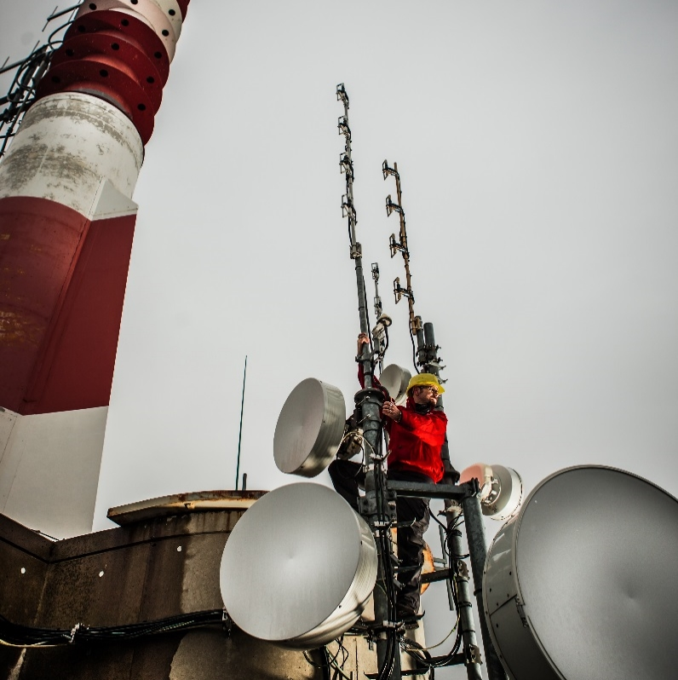
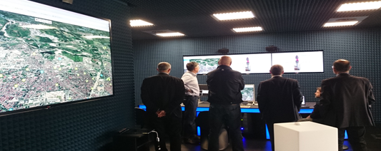



Smart Lift IoT EcoSystem: The vision of interoperability
#01
Control Rooms (remote tests, predictive maintenance, etc…
Augmented reality for technicians and for users
Communication networks
Smart Building
Intelligent services for users
Building Managers
Smart City

Slide 9
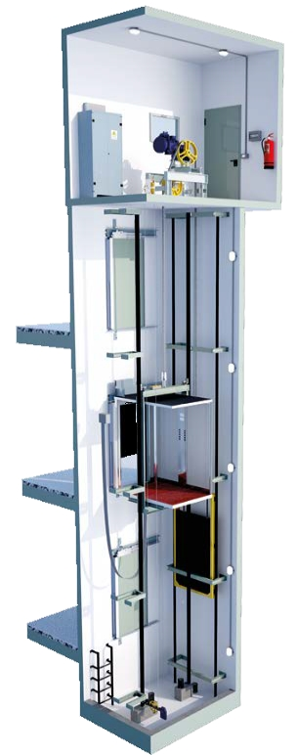
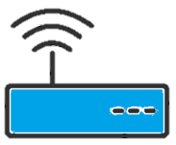


TC SmartM2M:
ETSI Smart Lifts Standardization
  TS 103 735 SmartM2M; Smart Lifts IoT System
  Aiming to evolve the Lifts to IoT and integrate it in the big picture of IoT.
    Developed with the support of major Lift Stakeholders:
    Excellent collaboration with vertical stakeholders (www.efesme.org) and (www.ela-aisbl.eu)
    Parallel PoC (TREE/TIM) developed
    9 months to develop the full system specification (leveraging on oneM2M communication/interworking framework)
  TS 103 410-11 SAREF4LIFTS extension developed on the basis of TS 103.735
  A twin specification on escalators is under development:TS 103 849 Smart Escalators IoT System
Temperature
Sensor
Control Panel
Vibration
Sensor
Car Sensor
+
Temperature
Sensor
Water in pit
Sensor

Slide 10
Smart Lifts IoT System: Standard and Normative Timeline
Fast standardization re-using exising ETSI/oneM2M communication framework standards!
It is possible to focalize the development on the lift system specific components!
Publication of
ETSI TS 103 735
Smart Lifts IoT System (Release 1)
2023 (TBD)
Assessing the opportunity to migrate TS 103 735
from an TS to an EN
April 2020
1Q 2021
PoC for demos and to TS 103 735 feedback
Publication of
ETSI TR 103 546 Requirements & Feasibility study for Smart Lifts in IoT
TREE-TIM
Proof of Concept
ETSI TS 103 735 (Release 2) with Building and Smart city integration
March 2021
1H 2022
2023 (TBD)
Finalization of Twin standard TS 103 849 Smart Escalators IoT System
Revision of ETSI TS 103 410-11: Extension to SAREF; Part 10: Smart Lifts
Integration with SAREF ontology standard
ETSI TS 103 410-11: Extension to SAREF; Part 10: Smart Lifts
TR: Technical Report
TS: Technical Specification
EN: European Norm
ETSI Standards are freely downloadable at ETSI website: www.etsi.org
SAREF: Smart Application REFerence ontology is an ETSI Standard developed to support the EU DG Connect initiative for semantic interoperability in IoT
website: saref.etsi.org

Slide 11






P.o.C. «Smart Lifts»
+

Slide 12

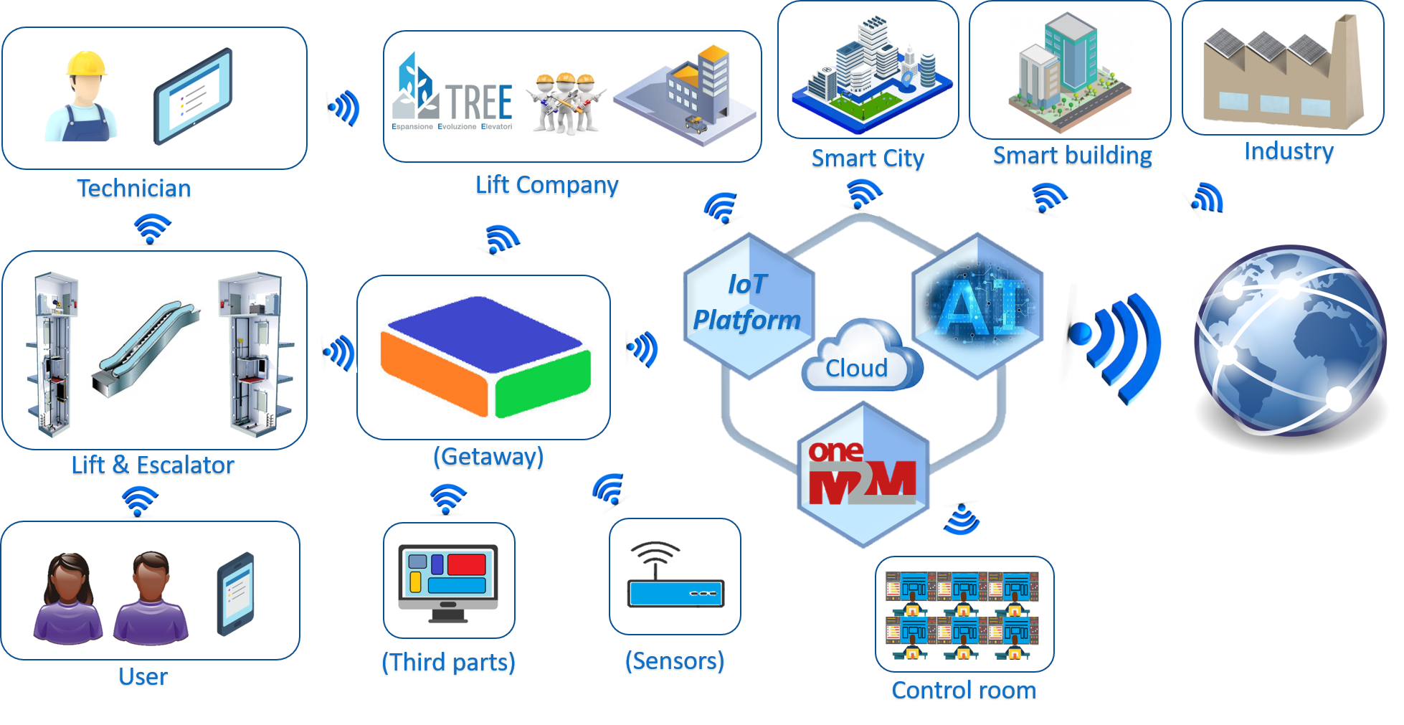


“Smart Lift – TRE-E - IoT System”

Slide 13
Smart Lift IoT System: ETSI TS 103 735
#01
Smart Lift installations at the EDGE of the communication framework
Integration of administrative data management and alarm management systems
#02
Smart Lift IoT System - ETSI TS 103 735 : Architecture
Scalable cloud service: from local company cloud, to consortiums and association clouds, to cloud services providers
#03
Integration non standard solutions and platforms via gateway interworking
#04
Integration legacy systems by augmentation of Lift features (e.g. addition of earthquake detectors, additional alarm sensors, vibration sensors, etc. )
#05

Slide 14
Smart Lift IoT System - ETSI TS 103 735 : Architecture
APs
Administrative
platform
Non standard administrative
information platform
APs
Non standard
APs
APs
Service
L
Edge
Control UNIT
platform
I
Interworking
gateway
Cloud
F
Non standard lifts
T
Additional
sensors
Non standard lift
Components
APs
Smart Lift
Installation
Old lift upgraded
Smart Lift Communication Framework

Slide 15
Smart Lift IoT System - ETSI TS 103 735 : Architecture
APs
#02
#04
Administrative platform
Non standard administrative
information platform
#01
APs
Non standard
#04
APs
SLAPP
Service
L
Edge Control
UNIT
platform
I
Cloud
Interworking
gateway
#04
F
Non standard lifts
T
Additional
sensors
#03
#04
#05
Non standard lift
Components
#05
APs
Smart Lift
Installation
Old lift upgraded
Smart Lift Communication Framework
#05
SLAPP= SLUAS or SLSAS

Slide 16
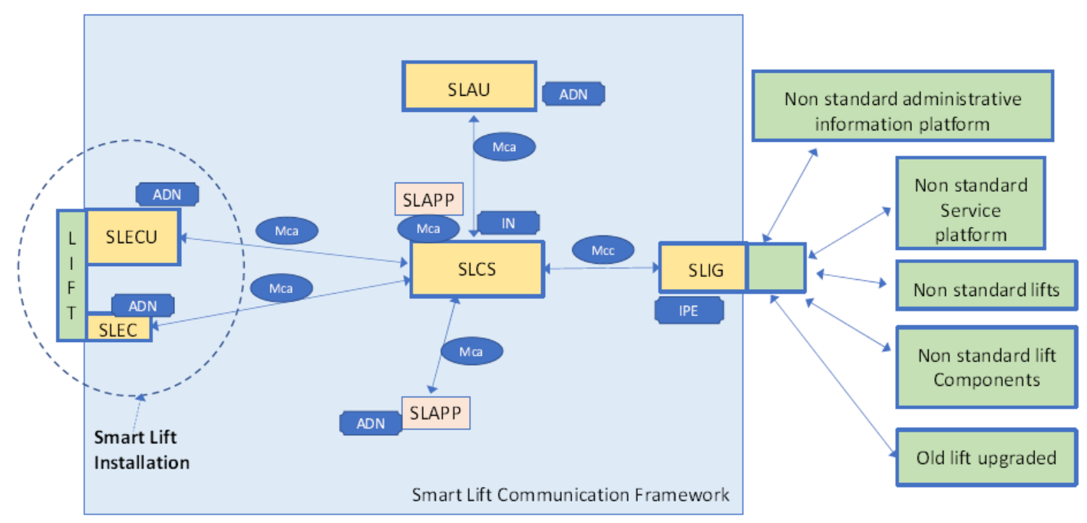
OneM2M mapping

Slide 17
Smart Lift IoT System - ETSI TS 103 735: information
#01
Smart Lift installations Identification and information
#06
Fault information
#02
administrative Information
#07
Commands
#03
Configuration information
#08
Power Energy Information
#04
Status information
#09
Communication system
#05
Statistic information

Slide 18
TC SmartM2M Smart Lifts Standardization:
The ingredients
  Sector stakeholders interest and support
  Tools: OneM2M, SAREF and 3GPP for voice calls
  Know how
  Experience
  Organization
  Processes

Slide 19
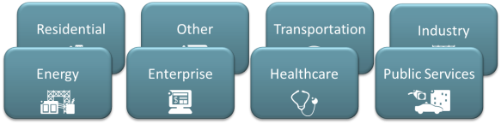





OneM2M
oneM2M specifies a distributed software/middleware layer, sitting between applications and underlying communication networking HW/SW,Integrated into devices gateways & servers
Bridges communication technologies, e.g.: fixed, NB-IoT, 3GPP 4G, 5G, LoRa..
Interworks existing solutions
Manages data (communicate, store, share)
Manages devices and nodes
Allows to annotate data with semantic descriptions
It is IP based and URL/URI based
Identifiers are IP domain based (URI-like format)
Separation of communication (data management) from specific semantic aspects (the information)
Application Layer
Service Layer
Network Layer
…and most importantly: is a Global Standard – not controlled by a single private company!

Slide 20
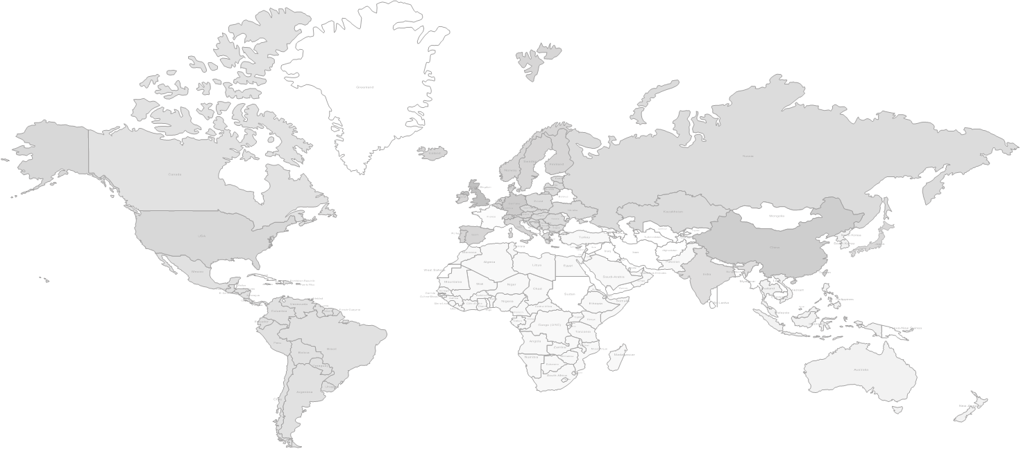









WHY to use oneM2M For Smart Lifts?
Full Ecosystem:
open “de jure” specs –opensource-interoperability –certification-products and services
oneM2M is a global Standard
- It is open and not controlled by a single private company!
oneM2M is hugely stable and complete
It shares the innovation effort of hundreds of companies with more than 500 man years of work
  http://onem2m.org/membership/list-of-deployments
over 220 member organizations
oneM2M Open Source Project
oneM2M Product Offerings
oneM2M Trial Deployment
www.oneM2M.org
All documents and specifications are publically available
oneM2M Commercial Deployment

Slide 21
WHY to use oneM2M for Smart Lifts?
THE ONLY IOT STANDARD “DE JURE” dedicated to Ecosystems integration
SECURE: MULTIPLE SECURITY LEVELS
DYNAMIC PRIVACY AND ACCESS CONTROL
EASY DB AND CLOUD INTEGRATION
DATA MANAGEMENT - DATA HISTORIZATION - INFORMATION SHARING
STORAGE AND EXPOSURE FOR
  Historical data
  Data search and aggregation
  Context information
  Dynamic data
  Real time control and actuation
  Field device management
  Network technologies independence
NATIVE DEVICE MANAGEMENT
FLEXIBLE DEPLOYMENT adapting to the requirements of the different domains
SCALABLE
INTER-PROVIDER NATIVE SUPPORT
AN INTERWORKING FRAMEWORK FOR
  Legacy field and core server technologies
  Other technologies
  Proprietary solution
  -> Not an additional solution, but a standard to integrate the different solutions
SEMANTIC ENABLED TO SHARE INFORMATION, NOT ONLY DATA!!!
INTERNET FRIENDLY FOR HUMAN INTERACTION
SIMPLE

Slide 22

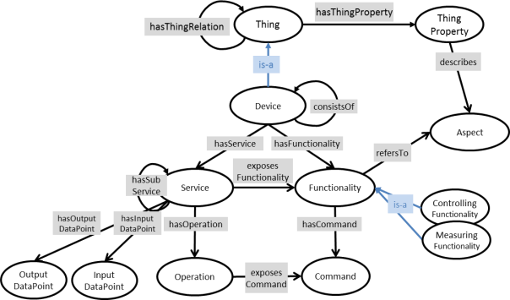

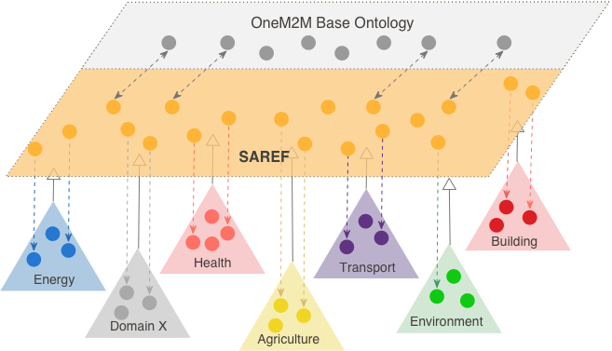

Universal semantic interoperability using SAREF/oneM2M
Specific Abstraction
Models, grouped around a core common ontology
General base
Ontology
OneM2M resources
Semantic annotation of data
1) Vertical ontologies
support
SAREF and its extensions
IoT base ontology +
Data annnotation
2) Semantic Support
3) Communication
Framework
IoT Data sharing

Slide 23







SAREF and its extensions
saref.etesi.org
Semantic interoperability
SAREF Core
Energy
Environment
Building
Smart Cities
Industry & Manufacturing
Automotive
Smart Agriculture
E-Health/
Aging Well
Smart Lifts
Smart Water
Smart escalatorsi
Wearables
01/2017
Q3/2019
Q2/2020
H12021
H12022

Slide 24


Dr. Enrico Scarrone
M2M/IoT Standardization Manager
TIM | Communication and Standards
OneM2M Steering Committee Chairman
ETSI TC SmartM2M Chairman
enrico.scarrone@telecomitalia.it
Grazie!
Thank you!

Slide 25
Discussion and conclusions
Discussion
Reccomandations to SmartM2M
g

