Slide 1
QSC - Migration (AGENDA items 2 and 3)
Scott Cadzow C3L UK

Slide 2
Migration and its importance to ESI
Electronic Signatures and Infrastructures are at existential risk from quantum computers applied to the algorithms used in digital/electronic signature
The algorithms are at risk but we build trust on the maths at the root of those algorithms
To quote (somewhat abstractly) from ESI’s Terms of Reference: “[responsible for]… registered electronic delivery, electronic seals as well as trust service infrastructures supporting such services to protect electronic transactions and ensure trust and confidence with business partners … at supporting regulatory requirements such as the eIDAS Regulation as well as general commercial requirements.”
If trust is lost (the existential risk) then regulation and other commercial agreements cannot be relied upon → they are at existential risk too.
Means exist to counter the risk → Quantum Safe Cryptography (algorithms that are largely immune to the risk of attack from a quantum computer)

Slide 3
What do we mean by migration?
Pre-migration state
Traditional crypto across the enterprise
Vulnerable to attack by quantum computing
From near 100% trust in asymmetric crypto to 0% trust overnight (transition period is zero)
Key length versus security strength cut in 2
Post migration state
No traditional asymmetric crypto anywhere in the enterprise
Extended key lengths in symmetric crypto

Slide 4
Why we need to consider (QSC) migration
It’s a foundation of crypto-agility
Update of algorithms
Update of keys
Update of devices
The Quantum Computing threat removes all trust in asymmetric crypto
The Armageddon scenario
Commerce, banking, social media no longer works with any security

Slide 5
Known QC threats to crypto – why we need to migrate #1
Shor's algorithm
Shor's algorithm solves the following problem: Given an integer N, find its prime factors.
The security of RSA is based on the assumption that factoring large numbers is computationally infeasible. So far as is known no classical algorithm can factor in polynomial time, whereas a quantum computer claims to solve this problem in polynomial time (in practice a bit more complex than that but essentially factoring is not feasible with conventional computers but is viable with a QC).

Slide 6
Known QC threats to crypto – why we need to migrate #2
Grover's algorithm
Grover's algorithm addresses problems with the following properties:
the only way to solve it is to guess answers repeatedly and check them,
the number of possible answers to check is the same as the number of inputs,
every possible answer takes the same amount of time to check, and
there are no clues about which answers might be better: generating possibilities randomly is just as good as checking them in some special order.
For problems with all four properties, the time for a quantum computer to solve this will be proportional to the square root of the number of inputs, thus for a symmetric key algorithm with key length n (i.e. 2^{n} inputs) the search time (brute force attack) is proportional to n/2. The result is that a 128-bit keyed algorithm with 128-bit classical strength is reduced with the existence of QC (and Grover's algorithm) to 64-bit classical strength.

Slide 7
The migration risks are subtle
Need to know a-priori where crypto is used in the corporation
Tools for auditing the presence of every crypto-enabled device don’t (visibly) exist
The risk timetable is most important. A very simple equation outlines the extent of the problem of evolution to a QC safe deployment of cryptography:
X = the number of years the public-key cryptography needs to remain unbroken.
Y = the number of years it will take to replace the current system with one that is quantum-safe.
Z = the number of years it will take to break the current tools, using quantum computers or other means.
T = the number of years it will take to develop trust in quantum safe algorithms
If "X + Y + T > Z" any data protected by that public key cryptographic system is at risk and immediate action needs to be taken. (Y is a function of, or dependent on, T)

Slide 8
Reviewing that timetable a bit
The risk timetable is most important.
If "X + Y + T > Z" any data protected by that public key cryptographic system is at risk and immediate action needs to be taken
X = the number of years the public-key cryptography needs to remain unbroken. ➔ Known for any asset that is protected by cryptography
Y = the number of years it will take to replace the current system with one that is quantum-safe. ➔ Migration analysis will allow calculation of Y
Z = the number of years it will take to break the current tools, using quantum computers or other means. ➔ Outside of direct control but “an engineering problem, not an existence problem”
T = the number of years it will take to develop trust in quantum safe algorithms ➔ Not controllable by the end users

Slide 9
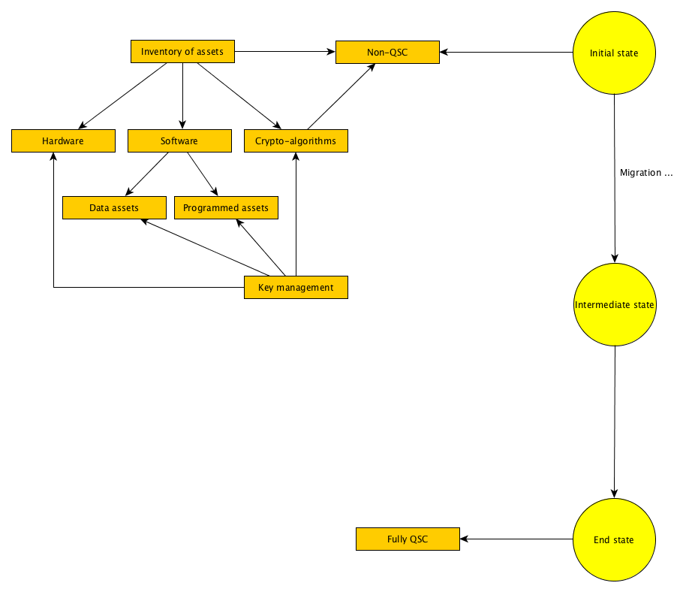
Taking the inventory
As the diagram hints crypto is an invasive entity:
Hardware – for acceleration, for storage, as root of trust
Software – for services and to access data assets and programmed assets
Algorithms – the core issue of cryptography but in many views the least important
Key management – the key to security in any system

Slide 10
Taking the inventory
REGULATORY ASSETS → A major element of ESI is the migration of regulation

Slide 11
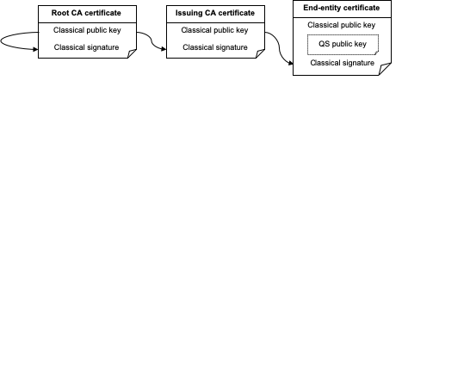
Hybridisation and isolation in migration
Hybridisation
A bit of QSC and a bit of non-QSC to give more time to migrate
X.509 extensions for dual-mode certificates
Isolation
Extends the concept of air-gapping with QSC-VPNs as interconnect of non-QSC islands

Slide 12
Hybrid certificate chains
The use of hybrid certificate chains for backwards compatibility depends on the relying party trusting the hybrid root certificate.
If the relying party only has classical trust anchors, or the relying party does not share a common hybrid trust anchor with the end-entity, then the hybrid root certificate will need to be cross-signed using an existing classical trust anchor.
A certificate chain that relies on a classical trust anchor cannot be considered quantum-safe.

Slide 13
Is there a plug’n’play replacement?
NO !!!!
There are no readily available algorithms for quantum safe asymmetric cryptography that can be used as drop in replacements to RSA or ECDSA without substantial (multiple orders of magnitude) degradation of performance

Slide 14
FAQ from CYBER-QSC #1
What is impacted by a Quantum Computer?
Known attacks on the mathematical properties of some cryptographic algorithms make vulnerable algorithms null and void in terms of the security they offer. This particularly impacts popular asymmetric (public key) systems such as RSA and ECC in which all material protected by vulnerable algorithms has their protection voided. For symmetric algorithms the impact is less severe but the effective key length is halved (e.g. a 128-bit key will only offer the security offered by 64-bit key).

Slide 15
FAQ from CYBER-QSC #2
Can existing hardware cope with hybrid systems, in terms of memory, processing power, crypto agility?
Not always. For symmetric key systems to cope with increased key size, in the same time, the required combination of memory, i/o and processor, bandwidth may not be available. Hardcoded systems with no crypto-agility may not be able to cope at all. For many systems whilst the QSC and hybrid algorithms may be substantially different the building blocks may be the same (e.g. hash processing), however unless the base pre-QSC system has some crypto agility it may be very difficult to re-use these capabilities.

Slide 16
FAQ from CYBER-QSC #3
Is migration a QSC only issue?
No. All of the steps and mechanisms given in the ETSI TR 103 619 apply to any migration of any technology to a new technology. The peculiarities of QSC migration are only that assets which make a claim of security that is challenged by the existence of a quantum computer (i.e. asymmetric cryptography based on discrete logarithms or on factorisation) are made immediately null and void (as the trust in the mathematics that surrounds their security claim no longer holds true).

Slide 17
FAQ from CYBER-QSC #4
Are Distributed Ledger Technologies (DLTs) impacted by QSC developments?
A complete answer depends on the nature of the ledger and the transactions it contains. However the nature of DLTs is that the integrity of each entry (the entry may be simply the hash of an externally held transaction) and each page is verified by a hash and each page is verified by finding a hash of the set of transactions and a random sealing value that results in a hash of a particular pattern, with the hash of the “sealed” page being the first entry in the next page of the ledger (hence linking all pages in the ledger together). If hashing is the only cryptographic function taking place the impact of a quantum computing attack is low. However in practice transactions may also be signed and in some instances encrypted which significantly alters the risk assessment.

Slide 18
FAQ from CYBER-QSC #5
Are all cryptographic operations impacted by a quantum computer?
Yes, but to a different degree in each case. The default position prior to migration should be that asymmetric cryptographic operations are nullified, and that the cryptographic strength of all other operations are severely cut.

Slide 19
FAQ from CYBER-QSC #6
Are hybrid solutions quantum safe?
No. Hybrid solutions are a way-point on the path to QSC and do not represent the end state. Hybrid solutions have themselves to be migrated to the end state.

Slide 20
How to consider QSC migration in ESI

Slide 21
The infrastructures come first
Business process management is core (the 3 stages in TR 103 619 stress this)
Appointment of a migration manager - the entire process
Inventory manager - responsible for identifying what assets exist, where they are, how they’re managed
Allocation of budget
This will not be trivial and includes …
Management of “down time”
It is unlikely this will be able to be done without interruption (more than once)

Slide 22
Test, test and test again
QSC Migration is not trivial
War gaming, playbooks and isolation
Regulatory engagement - can nation stage A migrate before nation state B? What impact has global regulatory divergence have on global supply chains?

Slide 23
Summary
Migration from non-QSC to QSC should be considered as a conventional business practice
QSC migration is a specific form of crypto-agility applied to the entire business process.
Migration can be addressed in stages by use of hybrid schemes, and air-gapping systems

Slide 24
That’s it …
Q & A if time allows

