Slide 1
Information and Data Modeling Way Forward
ETSI Multi-SDO WS
01/07/2016
Notes:
WL: copied from other deck; does no harm?

Slide 2
Big Picture
Situation (main issue leading to this initiative?)
Difficulty coordinating between SDOs and Open Source Communities
Problem statement
We heard: “We need to define a Common Information Model (CIM)”
Sounds like it could be a solution in search of a problem; because of too many unstated assumptions (could there be more stated?)
Complications (in the context of an agile world)
Open Source Communities and Developers will proceed anyway
Need link to market success in the context of an agile world
Clarified question
How to coordinate efforts and make SDO domain expertise available to Open Source Communities in a format they can use?
Recommended approach
Define domains of interest
Look for a niche success
Example that demonstrates SDO and Open Source Community collaboration
Succeeds because it’s a good idea and creates the conditions for success

Slide 3
Primary and Secondary Objectives
Primary
Light touch coordination among the SDOs and Open Source Communities
Understand the NFV related information model landscape (including gaps and issues)
Understand the work relationships among SDOs and Open Source Communities
Secondary
Common approaches or aspects to info modeling
Development of a NFV “Common Information Model”

Slide 4
Light Touch Coordination
Minimize impact on Organizations’ existing and current work
Identify and define interaction points
Define domains of interest
Avoid duplication
Encourage re-use
Coordination mainly impacts the Core
Other Org X and Org Y work is largely unaffected
Org X
Org Y
Exception: when Core functions are re-factored
Core
Domain X1
Domain Y1
Interaction points

Slide 5
Information Model Landscape
Conceptually a spreadsheet listing NFV-related aspects of each Organization’s relevant projects; for example
Aspect | Description
Project | Name, Description, Dependencies, Links, …
Methodology | Languages, Tools, Licensing, …
NFV technologies | Interfaces, Entities, …
Application Areas | Network-specific applications, …
Org relationships | Coordination / collaboration relationships, …
Roadmap | Current work plans, likely future work, …
Known issues | Potential overlaps, gaps, sub-optimal relationships, …

Slide 6
Work Relationships
Each Organization has its own rules and IPR policy
Some work in private (members only) and others in public
Some have RAND licensing and others have RAND0
How will Organizations collaborate?
Sharing contributions with other Organizations
Receiving contributions from other Organizations
Special considerations for Open Source Organizations
Management and review processes
Tools: Mailing lists, Wikis, Issues

Slide 7
Suggested Next Steps
Collaborate to create Information Model Landscape spreadsheet
Use this for analysis of gaps, overlaps, issues, relationships etc.
…

Slide 8
Thank You!

Slide 9
Acronyms
AAA – Authentication, Authorization and Accounting
ACS – Auto-Configuration Server (TR-069)
AN – Access Node
API – Application Programming Interface
BB - BroadBand
BBF – Broadband Forum
BCP – Best Current Practice
BPCF – Broadband Policy Control Function
BNG – Broadband Network Gateway
BRG – Bridged RG
BSG – Broadband Service Gateway
BSS – Business Support Systems
CPE – Customer Premises Equipment
DC – Data Center
DHCP – Dynamic Host Configuration Protocol
DM – Data Model
DT – Device Type
EM – Enterprise Management
FAP – Femtocell Access Point
FTTdp – Fiber To The Distribution Point
FW – Firewall
GW – Gateway
HTML – HyperText Markup Language
IP – Internet Protocol
IPR – Intellectual Property Rights
LSL – Logical Subscriber Link
MSBN – Multi-Service Broadband Network
MS-BNG – Multi-Service BNG
NAS – Network-Attached Storage
NAT – Network Address Translation
NERG – Network Enhanced Residential Gateway
NFV – Network Function Virtualization
NFVI – NFV Infrastructure
OAM – Operations, Administration and Management
OSS – Operations Support Systems
PCRF – Policy and Charging Rules Function
PDF – Portable Document Format
PON – Passive Optical Networking
RG – Residential Gateway
SAG – Software Advisory Group
SDN – Software-Defined Networking
SMB – Small/Medium Business
STB – Set Top Box
UML – Unified Modeling Language
VBG – Virtual Business Gateway
VoIP – Voice over IP
vCGNAT – Virtual Carrier Grade NAT
vBNG – Virtual BNG
vG – Virtual Gateway
XML – eXtensible Markup Language

Slide 10
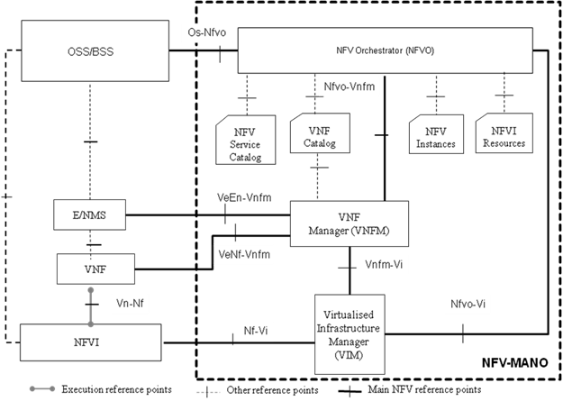
Standardization Landscape
TMForum
ETSI NFV
BBF/3GPP/ IETF…
ONF, ETSI, IETF
ONF, ETSI, IETF
Derived from bbf2015.411 “Reference Architecture Revisions”
Notes:
This illustrates possible SDO domains of interest in the context of the ETSI NFV architecture

Slide 11
Information Model Landscape
The Core has to be widely applicable
Implies information modeling (rather than data modeling)
Hence Core / Common Information Model (CIM)
Must consider the relevant layer for each interaction point
Also consider the modeling approach at that layer
Interaction should impact only this layer
Coordination impacts only the Common region
Core
Domain Y1
SDO X
Org Y
Other SDO X and Org Y work is not affected
Domain X1
Domain X.A
Common
Domain Y.B
Interaction points
Notes:
This illustrates how each interaction point is tied not just to a domain of interest but to a layer

Slide 12
Information Model Landscape: Example
G.fast YANG module based on IETF RFC 7223 “A YANG Data Model for Interface Management”
Need to map RFC 7223 interfaces to/from CIM interfaces
CIM needs to support NETCONF/YANG config/state separation?
Firewall NF defines rules referencing layer 1, 2 or 3 interfaces
Need to map these interfaces to/from CIM interfaces
Coordination impacts only the Common region
CIM
Firewall
NF
SDO X
Org Y
Other SDO X and Org Y work is not affected
G.fast
YANG
Domain X.A
Common
Domain Y.B
Interaction points
Notes:
This builds on the previous slide to provide an example where “layer” is taken to mean OSI layer (a different SDO might be responsible for each layer); layer could also be taken to refer to {service, element}, {application, service, network} etc.

Slide 13
YANG Best Current Practices
Domain of expertise is independent; like another dimension
RFC 6020 (YANG) and RFC 6087 (Guidelines)
IETF YANG
BBF
YANG BCPs
RFC 7223 (Interfaces) etc.
Common SDO YANG BCPs
Additional BBF-specific rules
Additional SDO X and Y rules
IETF
YANG BCPs
YANG that is directly useful to IETF, BBF, SDO X and SDO Y needs to follow the Common SDO YANG BCPs
SDO X YANG BCPs
SDO Y
YANG BCPs
The same principle applies to information modeling
Notes:
This is similar in some respects to slide 4’s Venn diagram but specifically in the context of YANG, with IETF core modules playing the role of the CIM (many of the same concepts apply both here and in the general information modeling case)

