Slide 1
MEF Common Information Model Overview
Jessie Jewitt

Slide 2
Modeling in the MEF
4 Types of Modeling driven from LSO Engineering Methodology
Business Process Modeling Defines the overall process flows relevant to LSO, i.e. MEF 50
Common Protocol Neutral Modeling Defines the MEF Core static model and extensions in the product / service / resource domains
Interface Specific Modeling Defines “interface profiles” that characterize the dynamic behavior of specific interface functionality based on static model classes
API Specific Modeling Defines functional interface specific “data models” (schema)

Slide 3
LSO Engineering Methodology - Modeling
LSO Reference
Architecture & Framework
API Implementations
Certifications
Common Information Models
MEF Service Definitions
(including virtualization)
Reference
Implementations
Business Process Flows
API Specifications
& Data Models
Interface Profiles

Slide 4
MEF Modeling Process
Based on ONF Modeling Process
Core Modeling Defines an “umbrella” model based on the TMF SID Product / Service / Resource domains
Working Group Specific Projects define MEF specific extensions to the core model, i.e. MEF 7.x
Interface Profiles The protocol neutral information model extensions are “pruned & refactored” to show class realizations and behavior of specific functional interfaces
Data Schema Interface profiles are mapped to API specific data schema used in the delivery of an API specifications

Slide 5
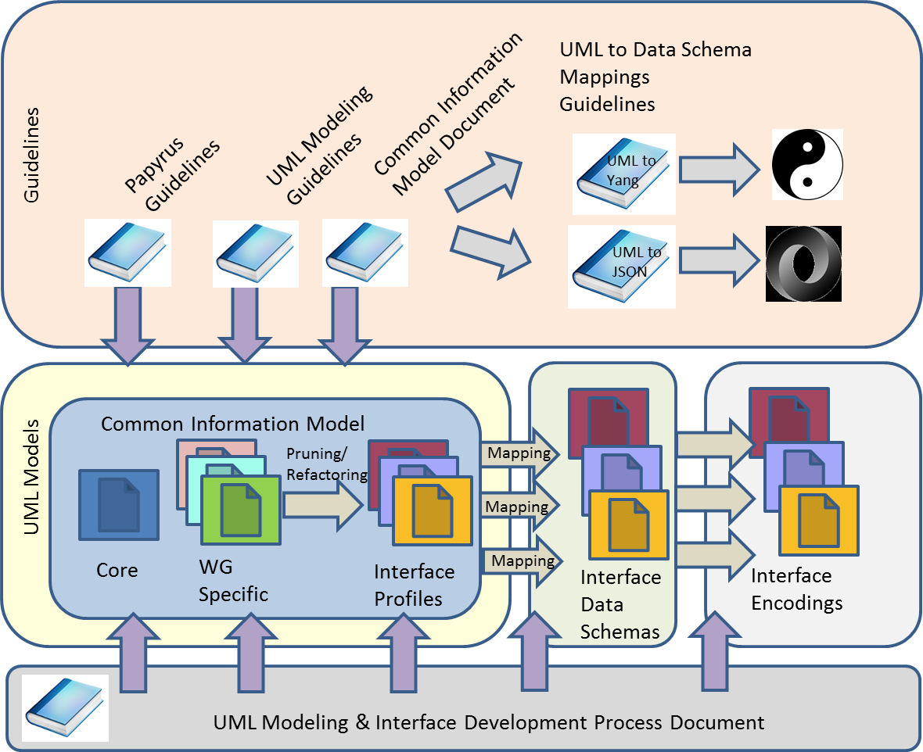
MEF Modeling Process

Slide 6
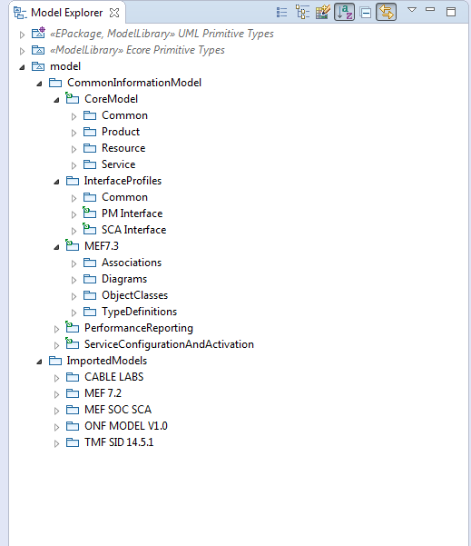
MEF Common Info Model Structure
Core Model
Interface Profiles
Work Group Specific

Slide 7
Mapping of Core Model to LSO RA
E
Customer Domain
SP Domain
Partner Domain
PRODUCT
Cantata
(CUS:BUS)
Business Applications
Sonata
(BUS:BUS)
Business Applications
Customer
Application Coordinator
LEGATO
(BUS:SOF)
LEGATO
(BUS:SOF)
SERVICE
Allegro
(CUS:SOF)
Service Orchestration Functionality
Interlude (SOF:SOF)
Service Orchestration Functionality
Presto
(SOF:ICM)
Presto
(SOF:ICM)
Infrastructure Control and Management
Infrastructure Control and Management
RESOURCE
ADAGIO (ICM:ECM)
ADAGIO (ICM:ECM)
Element Control and Management
Element Control and Management
Network Infrastructure

Slide 8
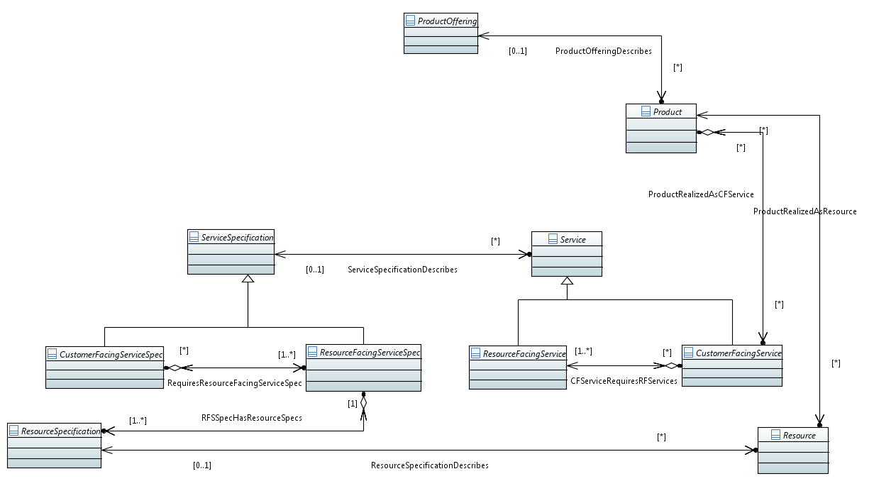
Core Product, Service, Resource Overview

Slide 9
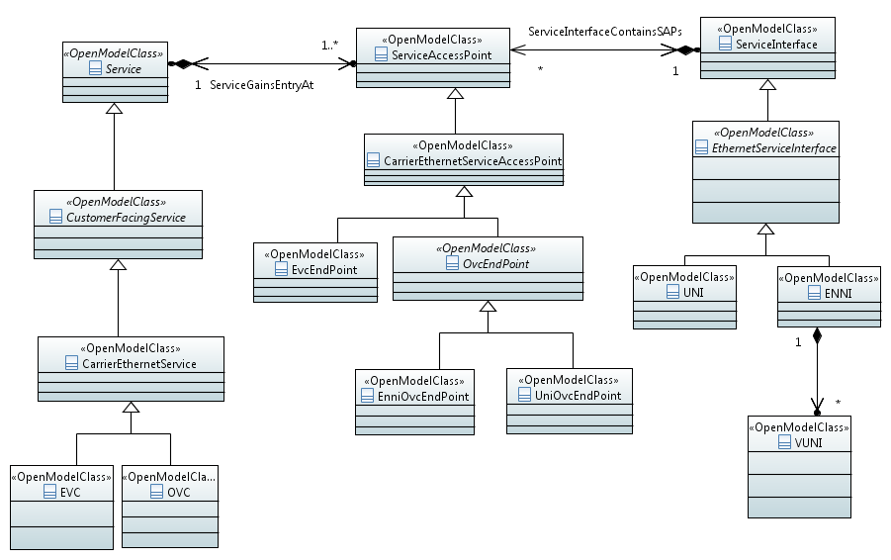
MEF 7.3 Extensions to Service Model

Slide 10
Service to Resource* Mapping
managed object classes at Service level (Legato, Interlude)
EVC (the end-to-end CarrierEthernetService)
ForwardingConstruct
ForwardingConstruct
NE
NE
NE
NE
UNI
UNI
LTP
I-NNI
I-NNI
ForwardingDomain
LTP
managed object classes at Resource level (Presto)
* Based on ONF Model

