Slide 1
The Lifecycle Service Orchestration (LSO) Reference Architecture and Framework

Slide 2
Outline
Third Network Vision
Lifecycle Service Orchestration (LSO)
Models in context
MEF’s Modeling Projects
LSO Hackathon
Challenges and opportunities

Slide 3
MEF’s Third Network Vision
Enable agile networks
Deliver assured connectivity services
Orchestrated across network domains
Between physical or virtual service endpoints
Notes:
To enable agile networks that deliver assured connectivity services orchestrated across network domains between physical or virtual service endpoints.

Slide 4
Lifecycle Service Orchestration
Orchestration capabilities are the backbone of the Lifecycle Services provided by The Third Network
Provides orchestrated management and control of Connectivity Services
Defines product, service, and resource abstractions
Abstracts complexity from applications and users of Connectivity Services
Infrastructure-agnostic (WAN technologies, NFV, SDN)
Notes:
What is MEF LSO?
LSO provides for the orchestrated management and control of Third Network Connectivity Services
LSO Reference Architecture characterizes the management and control domains and entities that enable the cooperative LSO capabilities
LSO overcomes existing complexity by defining product, service, and resource abstractions that hide the complexity of underlying technologies and network layers from the applications and users of the services

Slide 5
LSO Driver: On-Demand and Agile Services
On-Demand
Network
Services
On-Demand
Bandwidth
Self-Service
Portals
Cloud App/ Service
Initiated Network
Changes

Slide 6
LSO Engineering Methodology
Generate re-usable engineering specifications and artifacts
Capture LSO requirements, capabilities, functionality, behavior, processes, information, interfaces and APIs
Support management and control of Connectivity Services
Enable the transformation of LSO capabilities into interoperable, specific, consistent, and verifiable designs and implementations
Notes:
The primary goal is the generation of re-usable engineering specifications and artifacts capturing the LSO requirements, capabilities, functionality, behavior, processes, information, interfaces and APIs supporting management and control of Connectivity Services
These engineering artifacts will prove to be valuable resources in enabling the transformation of LSO capabilities into interoperable, specific, consistent, and verifiable designs and implementations

Slide 7
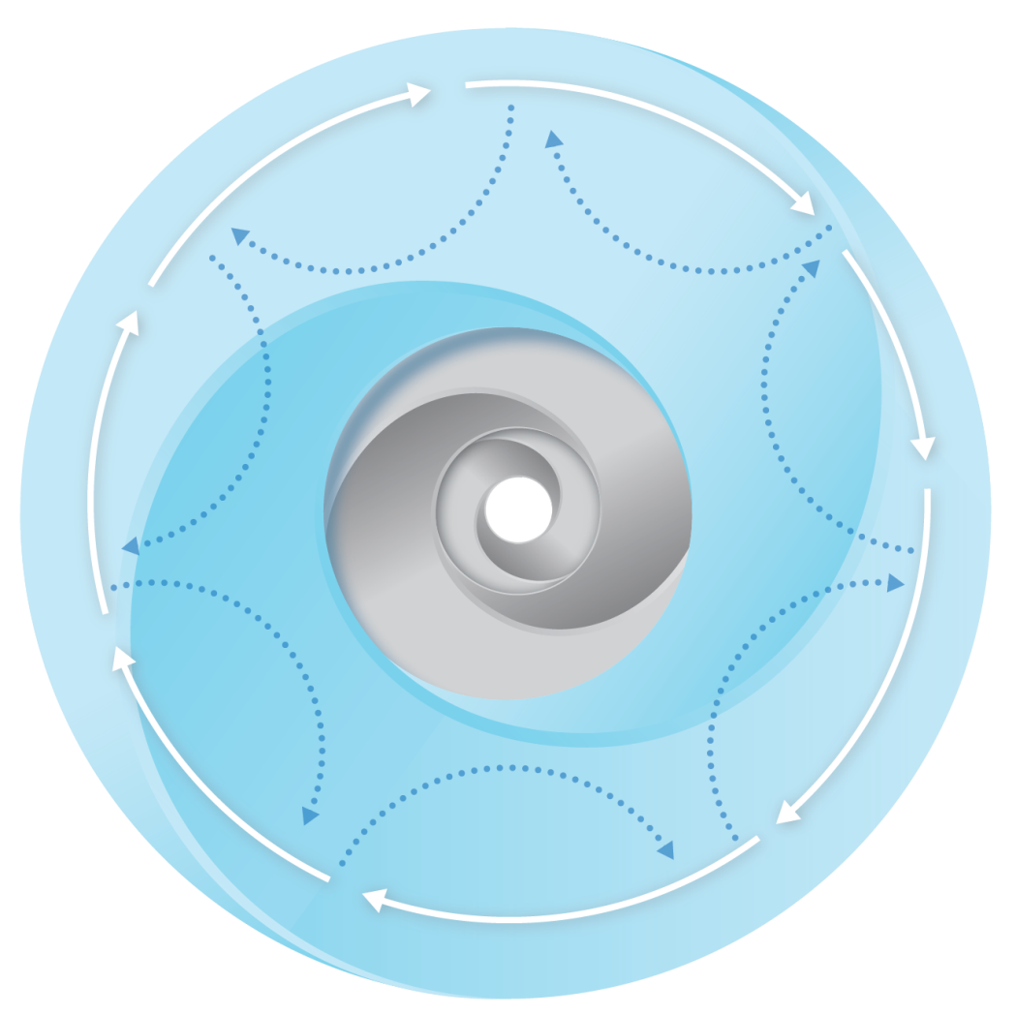
LSO-Related MEF Activities
SOC: Product Catalog, Ordering, Performance Reporting, Serviceability
MEF LSO Reference Architecture
& UNITE
LSO Reference
Architecture & Framework
MEF 7.3, Common Model, Resource Model,
Cloud Services
API Implementations
Certifications
Common Information Models
SCA API Test Suite
MEF Service Definitions
(including virtualization)
MEF 6.2, 33, 51, 10.3, 26.2, etc.
LSO Hackathon, ODL project, OPNFV
Reference
Implementations
Business Process Flows
MEF 50
SCA, YANG, etc.
Profiles for Presto, Lagato, etc.
API Specifications
& Data Models
Interface Profiles

Slide 8
LSO Reference Architecture and Framework
Expresses the vision of the MEF LSO capabilities
Layered architecture
Characterizes management and control domains/entities that enable LSO capabilities
Management Interface Reference Points characterize interactions between LSO ecosystem components
High level operational threads describe orchestrated Connectivity Service behavior and interactions among management entities
Notes:
Provides a layered architecture that characterizes the management and control domains and entities that enable the cooperative LSO capabilities for Connectivity Services.
High level operational threads describing user stories of orchestrated Connectivity Service behavior as well as interactions among management entities, expressing the vision of the MEF LSO capabilities
The management interface reference points that characterize interactions between LSO ecosystem components are identified in the reference architecture

Slide 9
E
REFERENCE ARCHITECTURE
Customer Domain
SP Domain
Partner Domain
Cantata
(CUS:BUS)
Business Applications
Sonata
(BUS:BUS)
Business Applications
Customer
Application Coordinator
LEGATO
(BUS:SOF)
LEGATO
(BUS:SOF)
Allegro
(CUS:SOF)
Service Orchestration Functionality
Interlude (SOF:SOF)
Service Orchestration Functionality
Presto
(SOF:ICM)
Presto
(SOF:ICM)
Infrastructure Control and Management
Infrastructure Control and Management
ADAGIO (ICM:ECM)
ADAGIO (ICM:ECM)
Element Control and Management
Element Control and Management
Network Infrastructure

Slide 10
LSO Management View Abstractions
Management
Abstractions
Information Class Examples per Management Abstraction View
LSO RA
Context
Product View
Product
Catalog
Product
Offering
Product
Instance
Product
Spec
Business Apps
Customer
Service Orchestration
(Provider domains & multi-domain)
Service Access Point
Service View
Service
Service Component
Service Spec
Service
Interface
Service Orchestration & Infrastructure Management
(Subnetwork)
Resource View
Link
Logical Termination Point
Route
Forwarding Domain
Forwarding Construct
Network & Topology
Link End
Endpoint
Element & Equipment
Fabric
Facility
VNE
Element Control & Management
Cross Connect
Network Element
Port
Card
Server
VNF

Slide 11
MEF LSO Related Modeling Projects
E
REFERENCE ARCHITECTURE
MEF 7.3 Information Model
(Allegro, Legato, Interlude)
Customer Domain
SP Domain
Partner Domain
Cantata
(CUS:BUS)
Business Applications
Sonata
(BUS:BUS)
Business Applications
Yang Modules
Customer
Application Coordinator
LEGATO
(BUS:SOF)
LEGATO
(BUS:SOF)
Network Resource Provisioning
Allegro
(CUS:SOF)
Service Orchestration Functionality
Interlude (SOF:SOF)
Service Orchestration Functionality
Network Resource Model
Presto
(SOF:ICM)
Presto
(SOF:ICM)
Infrastructure Control and Management
Infrastructure Control and Management
MEF Services with OpenFlow
ADAGIO (ICM:ECM)
ADAGIO (ICM:ECM)
Element Control and Management
Element Control and Management
Network Infrastructure

