Slide 1
ONF presentations to ETSI NFV m-SDO IM/DM Workshop ONF Common Information Model – Core Information Model
January 2016
Final version for presentation (updated 20160113)

Slide 2
Contents
Model overview
Key insights
Key advantages of ONF model approach
Adoption of the ONF Common Information Model

Slide 3
Rationale and approach
Information modelling is the process of identifying, defining, labelling and recording, from some viewpoint
The key concepts/things in the problem space
The interrelationships between those concepts/things
The information model provides
Terminology definition and terminology normalization
Enabling constraints, drawn from industry insight, to prevent errors and unnecessary excursions
The basis for all interface views of the domain
The process for development is “Agile Architecture” applied to the on-going evolution of the representation of the problem space
Building on existing work of the industry pulling in experts in these areas
Development by contribution and collaborative working refining and improving each aspect of the solution
Developing industry-wide guidelines for modelling
Use of open source tooling (Papyrus, Gendoc, Git etc.) and extending that tooling as required
Incremental publication of a snapshot of all work including experimental material
Gradually increase work in open modelling activities
Driving/guiding interface code development
The interface model views are constructed using the process of pruning/refactoring to transform the core model for external presentation
The interface encoded form is increasingly generated by tooling

Slide 4
Model Evolution History and Proposal
Formal UML model
Concepts
Network Technology Definition
ITU-T
TMF
ONF
MEF
etc
G.805
Insight
M.3100
Insight
MTNM/MTOSI
SID DeviceInterface
etc
2000
G.809
Insight
MEF 7
G.800
Q.840.1
MEF 7.1
Coverage and approach
2010
Inspiration
SID Converged Network ABE
Essence, structure and approach
Network Technology models
Insight
ONF Core
MEF 7.2
TR215
Clone
2015
TR225
Insight
Clone
MEF
Service
History
G.7711
MEF
Network
Resource
2016
Align
Proposal
Joint working
SID Enhanced
Align
ONF Enhanced
Clone
Update
Update
Shared network resource model
2017

Slide 5
Key sources and artefacts of the ONF-CIM
The ONF-CIM is based on
G.800/G.805 network architecture
Subnetwork, Link, Adaptation/termination
Layer networks, partitioning, recursion
Insights from TMF TR215/225+
Hypergraph, component-system, ForwardingConstruct
Key object classes (illustrated on next slide)
ForwardingDomain (FD) – derived from G.800 subnetwork
ForwardingConstruct (FC) – derived from G.800 forwarding relationship
Link – derived from G.800 Link
LogicalTerminationPoint (LTP) – derived from an assembly of G.800 termination and adaptation
Common core class definition
Extensions (via conditional packages) to provide technology specific classes

Slide 6
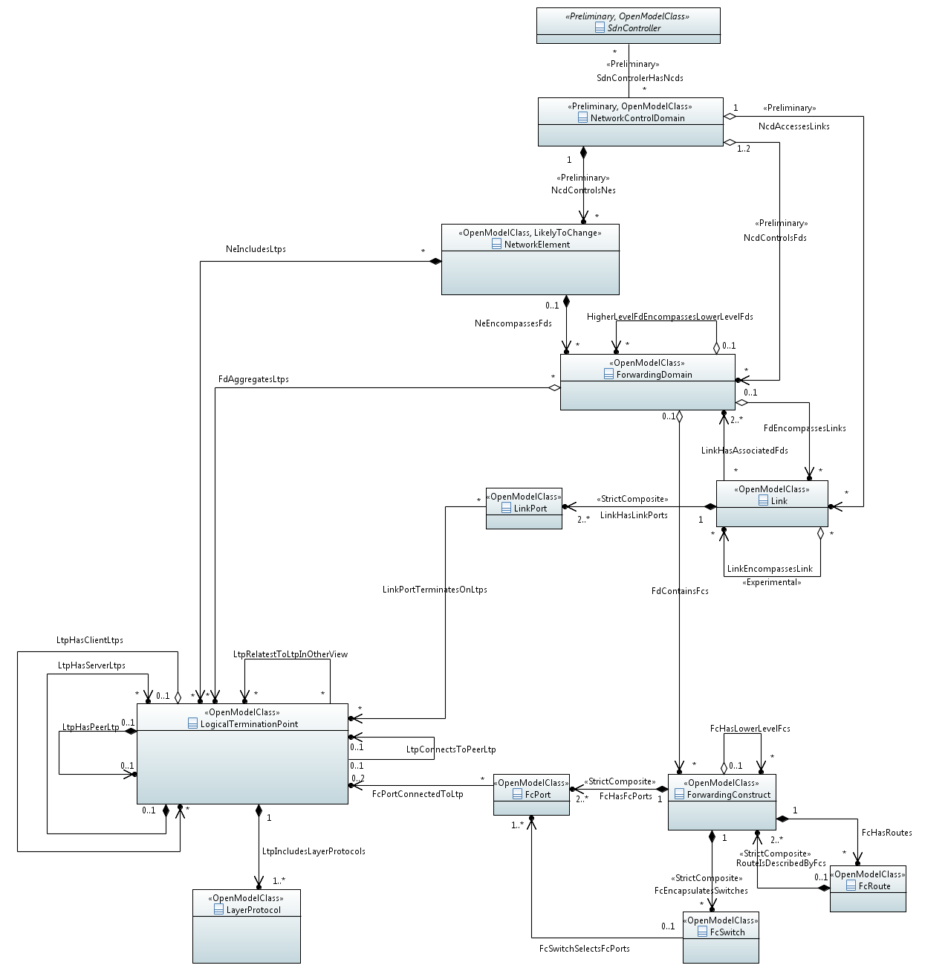
Skeleton Class Diagram of key object classes (Core Information Model Version 1.1 November 30, 2015 ONF TR-512)
Single multiply recursive model for representing networking
Shown in a physical context but equally represents abstract and virtual forms
NetworkElement
ForwardingDomain
Independent of the network technology, applicable to all
Provides Service-like abstraction of the network
LinkPort
Link
Covering all key aspects:
Topology
Forwarding
Termination
Identity and naming
State
Capability specification
LogicalTerminationPoint
FcPort
Forwarding
Construct
Layer
Protocol
FcRoute
FcSwitch

Slide 7
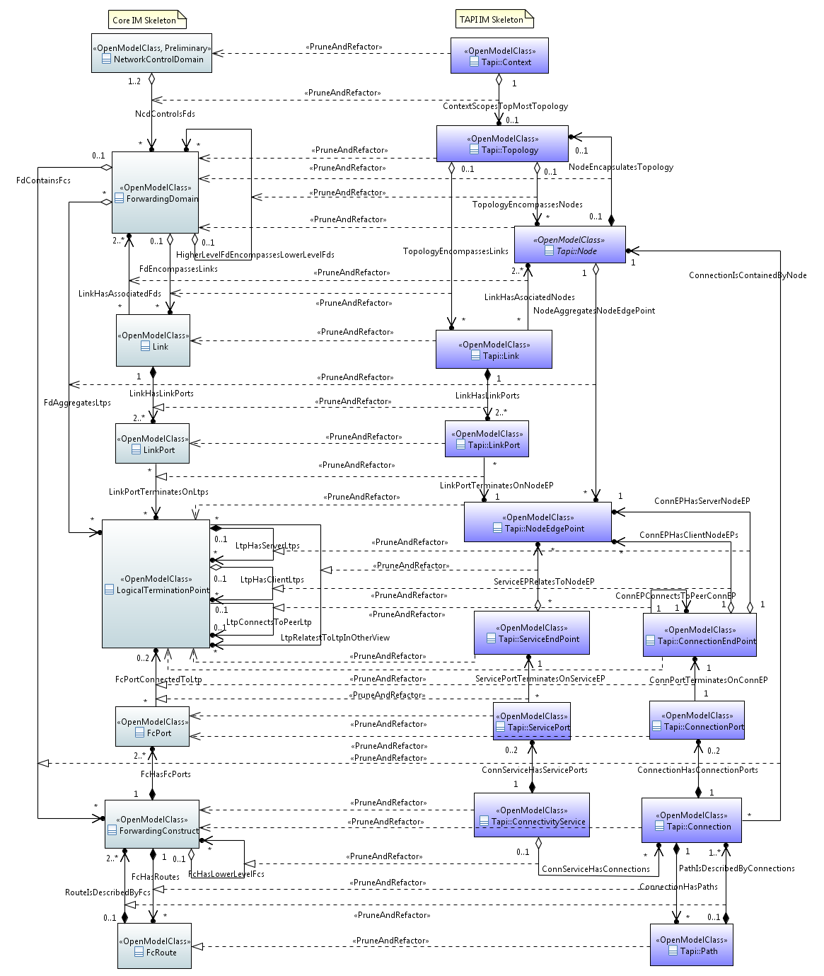
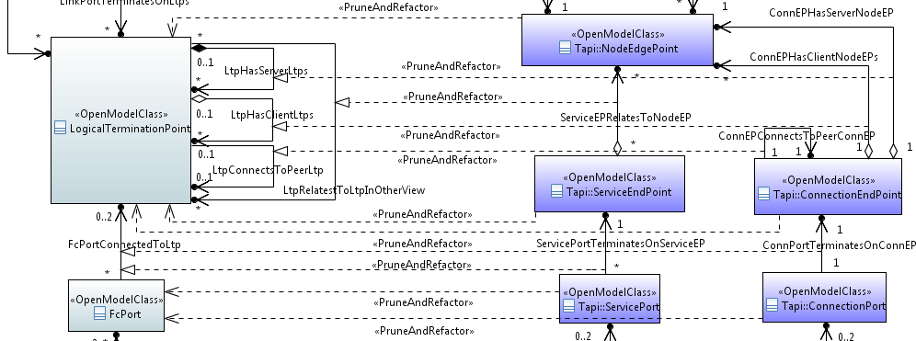
Transforming the Core Model into the Tapi (Transport API) Model
TAPI model is derived from the CIM by Pruning and Refactoring
Rules are being developed as the work progresses
Tapi use the same approach as the core so the LogicalTerminationPoint (LTP) derivatives are generally applicable
Conditional composition is used to extend LTP to cover any case
Specification classes (not shown) are used to explain the capabilities of a particular case
As illustrated by Tapi, for a specific view LTP may need to be specialized to match current terminology
The LTP brings all necessary attributes and the derivation process (Pruning and Refactoring) narrows content and adjust names

Slide 8
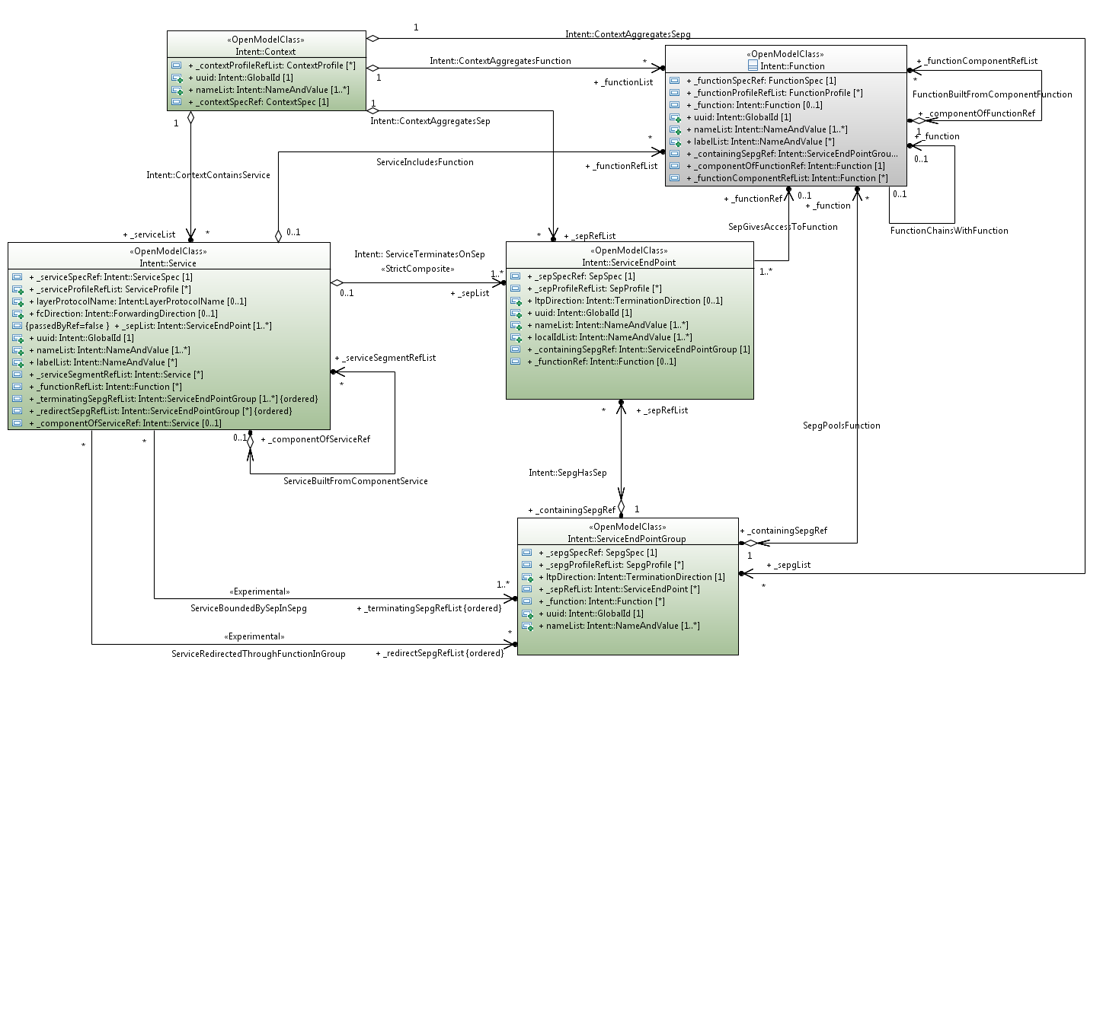
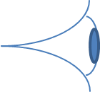
Transforming the Core Model into the “Boulder” Intent Model
Currently playing into OpenStack/ODL via the Boulder OpenSource project
Intent work focuses on constraint based outcome oriented interactions
The intent model is derived from the CIM by pruning and refactoring
Includes mapping object names
Prune And Refactored Core
Service is FC
Context is FD
SepGroup is LTP
Sep is LTP
Context
Function
Service
ServiceEndPoint
SepGroup
UML diagram: NestedServices

Slide 9
Key Insights used to design the ONF-CIM
Results from many years of theory and practical insight
Based on key patterns such as “component-system” and “encapsulation”
Provides a canonical model of “enabling constraints”
Modularized with light coupling to enable parallel working and independent evolution of parts
Use associations between modules to maintain flexibility
Extended by composition (rather than sub-classing)
Does not include operations in the canonical model but instead provides all necessary property constraints to govern operation generation at a later stage on the process

Slide 10
Key Advantages of using the ONF-CIM
Widely applicable model that uses an optimised compact assembly of classes
Focuses on the domain of Forwarding and Termination (in the Core Network Module)
Network technology neutral
Supports technology specific extensions
Extended by composition (rather than sub-classing)
Provides model for identifiers, names and states (in the Core Foundation Module)
Published as a snapshot of all current work including approved, preliminary and experimental parts
Maturity shown using the lifecycle stereotypes of the Open Model Profile
Modularized with light coupling to enable parallel working and independent evolution of parts
Oriented towards interface generation
Allows controlled adjustments via pruning/refactoring in interface development
Uses tooling to generate interface schema from the model
Developed using open source tooling with robust guidelines
Progressing parts to publication and evolution in an open source context under Apache 2.0.
Already used by several SDOs (see next)

Slide 11
ONF CIM Core Model already adopted by many projects
External to ONF
ITU-T: Transport resource and networking models
Published as G.7711 (ex. G.gim)
Extension & normalization of technology-specific fragments: G.874.1 (OTN), G.8052 (ETH), G.8152 (MPLS-TP)
MEF: Cloned to form MEF Network Resource Model
BBF: PoC exercise – simple firewall object for the broadband fragment
OIF: PoC using Tapi which is derived from the Core Model
All IM projects in ONF (including ONF Sponsored open source activities)
Extension for technology/application-specific fragments of the ONF-CIM
OTN, Carrier Ethernet, and MPLS-TP, Wireless Transport
Interface-views for specific purposes through pruning & refactoring
Transport API: e.g., topology/connection/path-computation/virtual-network services
North Bound Interface (NBI): e.g., Topology/Inventory/Service-Flow services
Intent: Client-focussed outcome-oriented constraint-based interactions
Interface encoding
Facilitate tooling-enabled mapping to OpenFlow, YANG, JSON, XML, etc. for specific interfaces

Slide 12
THANK YOU

Slide 13
Background material
Information Modelling rationale and approach

Slide 14
Information modelling
We all do at least informal information modelling in our day to day work
Information modelling is simply the process of identifying, defining, consistently labelling and recording, from some viewpoint:
The key concepts/things in the problem space
The interrelationships between those key concepts/things
When we analyse a problem we develop/use terminology and develop structure
But there is always a challenge of colliding terms and apparently contradictory structure
A key purpose of the ONF work is to provide “enabling constraints” and an appropriate degree of normalisation
Enabling constraints prevent errors and unnecessary excursions
Normalisation remove unnecessary variety, emphasises only inherent complexity, allows attention to be focussed on areas requiring exploration and improves interoperability
The key is the right degree of normalisation so as to not stifle innovation but instead to enable it
Formal Information Modelling is a technique that supports this purpose for things to be discussed in the solution especially over interfaces

Slide 15
Key considerations (1/5)
To what degree should we normalize each area/domain/concept?
ONF focus has been the domain of networking and forwarding which is a mature domain
Within that domain there is an opportunity to have deep normalization of concepts based upon ITU-T G.80x and the related TM Forum Converged Network model
This model is within the Core Information Model
There is very deep pattern normalization but still some terminology challenges
In general the degree of normalization depends upon the maturity of the domain (see next slide)
Which views are important to focus on?
ONF focus has been on several views
An interface oriented information architecture (G.805/800 work has inspired a more pure information architecture in TM Forum – this was liaised to ONF) that is network technology agnostic that provides
The essential model of the problem space
The rationale for various interface views
A bridge between those interface views
A generalized model of naming and identity
Specific technology additions via a compositional extension approach
A number of interface views for specific purposes where those views are derived from the Core Information Model
In general the focus depends upon purpose but for standardisation initiatives where interfaces and reference points are the key interoperability output the above focus would appear to apply

Slide 16
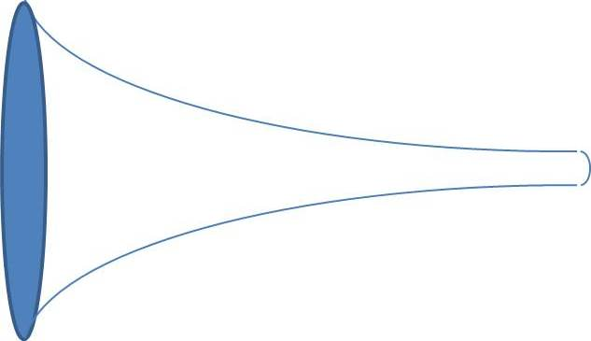
Normalization
Initial attempt
Raw Reality Models
Architected Information Model
Subsequent attempts
Crude Initial Classification Models
Problem space view (abstraction)
Principle
Mature Classification Model
Pattern
Architecture
Domain
Instance Example
Mappings between models
Increasing maturity with time
Application
Implementation
Specific
Unnecessary variety decreases over time
Code
Resolves to only the inherent complexity
Normalisation
opportunity
Notes:
To what degree should we normalize each area/domain/concept?
Depends upon maturity of the area/domain/concept
Depends upon relevance of the area/domain/concept
Depends upon the lifecycle timeframe of the area/domain/concept
Networking control/management is a highly relevant mature long lived domain and hence many things related to networking can be normalized
Consider implications of Innovation Value Lifecycle stage
Which views are important to focus on?
Domain analysis
Identifying the types of things in the overall domain
Application specific
Profiles of interface views etc for specific applications
Various abstractions and representation of virtualisations
Implementation neutral interface definitions per interface point
Capturing the types of things as they should be expressed over particular interfaces
Definition reflects solution viewpoint
There are multiple interface points in the solution and therefore multiple solution views
Definition may be oriented towards a particular representational form independent of specific implementation technology (e.g. Tabular style, Class-Association style)
There are potentially several representational views of a particular solution view
Allows for various implementation forms
Implementation specific
Captures implementation technology driven choices
Example
Capturing representations of instances (or partial instances) defined in any of the views
Mappings including mappings between
Various model views (e.g. the architecture view and the domain view)
Various solution views (e.g. a nodal view and a network view)
Various representational views (e.g. OF-Wire and the ONF ITU-T/TMF derived models)
ONF models and models from other bodies/groups (e.g. an ONF model fragment to a DMTF model fragment)
A specific solution and the model (e.g. a hackfest output and the preferred model)
Architecture and patterns (only extensive in the most mature areas)
Provides the rationale for choices and provides deep explanation of the problem space

Slide 17
Key considerations (2/5)
What approach should we use to develop & to apply the Information Model?
ONF has used an agile architecture approach
The model development takes on insights from the industry in the context of the SDN vision
The deliverable includes both formalized and agreed model as well as preliminary and experimental parts
The deliveries occur every 3 to 6 months
The interface models are being developed by appropriate pruning and refactoring of the core model
The interfaces are being validated via practical application with the results being fed back into the model evolution process
In general an agile approach is recommended with the delivery including preliminary work to help decision making in forward looking development enabling intercepts to be developed and that deliver enhancements rapidly as they emerge (see next slide)
What are the inputs to the modelling process?
ONF has drawn from existing work in the industry, from SDN definitions and from SDN vision
Drawing insights from ITU-T, TM Forum, OIF, MEF etc and collaborating in that work
Appling the recursive control architecture and the need for abstraction of the network to client views
Supporting Openflow needs
Validating with interface use cases
In general successful solutions emerge from development approaches that take advantage of a conjunction of theory and practical deployment experience.
Clearly the model should be positioned to match the vision, architecture and interface needs

Slide 18
Agile architecture
Recognise
Insights
Identify
Use cases
Raw Reality
Evaluate Standards and
best practices
Extract Insights
Feedback
Analysis
Consider Vision
Implementation Specific
Domain
Application Specific
Mappings
Example
Architecture
Patterns
Prototyping
Hackfests
Plugfest
Product
Implementation
“Fully”
Rationalized
Model capture
Bounded by Practical constraints
Scenario
Validation
Evaluate examples
Many overlaid asynchronous cycles at different phases with different lifecycle timeframes
Focus on specific
Current needs
Notes:
What approach should we use to develop and apply the Information Model?
An agile architecture approach blending rigor and insight with prototyping and practical application
A pragmatically holistic approach balancing implications of longer term targets with short term needs
What are the inputs to the modelling process?
For networking it is the deep insights from other SDOs (there has been excellent normalisation work carried out already in ITU-T and TMF) along with inputs from practical deployments. The aim is to:
Take advantage of past insight
Account for, explore and develop model in areas that are genuinely new
Take care to not reinvent
Use cases and scenarios both current and longer term
Vision, target scope and expectations
How much should we formalize the activity of Information Modelling?
Varies but in mature areas the activity can and should be formalized
We should use the same approach in all areas where we think formal Information Modelling is beneficial
The approach needs to be defined and documented as we progress
Who uses the Information Model, when is it used and how?
People developing further model build on/in the existing model
People coding interfaces “compile” the model
People doing prototypes and working in hackfests use interfaces “compiled” from the model and draw inspiration from the model
Code may be generated directly from the model in some cases or may be constructed manually using the model as a guide for key structures etc depending upon the maturity and completeness of the model
TM Forum have a program of model driven interface generation
Who develops the Information Model, when and how?
Various teams dealing with rationalisation of specific domains

Slide 19
Key considerations (3/5)
How much should we formalize the activity of Information Modelling?
ONF has chosen to strongly formalize information models for both the essential problem and the interfaces using UML
It was concluded that complex meshy problems benefit from a strong model and that UML provides an appropriate environment
To formalize the model it is necessary to use suitable tooling and in ONF Papyrus (free open source Eclipse platform tool) has been chosen. Incidentally this is also used in ITU-T and MEF
Formalization means consistent application of UML and to ensure this guidelines have been developed
In general it is recommended that complex areas (and most actually turn out to be) should be modelled with UML. The ONF guidelines provide a good basis for Information Modelling in any complex problem space
Who develops the Information Model, when and how?
ONF has chosen to set up an Information Modelling team to own the Core model on an on-going basis and to coordinate other modelling activities. There are also separate teams working on the interface models and on network technology enhancements
Interface development uses a pruning and refactoring approach to develop interface that allows loose coupling between the Core team and the Interface development teams
Modelling can occur in parallel in the various teams as each has been allocated a suitable branch in Git
The model ownership has been clearly demarked
In general it is recommended that an ownership approach that partitions the work to minimize dependencies is developed and for work on solutions similar to that of ONF an approach similar to that chosen in ONF is recommended

Slide 20
Key considerations (4/5)
Who uses the Information Model, when is it used and how?
In ONF the:
Core model is used when advancing the understanding of the problem space.
Development is done incrementally drawing from expertise and industry insight as well as from feedback from the interface work
Core model is used when developing interface definitions
As noted before by pruning and refactoring
Interface models are used when developing interface schemas (e.g. JSON or Yang)
Currently manual but to specific guidelines and aiming at automation
In general it is important that the role of each aspect of the model and the relationships between each aspect is explained well and understood. It is expected that a similar approach would be valid for any other body developing interfaces
How should we represent the formalized Information Model?
The ONF model is provided in both a Papyrus UML model form and a document form.
It is supported by pictorial representations in a domain specific language
In general it is suspected that a similar approach of tooled model, documentation and supporting material would be applicable

Slide 21
Key considerations (5/5)
How do we deal with variety, extensibility and change?
The ONF model uses several approaches:
The lifecycle of extensions/changes are indicated using the Lifecycle stereotypes
Changes are coordinated by the Information Model team with the aim of maintaining stability and fostering convergence
Variety is allowed between views where it is driven by external need but each view needs to relate to the common core model
Network technology specific attributes are added in conditional packages by the network technology experts
There is a recognition that there is unnecessary variety between network technologies and there is work underway to help remove that variety
Coordination using git
It should be noted that the model is an on-going development
In general it is recommended that a similar approach with lifecycle stereotypes, model governance and partitioned ownership is followed
How many Information Models?
ONF essentially have one model made of many model modules, some of which are stand-alone and could be considered as models in their own right
Hence it is both one model and many models… or all are fragments of one model
In general a model is in many fragments. Where there are fragments the key is to coordinate/collaborate
Apply consistent terminology defined in terms of structure of a model
Collect domain experts to cover each area
Be pragmatically holistic

Slide 22
Benefits of the core model
Help to reduce unnecessary variety in the industry
A major and essentially removable cost is that of integration of solution elements that use unnecessarily different ways to represent what are essentially common concepts.
Assist in sharing of the fundamental concepts to enable linkage between management and control environments
Because of the linkage to traditional models the Core Model Fragment will enable relatively easy integration into existing management/control environments
Assist driving mappings between OF and Service level abstractions (with the Core Model as an intermediary) improving coherence and enabling the necessary bridge between OF and Application models
The key concepts in the Core Model Fragment can be related through defined specification classes in the Core Model Fragment to the TTPs (as principles behind the TTPs are similar to those behind the core model)
Provide a formal base for the work of the NBI /Transport API teams improving ONF internal coherence
Through this model assist in the rationalization across the industry of the representation of networks for the purpose of management-control

