Slide 1
ONF presentations to ETSI NFV m-SDO IM/DM Workshop
Proposal for way forward – Interconnecting ONF and NFV work
January 2016
Final version for presentation (updated 20160113)

Slide 2
Topics in scope for cross SDO alignment
(timing for 40 min presentation, 20 min presentation)
(some slides will not be presented in detail)
Functional model interrelationship (12 min, 8 min)
  Presents a proposal for interconnect of the NFV and ONF models to provide a single federated model, highlights model adjustments necessary and provides rationale
Challenge of Nested Recursions (5 min, 3 min)
  Highlights that NFV builds on SDN and SDN builds on NFV. Discuss the implications.
Model development and interactions (4 min, 2 min)
  Explores peer and hierarchical interaction approaches (umbrella/federation) and makes a proposal for a particular way forward
Responsibility partitioning and cooperative working (4 min, 1 min)
  Based on the discussions above proposes a division of work across the bodies
Control Model interrelationships (3 min, 1 min)
  Presents proposals for unification of the management/control following the principles of Management-Control Continuum and a related proposal for refactoring the NE
Sharing patterns (3 min, 1 min)
  Provides a list of patterns that underpin the network model and suggest that at least some of these would appear to underpin the NFV model and hence should be commonly used.
Other model fragments that may benefit from sharing (2 min, 1 min)
  Highlights other areas that may benefit from collaboration and convergence
Generating interfaces (3 min, 1 min)
  Explains the ONF process to development of interfaces from the model and exposes open source tooling to generate schema (inc Yang) from UML
Tooling and process interworking (3 min, 1 min)
  Discusses further alignment of tooling and guidelines to ease sharing and interconnecting of models
IPR and copyright (0 min, 0 min)
  Touch on IPR, copyright, open source and other related topics highlighting key challenges
Conclusions (1 min, 1 min)

Slide 3
Functional model interrelationship: Analysis and proposal
Brief analysis of the NFV model and approach to attachment to the ONF model
Considered:
  Key focus of the two bodies of work
  Positioning as identified in various previous activities across the industry
Further evaluation required after
  Clarification of definitions of NFV classes
  Potential refinements of definitions
  Recent update to NFV model is accounted for (appears to be no impact at this level of analysis)
Strawman proposal (depicted in detail in later slide)
  Summary:
    Use ONF network model capabilities to join NFV VNF model ports (choice depends upon NFV definition)
      With two alternative forms (depending upon whether there is a layer protocol aspect in the VnfExternalConnectionPoint or not)
        Option 1: Derive the VnfExternalConnectionPoint from the ONF LTP
        Option 2: Attach the port of the VNF (VnfExternalConnectionPoint) to an ONF LTP
      With two types of join (both can be used in combination)
        Adjacency of some VNF protocol – ONF Link
        Forwarding of transport protocol – ONF FC
  Actions:
    Addition to ONF CIM: Make some NFV classes part of an enhanced ONF Core IM
    Derive some NFV model elements from ONF CIM: Use either prune/refactor or inheritance
    Removal of some classes: Directly link the NFV and ONF models and remove redundant classes
  Next steps
    Validate rationale for choice of attachment and make choices from above
    Identify changes to NFV model and ONF model and act on those changes
    Coordinate work on-going

Slide 4
Functional model interrelationship: Rationale
There is one problem space being covered by several specification bodies
  Networking is not new and there is a model already in place
  What is new is coherent representation of the virtual functions
The problem can be divided neatly between modelling of specialist virtual functions and modelling of networking/forwarding
The ONF CIM Core Information Model is built on many years of networking experience as noted in the model overview
  TMF SID Converged Network ABE (Abstract Business Entity) Info Architecture section
  TMF TR215 Component System pattern etc.
  ITU-T G.800

Slide 5
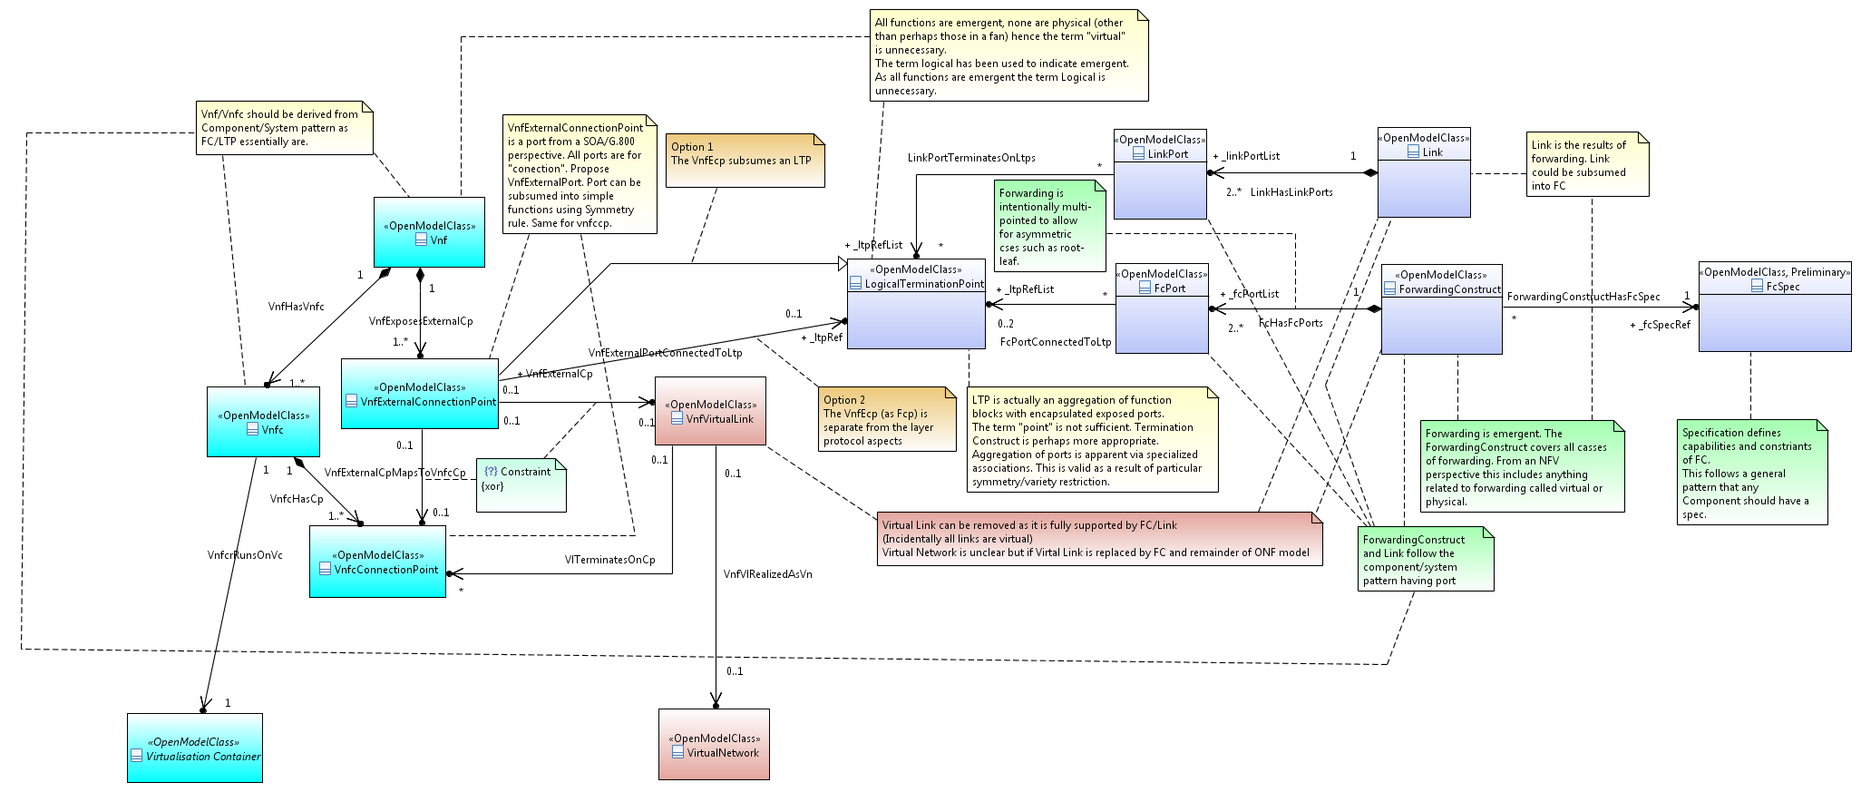
Functional model interrelationship: Detailed proposal
ONF/MEF/ITU-T Class
To be refined to align with current iteration of NFV model (late December version)
NFV Class
NFV Class to be replaced by ONF/MEF/ITUT class
NFV model
Link
Vnf
LTP
FC
FcSpec
VnfExtCp
VnfvLink
Vnfc
VnfcCp
VNetwork
ONF model

Slide 6
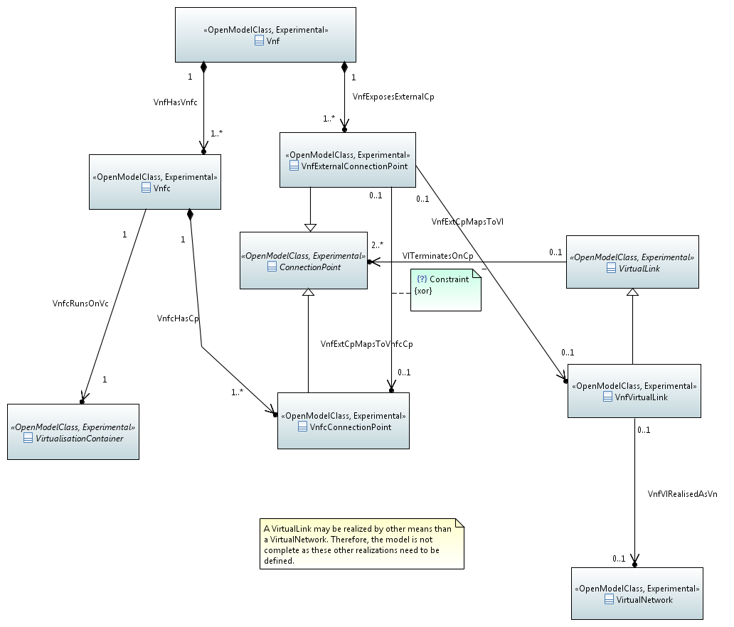
Functional model interrelationship: Extract for latest NFV model

Slide 7
Challenge of Nested Recursion: Rationale and data points
As a context for this discussion, consider two distinct services:
  A transfer (forwarding) service where the intention is that “what goes in comes out” so the input information is unchanged (ONF focus)
  A transform (processing) service where the intention is that “information is assimilated and used to provide some result” so the input information is transformed (NFV focus)
In a real environment
  Transfer service
    Achieved by transforming the representation of the information to enable it to be conveyed
    To determine whether transfer has been successful processing is carried out
  Transform service
    Achieved by transfering information between transform points
All aspects can be considered as components in a Component – System recursion
  A system is an assembly of components that can itself be viewed as a component
Modelling practice leads to encapsulation of lesser parts in parts that focus on the critical emergent behaviour
  The outer most view focuses on the key emergent behaviour
Considering existing forwarding models there are clearly processing aspect encapsulated
  Decision to throw a protection switch
  Decision to discard a packet (various reasons)
Forwarding is itself a somewhat dull processing function
The user may primarily need information to be transferred or may primarily need information to be transformed
  Information transfer necessarily has as its outer most representation a Forwarding construct
  Information transform necessarily has as it outer most representation a Processing construct
There appear to be essentially three distinct behaviour, transfer/forwarding, transform/processing and storage (the last being ignored here)

Slide 8
Challenge of Nested Recursion: Implication
The presentation should match the users expectations
  If the user has requested a forwarding service then a forwarding model should be presented
  If the user has requested a processing service then a processing model should be presented
Forwarding requires processing and processing requires forwarding
  There is a deep intertwining of the two
Forwarding can be encapsulated into a processing representation and processing into a forwarding representation (given the right circumstances). Hence:
  An ONF FC/LTP can encapsulate processing functions
    The LTP is a representation of the necessary protocol access stack
  An ETSI NFV VNF can encapsulate forwarding functions
Neither are necessarily at the top or at the bottom of the stack and both may be intertwined at many levels of recursion
  There is benefit in converging the modelling approaches, styles and patterns to maximise the opportunity for appropriate intertwined usage
It is proposed that figures be drawn that emphasize this recursion to better explain the positioning of ONF and ETSI NFV work

Slide 9
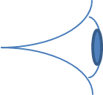
Challenge of Nested Recursion: Illustrative sketch
Extracts from ONF intent work (reference provided in original input)
The figure below shows network function connected by Forwarding Constructs with the assembly forming a ForwardingConstruct
The figure below shows processing function where the effect is a processing service
Key
Effect
ForwardingDomain
LTP (Connection)
Processing Function (VNF)
LTP (physical or virtual)
Realization
ForwardingConstruct
LTP (Termination)
Effect
Realization

Slide 10
Model development and interaction
Two distinct approaches
  Peering of models in a federation where
    There is no specific hierarchy and no overarching model
    Work is done jointly by members of two or more bodies at touch-points
      Where touch points become an overlap a new domain of work is created with clear ownership
  Hierarchy of models with an umbrella where
    The umbrella model provides a light weight representation of relationships between models
    The umbrella may stay as a light weight form or may deepen to become a core model for all domains and where that umbrella model is enriched as models converge
An umbrella model approach was used between 3GPP and TM Forum
  The specific approach had challenges with ownership and the need for detailed re-approval of work in the participating bodies
It is proposed that a distributed federation of peer domain focus activities be the approach rather than a shared umbrella (hierarchy)
  Each domain focus has clear ownership
  Convergence leads to new arrangements of domain focusses
  As the approach matures some domains may have very broad influence (covering patterns etc)

Slide 11
Responsibility partitioning and cooperative working
Position focuses (showing some bodies closely related to ONF work)
  ONF: Forwarding (encapsulating Processing)
    Simple processing (and complex processing with a simple emergent effect) is subsumed (e.g. packet discard)
    Network lifecycle management and control
    Note that it is intended that this be joint work by MEF, TMF and ONF (and ITU-T)
  NFV: Processing (encapsulating Forwarding)
    Simple Forwarding is subsumed (e.g. some local wiring)
    VNF lifecycle management
  MEF: Ethernet specific services and operations, general service specification
  TMF: Operations practices (FMO (Future Mode of Operation) and MCC) and business operations models
  ITU-T: Network technology specific models (OTN, Ethernet, MPLS-TP etc)
Other potential position focus considerations
  OCC: Interconnect above L2 (note that ONF Information Model team has had little exposure to OCC work to date)
  … (this needs to be worked further as a result of the meeting)
Generalizable items that may warrant their own focus (work is underway in ONF on each item below)
  Complex Functional Component (i.e. anything that is a complex emergent function such as a word processor)
  Physical Component (i.e. that can be measured with a ruler)
  Management-Control
  Specifications and specification pattern
Related… Architecture needs to be converged between ONF, TMF, MEF, ITU-T, NFV etc
  Proposal: A recursive, component-system pattern based architecture
  Note that convergence of architecture will point to deeper convergence of the information models and improvement in joint working

Slide 12
Control model interrelationships
The traditional network element is a hybrid of physical, functional, control scope/view and control access considerations
  There are many issues with the current form
  Separation of concerns brings clarity
  Functional aspects are essentially virtual within the physical boundary
  Control scope/view and control aspects are common with all other controller/manager entities
There would appear to be a generalized form of control scope/view/access model that applies to all cases of management-control
  This model recurses through layers of management-control
Management is control (consider Management Control Continuum (MCC))
  We should have the same patterns for management/control/orchestration at all levels of abstraction
  There is an opportunity to develop vision in this space and to work to eliminate historic problematic practices
  This should be collaborative across all bodies
Work is proceeding in the ONF on a generalized control model to apply to the controller and the Network Element
  There may be an opportunity for closer working with ETSI NFV in this area
Propose that current modelling work be shared with a view to alignment etc

Slide 13
Sharing patterns
We should align on common patterns that are generally advantageous:
Use TMF TR-215 liaised to ONF and provided by TMF to ETSI-NFV for the meeting
  Hypergraph: A graph with multi-pointed edges (hyperedge)
  Component-System
  Encapsulation (illustrated in Component-System and Hypergraph)
  Transfer-Transform
Specification to constrain a model that exposes variety via conditional composition rather than inheritance
Recursive/nested control loops

Slide 14
Notes on hyper-edge

Slide 15
Notes on System of components viewed as a component (animated)
A component with ports
Function
Function
Function
Function
Function
Function
Function

Slide 16
Other model fragments for potential convergence
Specifications, descriptors and templates
Equipment and physical constructs
Naming and Identifiers
State machines
Dependency graph

Slide 17
Generating interfaces
Use essentially the prune/refactor process as identified and used in ONF
  The ONF-CIM provides Canonical models for domains of interest relevant to ONF
  For any particular purpose, a view of the domains will be required
  A view model must abide by the Canonical models but will be a subset of the models covering a narrower scope and capability set
  Pruning is the process used to derive a model with the appropriate narrower scope for the view
  As the view is narrower it could benefit from restructuring
  A view may also benefit from relabeling to make it compatible with the viewers terminology
    This may also include sub-classing (to apply different labels to different cases of a single core model class)
  Refactoring is the process used to restructure and re-label things in the model
  The primary purpose of a view is for presentation over an interface to enable interoperable interaction between controllers and other devices
  The view will be oriented towards a relevant presentation and the encoding of that presentation
Share development of tooling to support the prune/refactor process
Use auto-generation of interface schema from appropriate UML model
  Tooling available (and evolving) in ONF Open Source project (Eagle)
    https://github.com/OpenNetworkingFoundation/EAGLE-Open-Model-Profile-and-Tools
    https://community.opensourcesdn.org/wg/EAGLE/dashboard

Slide 18
Tooling and process interworking
Tooling and model generation/usage approaches should be aligned
ONF and NFV have exchanged guidelines but these are not fully aligned
  UML Modeling Guidelines
  Papyrus Guidelines (also covers approach to parallel working, use of gendoc and used of git)
ONF and NFV should target alignment by end 2016
  There is detailed material on this in the background of this slide pack and it is proposed that this be used (ideally whilst in this face to face meeting) to identify areas for focus on alignment (target for alignment end 2016)
  Noted that MEF and ONF share aligned guidelines
ONF is developing mapping guidelines and associated tooling (in open source Eagle community)
  UML → YANG
  UML → JSON
  etc
It is proposed that the mapping guidelines and tooling be used by ETSI-NFV

Slide 19
Current ONF model structure, documents and process
Common Information Model
Interface Creation Process
Core model fragment (TR-512)
module-1
module-2
….
module-n
View of the common IM for a particular purpose
Map
Data schema
for interface 1
Map
Interface
instance 1
Prune/refactor
Technology (e.g. OTN) model fragment
(e.g. from OT project)
Map
Interface instance 2
Application 1 model fragment
(e.g. from NBI project)
xxx model fragment
(from yyy project)
Guidelines
TR513
Model structure
TR514
UML
TR515
Papyrus tool and GitHub
TR513
Common process
Interface specific
Interface specific
Interface specific

Slide 20
Opportunity to align IPR and copyright
Not the focus here but a critical aspect
  Challenges
    IPR modes
    Copyright agreements
    Use of open source
    Integration of standard processes with Open Source processes
  Will require updates to current agreements
    Revise the agreements so we can joint work and cross deliver

Slide 21
Conclusions
We can act now to leverage the key significant opportunity to not duplicate effort
  Consistent tooling – we should ensure we maintain this
  One relatively obvious touch point between the two models identified (as per Core Proposal Sketch)
  Some areas identified where future joint working or collaboration would benefit
There are significant challenges to joint work we need to be aware of and deal with
Next steps whilst we are face to face
  Validate the functional model interrelationship
    Agree the approach
    Plan for first federated deliverable
  Use backup material to agree improved tooling and methodology alignment
  Agree how to proceed to find further areas for joint/collaborative federated/delegated work

Slide 22
THANK YOU

Slide 23
Background material
UML Guidelines

Slide 24

UML Modeling Guidelines
References
ETSI NFV UML Modeling Guidelines (v0.0.4, 2015-11)
→ NFV-IFA015v010
ONF UML Modeling Guidelines (v1.1)
→ TR-514_v1.1_UML_Modeling_Guidelines (November 2015)
Detailed Comparison (includes also MEF)
→

Slide 25
UML Modeling Guidelines: Differences
ETSI NFV
ONF
Title
  ETSI has “NFV” in the title
Object Classes
  multiple inheritance not supported
  Choice not supported
Attributes
  Ordered not used
  Unique not used
  Read Only not used
  Default Value not used
  Type can be empty to indicate it would be specified in stage 3
  valueRange not supported
Title
  Neutral title
Object Classes
  multiple inheritance supported
  Choice supported
Attributes
  Ordered used
  Unique used
  Read Only used
  Default Value used
  Type must not be empty
  valueRange supported

Slide 26
UML Modeling Guidelines: Differences
ETSI NFV
ONF
Associations
  Non-navigable Associations not used
  Dependency Relationships not used
  Realization relationship not used
  Abstract not used
  Additional annotations on associations not supported
Interfaces not used
Operations not used
Operation Parameters not used
Notifications
  Inheritance not used
  Abstract not used
C (Conditional) qualification not supported
Associations
  Non-navigable Associations used
  Dependency Relationships used
  Realization relationship used
  Abstract used
  Additional annotations on associations supported
Interfaces used
Operations used
Operation Parameters used
Notifications
  Inheritance used
  Abstract used
C (Conditional) qualification supported

Slide 27
UML Modeling Guidelines
Questions
  Does ETSI NFV need Interfaces/Operations in future?
Summary
  Common used artifact properties are applied in the same way
  Many differences exist due to ETSI NFV not using / not supporting artifact properties
  → Single “instance” of UML Modeling Guidelines could be used by both SDOs (with restrictions on ETSI NFV side)

Slide 28
Background material
Papyrus Guidelines

Slide 29

Papyrus Guidelines
References
ETSI NFV Papyrus Guidelines (v0.0.4, 2015-11)
→ NFV-IFA015v010
ONF Papyrus Guidelines (v1.1)
→ TR-515_v1.1_Papyrus_Guidelines (November 2015)
Detailed Comparison (includes also MEF)
→

Slide 30


Papyrus Guidelines: Differences
ETSI NFV
ONF
Title contains “NFV”
Software versions
  eclipse 4.5.0
  Papyrus 1.1.0
  Gendoc ?
Model development in teams
  Contributions
  ?
Data extraction from Papyrus Model
  Gendoc
    No installation guide
    Brief tutorial
  Papyrus tables?
Stereotypes
  How to apply stereotypes
  How to change property values
Importing RSA Models not described
Title is SDO neutral
Software versions
  eclipse 4.5.1 (Mars SR1 or Mars.1)
  Papyrus 1.1.2
  Gendoc 0.5.1
Model development in teams
  GitHub
  Model splitting during development
Data extraction from Papyrus Model
  Gendoc
    Installation guide
    Extensive tutorial
  Papyrus tables explained
Stereotypes
  How to apply not described
  How to change not described
Importing RSA Models

Slide 31

Papyrus Guidelines
Questions
  Software version management necessary?
  Model and Profile in one project or separate projects?
  How to make the guidelines “SDO agnostic”?
Summary
  No substantial difference
  Modeling in teams is different

Slide 32
Background material
Mapping Guidelines (driving tooling)

Slide 33



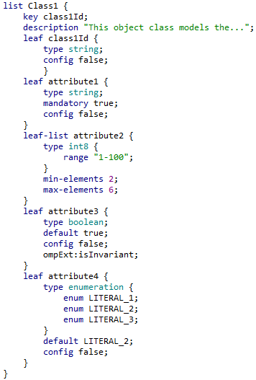
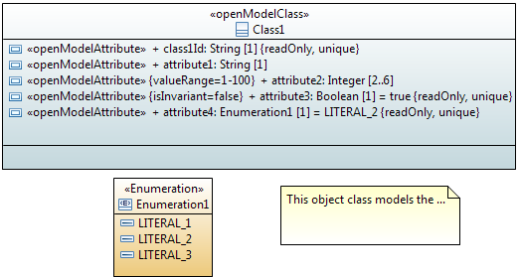
UML → YANG Mapping Guidelines and Tooling
Simple Mapping Example

Slide 34
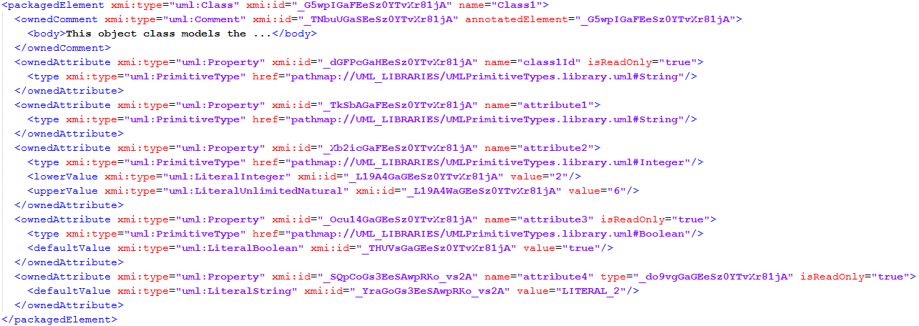
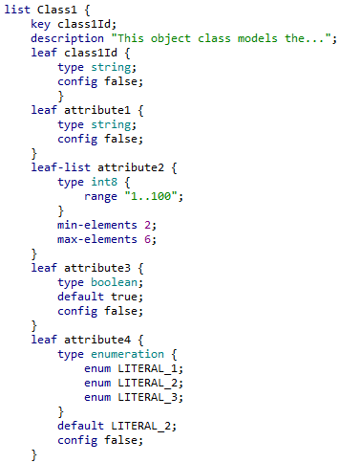

UML → YANG Mapping Guidelines and Tooling
Simple Mapping Example
Mapping XMI → YANG
Mapping within XMI

Slide 35
UML → YANG Mapping Guidelines and
Tooling
Questions
  Which data schema language is of most importance to ETSI NFV?
  Does ETSI NFV plan to specify a complete UML model?
  Note: A complete UML model is prerequisite for tool mapping.
Summary
  Just one of the many potential mappings of UML to interface data schema languages
  Describe how to map UML artifacts to YANG statements including:
    Object Classes, Attributes, Data Types, Associations
    Interfaces, Operations, Parameters, Notifications
  Not all properties of the UML artifacts are relevant to interface generation
  UML and YANG don’t easily match
  (UML is Object-Oriented supporting a rich meshing of artifacts, YANG is Tree-Oriented)
  Handling UML Recursion
  UML Conditional Pacs
  Intention to develop the Papyrus tooling to enable automatic generation of interface data schema from a UML model (including the generation of Yang)
    Project EAGLE: Open Source Community for UML → YANG Mapping
    First draft version of mapping tool already available

Slide 36
Interworking Tooling Proposal
Papyrus
  Work using the same (latest) version across the bodies
  Join the Papyrus community to assist progression
Gendoc
  As per Papyrus
UML-Yang
Prune and Refactor tooling (not yet started)
Git
  Branches and Forks usage
  Eagle
  Joint (not yet created)
  ONF
  Etc.
Guidelines
To be enhanced in the final version to provide key details

Slide 37
Background material
Encapsulation

Slide 38
Encapsulation (animated)
NEs with ports
ForwardingConstructs between ports in NEs
Forms a network connection
Which forms a Trail
Which forms a Link
This is a conceptual port.
But all ports are conceptual!
Note: Where the client support at each end of a multi-ended Trail is not the same the Link for each client is a subset of the Trail ForwardingConstruct.

