Slide 1
NFV Information Modelling 3GPP SA5 Status
March 29th 2016

Slide 2
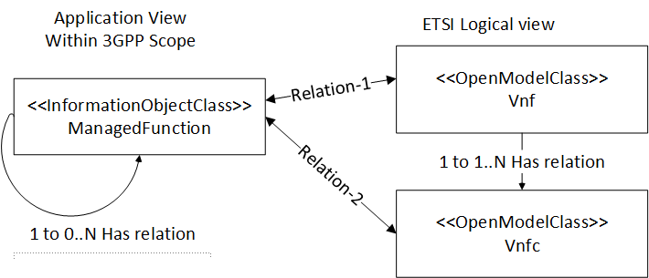
3GPP SA5 work in progress
The specifications of the bilateral relation-1 & relation-2 are currently being discussed within 3GPP SA5.
3GPP SA5 recommends to harmonize views on those relations among ETSI ISG NFV, 3GPP SA5 and other concerned SDOs.

Slide 3
Status of 3GPP SA5 issues
Orga | ID | Issues | Proposals | Status
3GPP | 4 | Application-specific models applicability to all SDOs? "Difference in application models" | Proposal: Does not recommend to conduct model harmonization work between 3GPP SA5 defined managed function application-specific model and all other SDO-defined application-specific models. It needs to be validated, whether the need to harmonize | Would need use cases to justify model harmonization at application level
3GPP | 5 | Need to clarify the relationship between the application view and the logical view | Proposal: Focus on the harmonization in two aspects. Focus on relationship. Relation-1: Between Managed Function and VNF, Relation-2: Between Managed Function and VNFC | Work is ongoing in the context of the cooperation 3GPP SA5 - ETSI ISG NFV IFA
3GPP | 6 | Mixing of information model and the management protocols. | Proposal: must have a clear separation of management protocols and the information that the protocols transport. | Clear separation already done in 3GPP SA5
3GPP | 7 | Lack of common information model on ETSI defined NS that captures the virtualization aspects of VNF. | Proposal: In the case that ETSI NFV decides to work on a CIM related to various SDOs application-specific and not related to virtualization aspects, re-use the Umbrella Information Model as the base for SDO's model harmonization work. Already ongoing among 3GPP SA5, MEF, ONF, TMF, and ITU-T (partially BBF) | Would need use cases to justify model harmonization at application level

Slide 4
Next steps
The work on the modelling of the relations between the application view and the logical view will continue at SA5 meetings in April and May 2016.
When SA5 will reach agreement, the results will be shared with ETSI ISG NFV IFA via the cooperation channel established in February 2015.
End of 2016 seems a reasonable timeline to agree on the modeling of relations between 3GPP SA5 and ETSI ISG NFV IFA.
However, the progress will depend on contributions and on respective opinions of 3GPP SA5 and ETSI ISG NFV IFA companies.

Slide 5
Thank You !
www.3gpp.org
contact@3gpp.org

