Slide 1
IEEE Standards association and iot
Document No: | GSC(14)18_010r1
Source: | IEEE-SA
Contact: | Bruce Kraemer/Moira Patterson
Agenda Item: | 5.1
Bruce Kraemer, President-Elect, IEEE Standards Association
GSC-18 Meeting, 22-23 July 2014, Sophia Antipolis, France

Slide 2
IEEE initiatives
Future Directions
Committee within the IEEE that is chartered to anticipate the direction of existing, new, and emerging technologies and related issues and coordinate their investigation within the IEEE Societies, Councils, and industry
Each is responsible for
Web Portal
Publications
Conferences
Collaboration - Cross Society + External
Standards
Education
Scenarios

Slide 3
IEEE initiatives
Working Initiative Groups (3 year lifetime, listed newest to oldest)
SDN: Software Defined Networks
GICT: Green Information Communication Technology
RC: Rebooting Computing
CbS: CyberSecurity
IOT: Internet of Things
SC: Smart Cities-Urbanization
CC: Cloud Computing
TE: Transportation Electrification
LS: Life Sciences
SG: Smart Grid

Slide 4
Common Themes and Challenges
The Internet of Things (IoT) is predicted to become one of the most significant drivers of growth for many emerging and future “smart” applications and markets
From the Connected Consumer to Smart Home & Buildings, E-Health, Smart Grids, Next Generation Manufacturing and Smart Cities
IoT size and scope
Because IoT can potentially encompass all of IT—the smart home, the smart city, the smart grid, the smart.... How do we define the boundaries of IoT?
What is not included?
How best to Generate, Move, Store, Analyze, Represent, Act upon large amounts of data
Note that Enormous numbers of sensors will be added to the net
The challenge is to design low-power sensors that require no battery change
There is demand for energy-efficient designs and energy harvesting, including low-power circuits and communication protocols
Privacy and security
A challenge for technology, for consumers, regulatory bodies, for governments
How does the technology accommodate diverse demands?

Slide 5
IEEE-Standards Association IOT: ACTIVITIES
Worldwide IoT standards workshops
2012: Beijing, China and Milan, Italy
2013: Shenzhen, China and Mountain View, CA, USA
2014: IEEE IoT World Forum, Seoul, Korea (6-8 Mar)
2014: 18-19 September in Mountain View, California
IoT industry roundtables and webinars
2012: Milan
2013: Korea and USA
2014: Four industry roundtables in US, Europe, and Asia
Notes:
IEEE has held a number of public events highlighting the Internet of Things and the role IEEE standards plays to support them.
It has also created new programs, such as CSHBA, that support the IoT.
IEEE-SA also interacts with an overall initiative within IEEE to support the IoT.

Slide 6
Newest IOT Activity
Standards activities predate the IOT label - over 140 IEEE existing standards and projects are relate to the Internet of Things
…but there’s always room for one more standard
IEEE P2413—Standard for an Architectural Framework for the Internet of Things
P2413 intends to consider a very broad range of verticals and stakeholder groups
The architectural framework defined in this standard will promote cross-domain interaction, aid system interoperability and functional compatibility, and further fuel the growth of the IoT market

Slide 7
IEEE Architecture for IoT
IEEE P2413 will provide an architectural framework for the IoT and its sub-domains
The architectural framework for IoT will include
A reference model that defines relationships among various IoT verticals (e.g., transportation, healthcare, etc.) and common architecture elements
Architectural building blocks and their ability to be integrated into multi-tiered systems
A blueprint for data abstraction and the quality "quadruple" trust that includes protection, security, privacy, and safety”

Slide 8
IEEE P2413 and other bodies
A unified IoT architecture framework cannot be constructed in isolation. It must include interaction with, and input from other standardization activities. A broad range of vertical applications need to be understood to
Cover the various applications, their requirements and specific IoT functionalities in the IoT architecture framework
Ensure that the framework addresses the needs for standardization activities
P2413 will include interactions with standardization activities within IEEE
Additionally, P2413 will strive to establish liaisons with other standardization bodies
for example IEC (e.g. Smart Manufacturing, Smart Grid), ETSI oneM2M and ISO (e.g., Intelligent Transportation Systems, e-Health) on IoT matters

Slide 9
Next Steps / Actions
P2413 completed its initial working group meeting
1st WG meeting completed 10-11 July in Munich, Germany
2nd WG meeting scheduled for September 16&17 in the San Francisco bay area just prior to the IOT workshop (see below)
Broad desire to add to, not replicate, existing work inspired formation two sub-committees
One is responsible for reviewing the forthcoming oneM2M Release 1 specifications, providing comments to oneM2M and identifying portions for potential re-use
A second is broadly reviewing the standardization landscape and potential liaisons
http://grouper.ieee.org/groups/2413/
IEEE-SA IoT workshop
18-19 September 2014 in Mountain View, CA
Featuring panels and speakers on various IoT topics
More information at iot.ieeesa-events.org
Convergence of Smart Homes and Building Architectures
IEEE-SA Industry Connections program for pre-standards work
Find out more at http://standards.ieee.org/develop/indconn/iccshba/index.html

Slide 10
Supplementary Slides

Slide 11
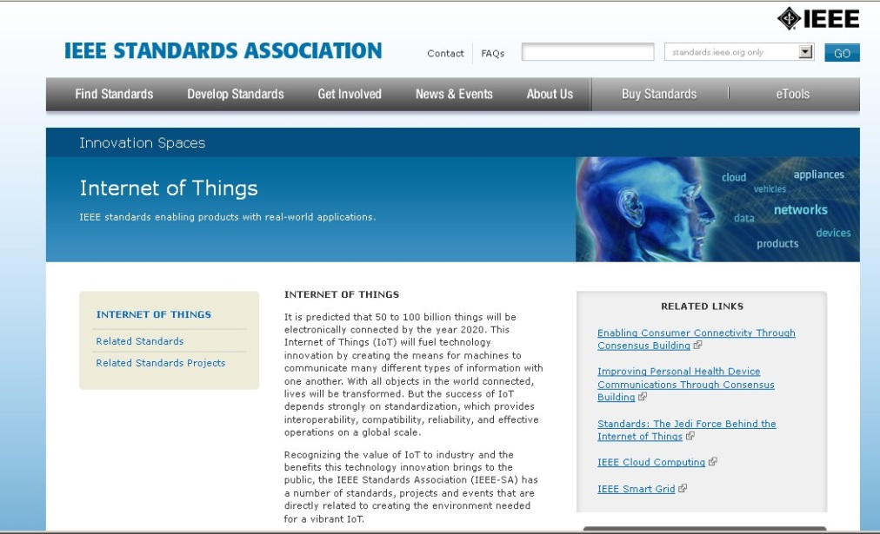
IEEE-SA INTERNET OF THINGS: PRESENCE
http://standards.ieee.org/innovate/iot
Notes:
You are invited to explore more in this evolving web area for IEEE-SA.
IEEE-SA has identified over 140 standards and projects that are foundational for the IoT
Includes related fields because so many other established technical areas, like the smart grid, relate to IoT.

Slide 12
Key ieee iot initiative resources
IEEE IoT Initiative Web Portal
http://iot.ieee.org/
The Institute: Special Issue on IoT The March special issue of The Institute focused on Internet of Things. It featured various articles on what IEEE is doing in the field of IoT. http://theinstitute.ieee.org/video/technology-focus/technology-topic/tech-news-the-internet-of-things
The Great Internet of Things Debate IEEE recently held an hour-long live Q&A with some of the top IoT experts. It is now available for viewing on IEEE’s Google+ page. https://plus.google.com/events/c4m936s9g47n5aokrkuvroic5pc
IEEE WF-IoT Conference Proceedings The 2014 IEEE World Forum on Internet of Things (WF-IoT) conference proceedings are now available in IEEE Xplore. http://ieeexplore.ieee.org/xpl/mostRecentIssue.jsp?punumber=6784568
IEEE Internet of Things Journal (IoT-J) http://iot.ieee.org/journal

Slide 13
IEEE Iot initiative structure
Chair
(R. Minerva)
Web Portal Track
(A. Roy)
Conferences Track
(V. Piuri)
Standards Track
(M. L. Nielsen)
Publications Track
(Y.K. Chen)
Comm./PR Track
(L. Stogner)
Scenarios
Track
(R. Minerva)
Education Track
(A. Pears)
Education Working Group
Publications Working Group
Web Portal Working Group
Conferences Working Group
Standards Working Group
Comm./PR Working Group
Scenarios Working Group

