Slide 1
India in Global Telecom Standardization From Jeju To Sophia
Document No: | GSC(14)18_023r1
Source: | DoT
Contact: | A. K. Mittal
Agenda Item: | 3
A. K. Mittal, Sr. DDG & Head (TEC), Department of Telecommunications, Government of India
GSC-18 Meeting, 22-23 July 2014, Sophia Antipolis, France

Slide 2
Flow of Contents
The Indian Opportunity
Standardization in India
Indian Presence in Global Standards
National Telecom Policy 2012
Announcement of TSDSI Formation
Recognition of TSDSI as the National TSDO
Launch of TSDSI

Slide 3
DEPARTMENT OF TELECOMMUNICATIONS (DoT)
Under Ministry of Communication & IT
Handles all telecommunications issues
Major Functions:
Policy making
Technical regulation
Licensing
Standardization
Spectrum Resources Management

Slide 4
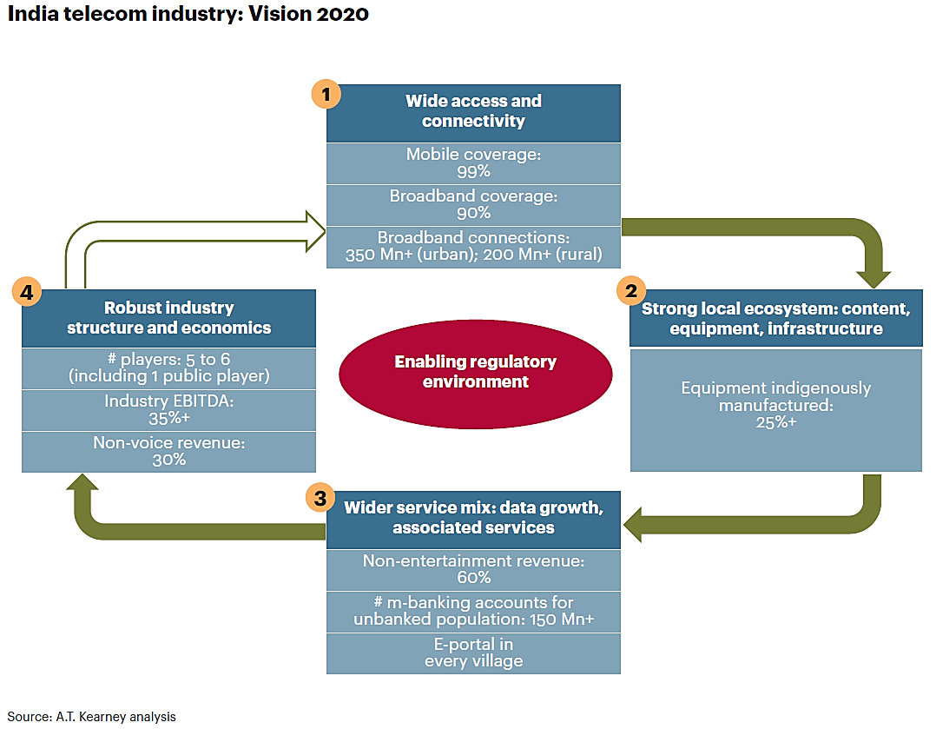
Future Demand Projection

Slide 5
Opportunities
Huge requirement/ demand for state-of-the-art & affordable products, equipments, and services, for-
Broadband services, especially for rural areas
Green telecom applications
Secure networks
Fixed-Mobile convergence
Pool of talented engineers
Robust infrastructure in place

Slide 6
Standardisation in India
Telecom Engineering Centre (TEC)
Technical arm of DoT
Formulates technical requirements in harmony with international standards
Tests and certifies telecom products
Represents DoT in international standardization forums
Present status
No mandatory standards

Slide 7
Testing and Certification
TEC carries out testing and certification w.r.t the following:
Connectivity
Interface Approval
Equipment
Type Approval
Certificate of Approval
Technology
Technology Approval

Slide 8
Indian Presence in Global Standards
Mostly in ITU, APT and other regional forums
Indian presence in major wireless standards bodies 3GPP, 3GPP2 meagre
Requires participant to be a member of a partner SDO of 3GPP/3GPP2 to participate
With no India SDO participation, Indian entities have been forced to choose external routes to participate

Slide 9
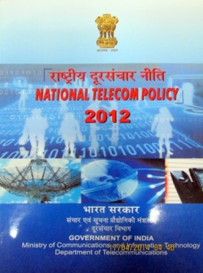
National Telecom Policy 2012 (NTP 2012)
Under Clause IV. STRATEGIES:
2.7. To promote setting up of Telecommunications Standard Development Organisation (TSDO) as an autonomous body with effective participation of the government, industry, R&D centres, service providers, and academia to drive consensus regarding standards to meet national requirements including security needs. It will facilitate access for all the stakeholders in the International Standards Development Organisations and act as an advisory body for preparation of national contributions for incorporation of Indian requirement/IPRs/standards in the international standards.

Slide 10
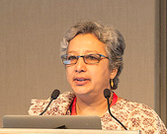
Announcement of TSDSI Formation
Extract from GSC17-CL-36r1
Dated 16th May 2013

Slide 11
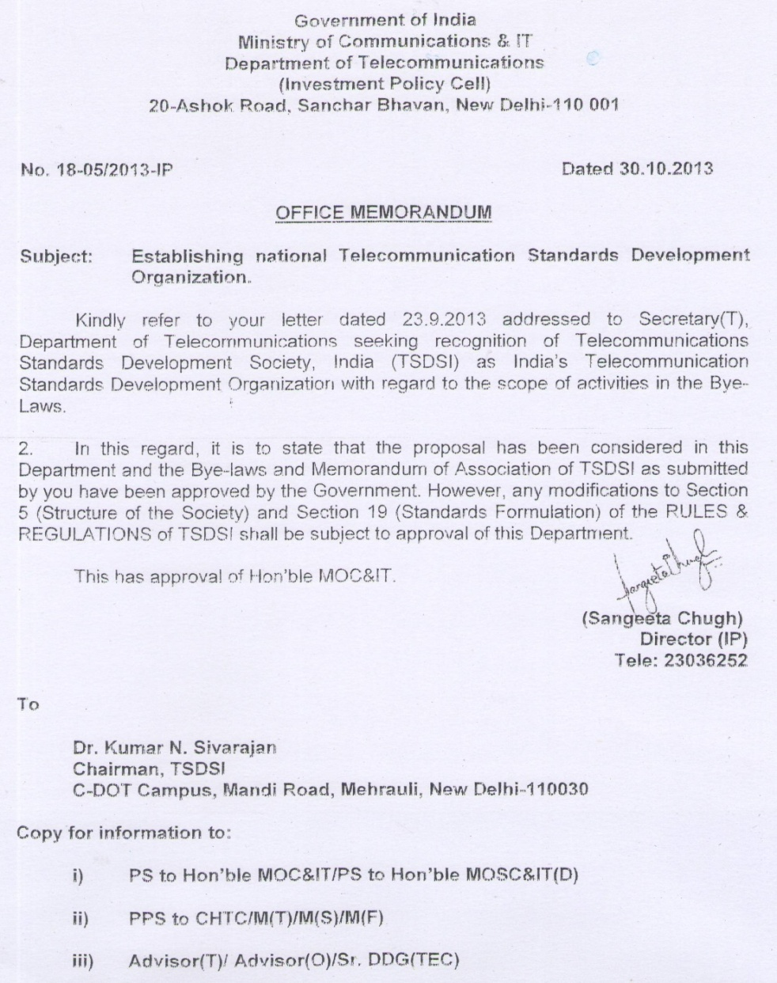
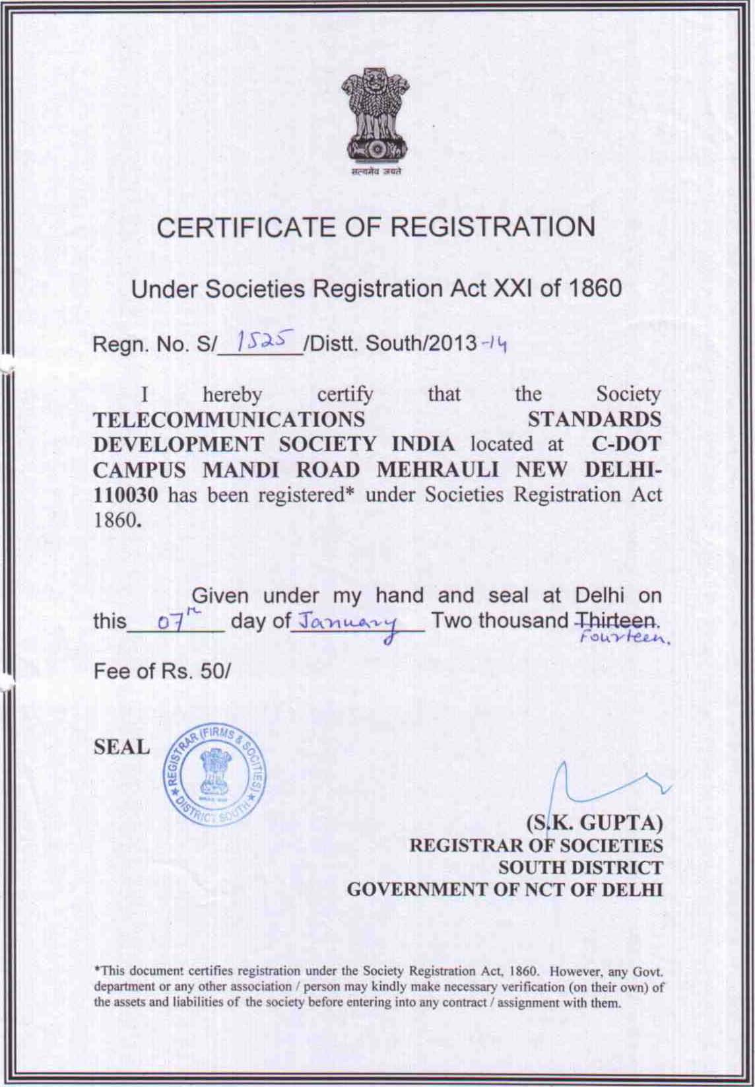
Recognition as the Indian National TSDO
DoT’s Approval & Registration

Slide 12
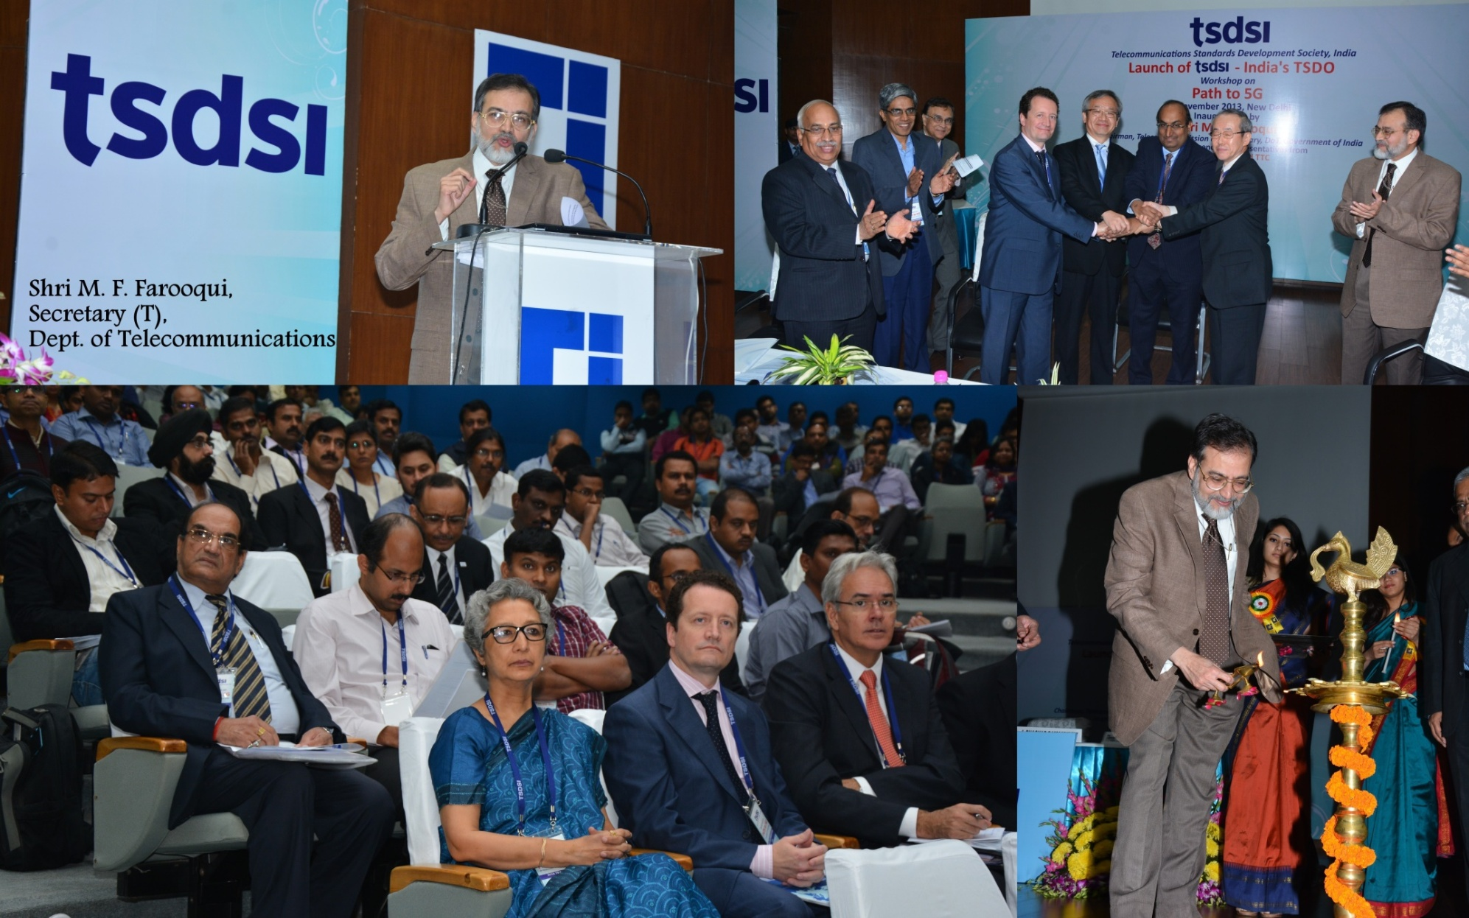
Launch of TSDSI- 8th Nov 2013

Slide 13
Supplementary Slides

Slide 14
Indian Scenario
Broadband
Source: The Indian Telecom Services Performance Indicator Reports, TRAI dated 7th July 2014

Slide 15
National Plans/Projects
Plans and projections
Rural tele-density– 70% by 2017 and 100% by 2020
Broadband-on-demand
Broadband Connections– from present 65m to 175m by 2017 & 600m by 2020
Major schemes/projects
National Optical Fibre Network (NOFN) – 500,000 km of OFC; 250,000 rural PoPs with a minimum data rate of 100 mbps
NFS Project with 40,000 km of OFC; 414 main nodes
Other projects for Rural Broadband, North-East Region, Islands, Border areas, etc.

Slide 16
TEC Standards
Generic Requirements (GR) 572
Interface Requirements (IR) 57
Service Requirements (SR) 11
Standards (SD) 28
TEC Technical Requirements broadly cover:
Conformance
Interoperability
EMI/EMC
Security
Safety
Health
Test Schedule & Test Procedure (TS/TP)
Testing & Certification

Slide 17
Contributions of TEC in ITU
ITU-R
DDG (R) TEC is Vice-chairman of SG 7
Contribution on ‘High Altitude Platform Station (HAPS)’ to APT
15 contributions have been sent through NWG 5 chaired by Sr. DDG and head of TEC
ITU-T
Contribution in formation of Focus Groups on ‘Bridging the Gap: from Innovations to Standards’ and ‘Recovery and resilience of network infrastructure’ in TSAG
Contribution on ‘Deep Packet Inspection’ in Study Group 13
Contribution on ‘Low Cost Telecom Infrastructure’ in ITU-T SG-5. DDG (WR) TEC was Editor and Dir. (M) co-Editor
ITU-D
3 proposals on ‘Interoperability in Next Generation Networks’, ‘Creation of Common Database of Information and Sharing-mechanism of Radio Equipment for Emergency Communications’, and ‘ITU-D Assistance in Digital Broadcasting’ formulated, and presented on behalf of India and APT in WTDC-10 Meeting of ITU-D at Hyderabad, India
DDG (T) TEC drafted the ‘Hyderabad Declaration’ of ITU; chaired the meetings of drafting group; and presented it in Plenary Sessions
Contribution on NGN Testing in Sept-2013 meeting of ITU-D SG-2

Slide 18
Thank You
Visit us at www.tsdsi.org for more details

