Slide 1
Recent work in ITU on disaster relief & emergency communication
Document No: | GSC(14)18_032
Source: | ITU
Contact: | Reinhard Scholl
Agenda Item: | 7.3
Reinhard Scholl, ITU
GSC-18 Meeting, 22-23 July 2014, Sophia Antipolis, France

Slide 2
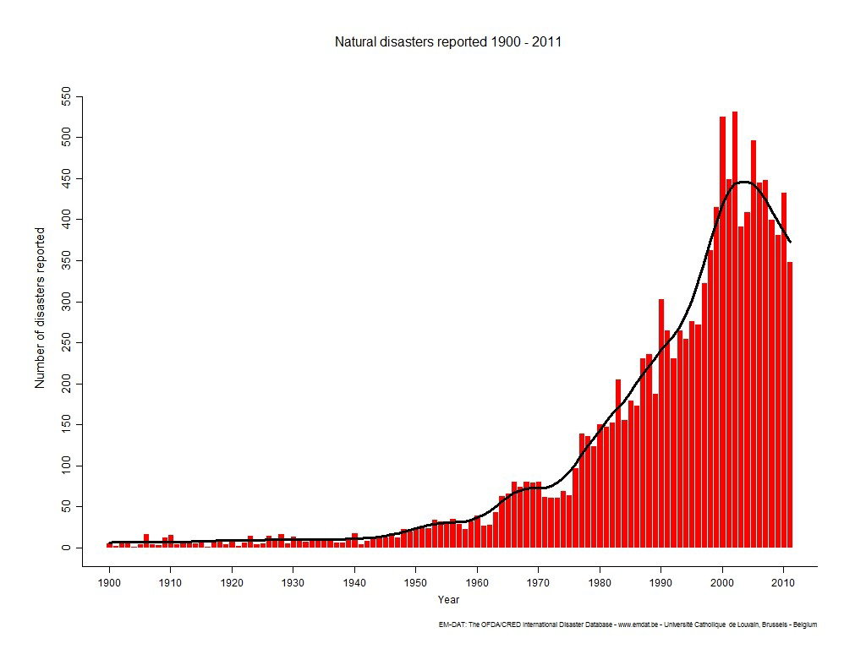
Natural disasters reported 1900 - 2011

Slide 3
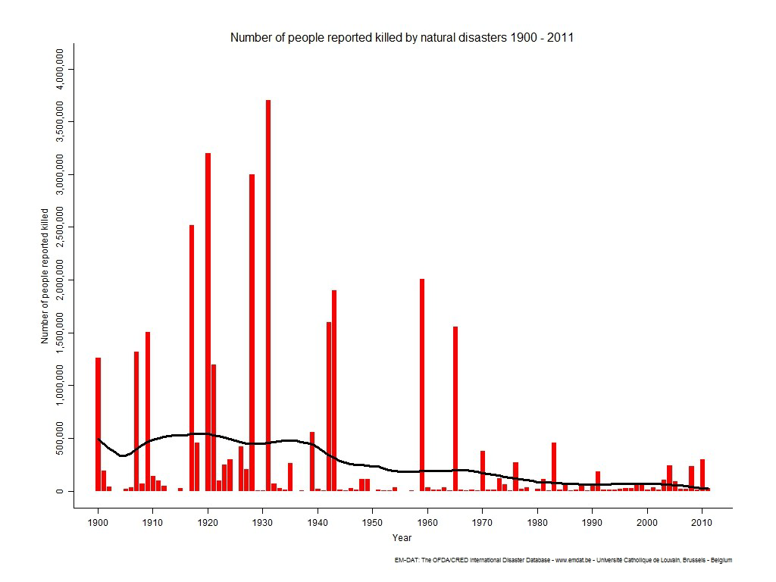
# of people reported killed by natural disasters 1900 - 2011

Slide 4
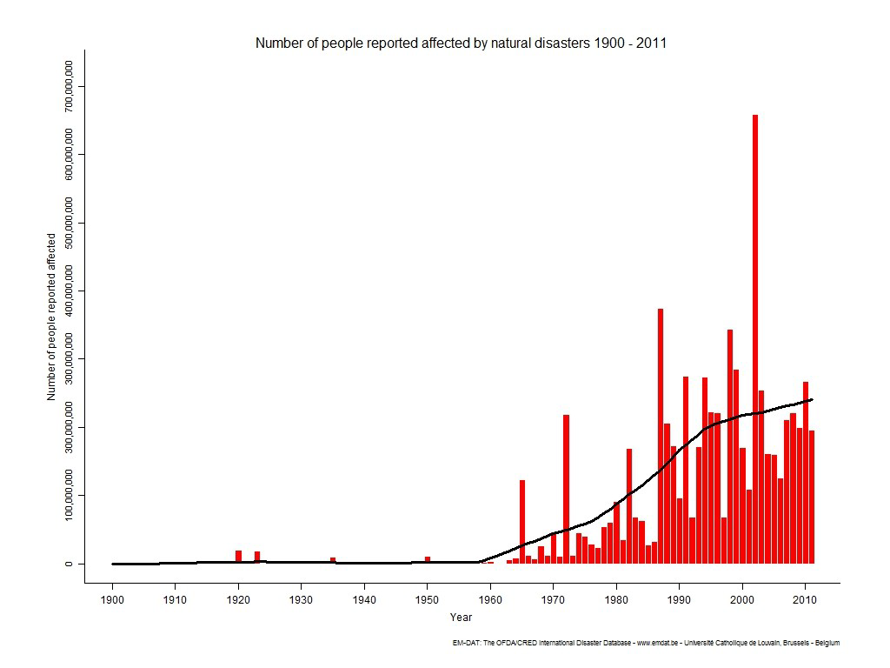
# of people reported affected by natural disasters 1900 - 2011

Slide 5
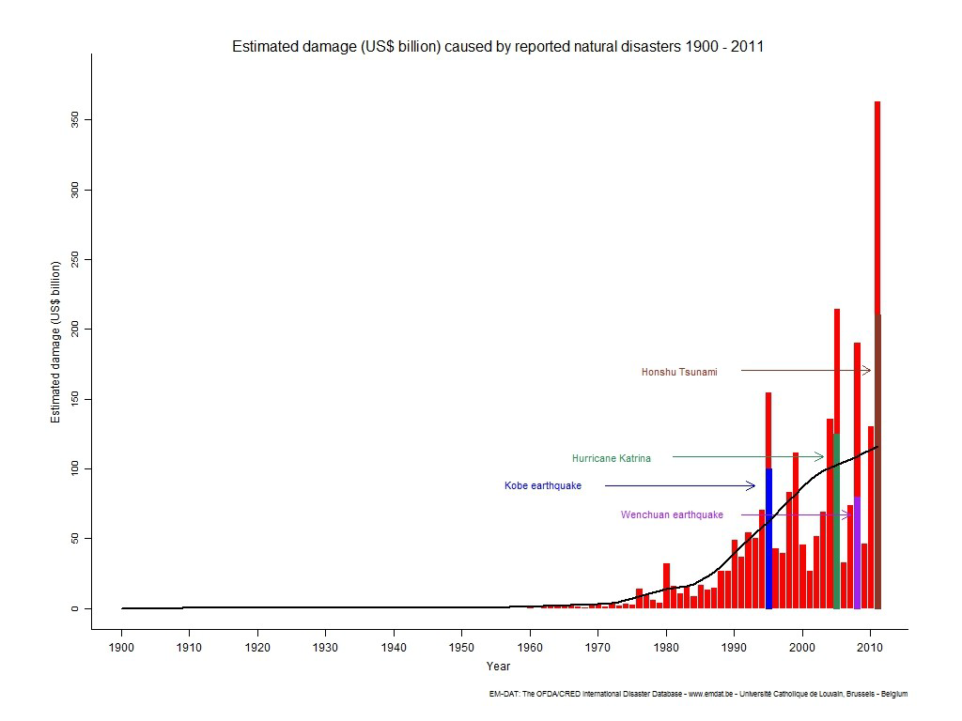
Estimated damage (US $ billion) caused by reported natural disasters 1900 - 2011

Slide 6
Disaster relief and emergency communication in ITU
All Sectors of ITU (ITU-T, ITU-R, ITU-D), and most of the study groups, are working to contribute to disaster relief from the telecommunication/ICT perspective
Disaster relief activities include
  preparation for possible disasters,
  early detection,
  rescue,
  evacuation assistance,
  safety confirmation,
  recovery assistance, etc.

Slide 7
Missing and critical items
A Focus Group tackled the missing and critical issues (Jan 2012 – June 2014)
The items below were identified
  Disaster relief for individuals (victims notifying their relatives, friends, or employers)
  Disaster relief guidance (to show victims the routes to evacuation shelters, home, etc.).
  Network resilience and recovery capability of infrastructure to cope better with disasters
Eight technical reports published (July 2014):
http://www.itu.int/en/ITU-T/focusgroups/drnrr/Pages/default.aspx
Notes:
ITU-T has already been working on the issues for disaster relief.
However, it is felt that two important areas may have not been addressed: (1) disaster relief for individuals (to notify the damage situation from victims to their relatives, friends, or employers) and (2) disaster relief guidance (to show victims the routes to evacuation shelters, home, etc.).
In addition, it was felt that the issues of network resilience and recovery of infrastructure following disasters are important and that there is need to identify all standardization requirements and issues in these areas.
Indeed large scale damage could happen on a telecommunication network by a disaster, new methods and/or new network architecture might be necessary for improving network resilience and recovery capability to cope better with a disaster. Different types of disasters may require different solutions (e.g. ad-hoc networking, delay-tolerant networking).

Slide 8
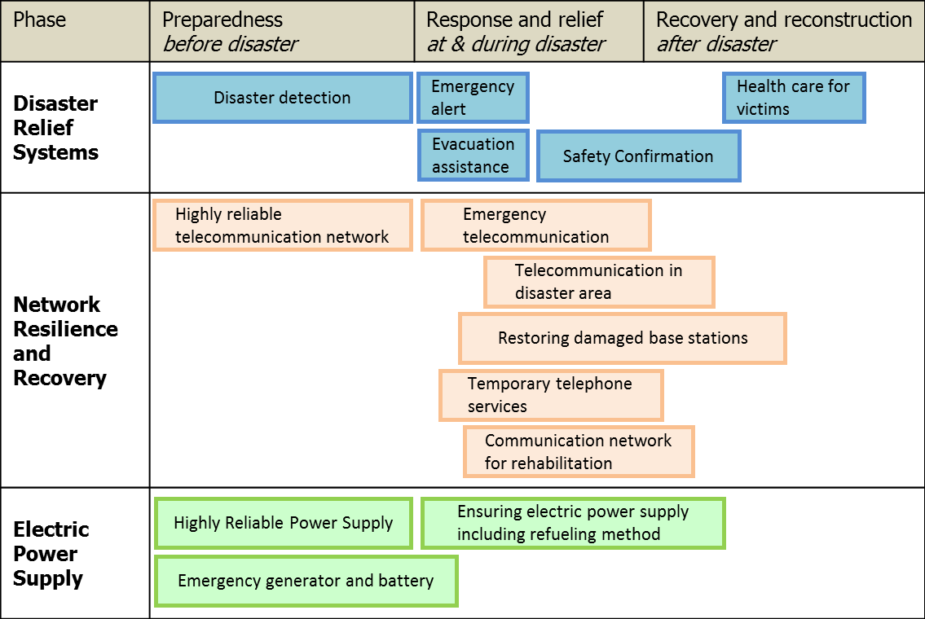
Scope of Focus Group on disaster relief systems,
network resilience and recovery (FG-DR&NRR)

Slide 9
Output of FG on disaster relief systems, network resilience and recovery
Overview (20 pages)
Terms and Definitions (13 p)
Gap Analysis (34 p)
Promising technologies and use cases (21 p + 127 p)
Requirements for Disaster Relief Systems (31 p)
Requirements for network resilience & recovery (28 p)
Requirements on the improvement of network resilience and recovery with movable and deployable ICT resource units (25 p)
Technical Report on Telecommunications and Disaster Mitigation (73 p)

Slide 10


Proposal: Emergency Communication System for
Persons with Hearing and Speaking Disabilities
Emergency call is sent to nearest fire station.
Fire station
A person with hearing and speaking disability chooses packet communication or relay service
packet communication
data center
Closed
network
Fire station
Internet
Fire station
Telephone network
relay service
telecommunication
relay service center
Fire!
Operator interprets emergency call in sign language into spoken language
10

Slide 11
Proposal: Digital Signage
Digital Signage = Information delivery display that shows local news, local public information, advertising, TV programmes and other messages.
Installed in public and semi-public areas (railway stations, hotels and corporate buildings)
Powerful way of delivering real-time disaster-related information to the general public.
1st stage approval July 2014: ITU-T H.785.0 “Digital signage: Requirements of disaster information services”
Notes:
ITU-T has already been working on the issues for disaster relief.
However, it is felt that two important areas may have not been addressed: (1) disaster relief for individuals (to notify the damage situation from victims to their relatives, friends, or employers) and (2) disaster relief guidance (to show victims the routes to evacuation shelters, home, etc.).
In addition, it was felt that the issues of network resilience and recovery of infrastructure following disasters are important and that there is need to identify all standardization requirements and issues in these areas.
Indeed large scale damage could happen on a telecommunication network by a disaster, new methods and/or new network architecture might be necessary for improving network resilience and recovery capability to cope better with a disaster. Different types of disasters may require different solutions (e.g. ad-hoc networking, delay-tolerant networking).

Slide 12
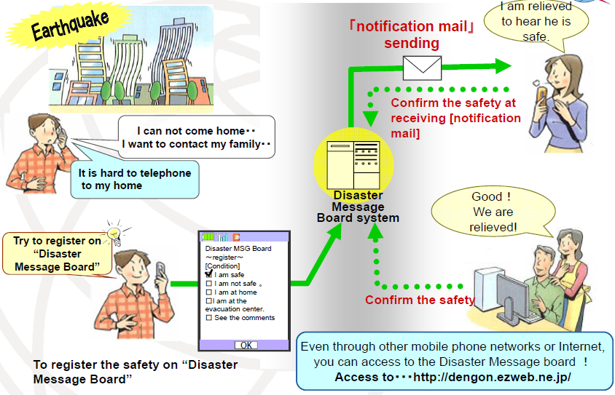
Proposal: Disaster message board service

Slide 13
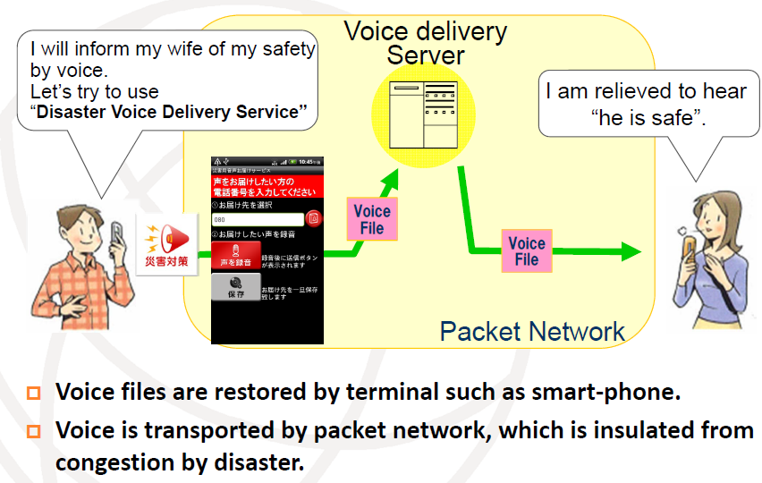
Proposal: Disaster voice delivery service

Slide 14
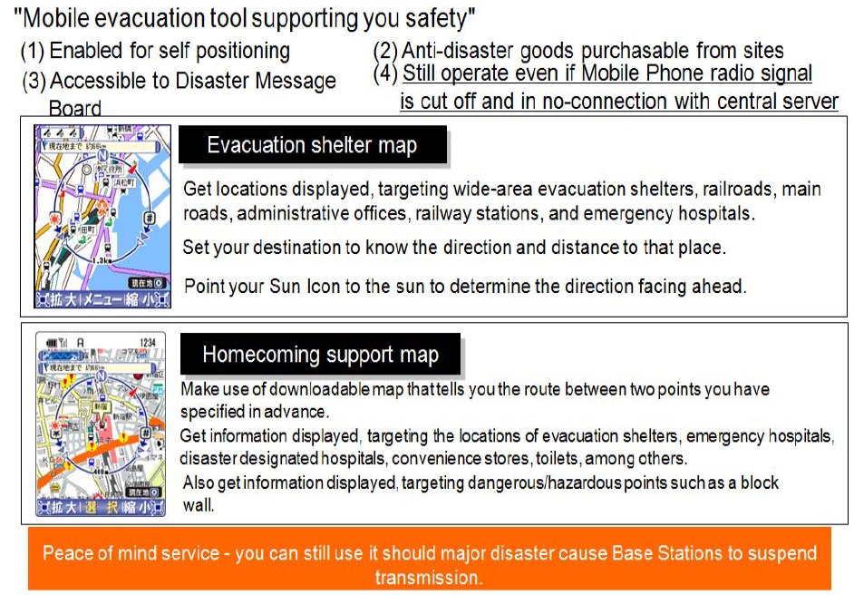
Proposal: Disaster relief by guidance

Slide 15
Proposal: Safety confirmation and broadcast message service
Hospitals, fire depts, electricity companies, telcos … need to continue operating
2-part service:
  Safety confirmation: staff confirms their safety
  Broadcast message: managers to share info with staff and dispatch available staff to work sites
Safety Confirmation and Broadcast Message Service via Cloud Computing
Notes:
ITU-T has already been working on the issues for disaster relief.
However, it is felt that two important areas may have not been addressed: (1) disaster relief for individuals (to notify the damage situation from victims to their relatives, friends, or employers) and (2) disaster relief guidance (to show victims the routes to evacuation shelters, home, etc.).
In addition, it was felt that the issues of network resilience and recovery of infrastructure following disasters are important and that there is need to identify all standardization requirements and issues in these areas.
Indeed large scale damage could happen on a telecommunication network by a disaster, new methods and/or new network architecture might be necessary for improving network resilience and recovery capability to cope better with a disaster. Different types of disasters may require different solutions (e.g. ad-hoc networking, delay-tolerant networking).

Slide 16
Proposal: Reconnecting broken optical fibre links
Underground optical cables have high survival rates after disasters
However, connections may be broken
A portable optical amplifier can connect a pair of surviving underground optical fibres
  portable burst-mode erbium-doped optical fibre amplifier (EDFA)
Notes:
ITU-T has already been working on the issues for disaster relief.
However, it is felt that two important areas may have not been addressed: (1) disaster relief for individuals (to notify the damage situation from victims to their relatives, friends, or employers) and (2) disaster relief guidance (to show victims the routes to evacuation shelters, home, etc.).
In addition, it was felt that the issues of network resilience and recovery of infrastructure following disasters are important and that there is need to identify all standardization requirements and issues in these areas.
Indeed large scale damage could happen on a telecommunication network by a disaster, new methods and/or new network architecture might be necessary for improving network resilience and recovery capability to cope better with a disaster. Different types of disasters may require different solutions (e.g. ad-hoc networking, delay-tolerant networking).

Slide 17
Proposal: disaster-resilient wireless mesh network
Consists of fixed and portable mesh relay nodes
  On top of buildings
  On the ground
Provide wireless LAN access around the nodes
WiMAX links nodes
Notes:
ITU-T has already been working on the issues for disaster relief.
However, it is felt that two important areas may have not been addressed: (1) disaster relief for individuals (to notify the damage situation from victims to their relatives, friends, or employers) and (2) disaster relief guidance (to show victims the routes to evacuation shelters, home, etc.).
In addition, it was felt that the issues of network resilience and recovery of infrastructure following disasters are important and that there is need to identify all standardization requirements and issues in these areas.
Indeed large scale damage could happen on a telecommunication network by a disaster, new methods and/or new network architecture might be necessary for improving network resilience and recovery capability to cope better with a disaster. Different types of disasters may require different solutions (e.g. ad-hoc networking, delay-tolerant networking).

Slide 18
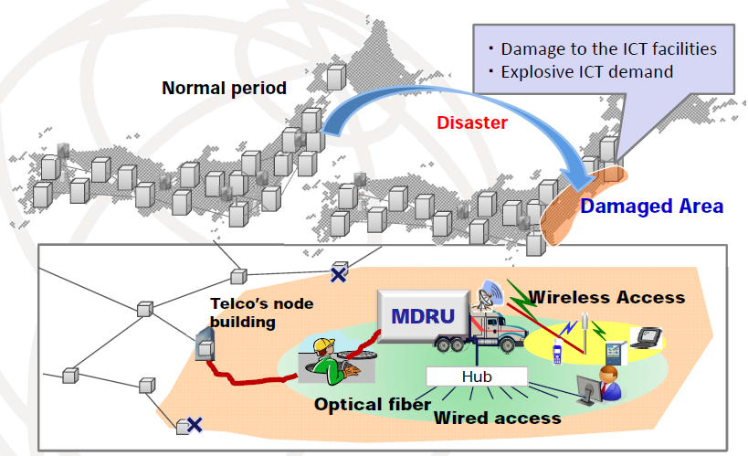
Proposal: Resilient network architecture based on
Movable and Deployable Resource Unit (MDRU)

Slide 19



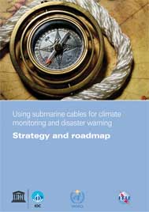


Proposal: Green cable for tsunami warnings
Joint Taskforce:
Equip submarine telecommunication cables equipped with sensors (e.g. water temperature, pressure and acceleration) on ocean floor:
  provide tsunami warnings and monitor climate change
Notes:
ITU-T has already been working on the issues for disaster relief.
However, it is felt that two important areas may have not been addressed: (1) disaster relief for individuals (to notify the damage situation from victims to their relatives, friends, or employers) and (2) disaster relief guidance (to show victims the routes to evacuation shelters, home, etc.).
In addition, it was felt that the issues of network resilience and recovery of infrastructure following disasters are important and that there is need to identify all standardization requirements and issues in these areas.
Indeed large scale damage could happen on a telecommunication network by a disaster, new methods and/or new network architecture might be necessary for improving network resilience and recovery capability to cope better with a disaster. Different types of disasters may require different solutions (e.g. ad-hoc networking, delay-tolerant networking).

Slide 20
Supplementary Slides

Slide 21
WCIT-12
ITR – International Telecommunication Regulations was revised
  Member States should encourage authorized operating agencies to inform all users, including roaming users, in good time and free of charge, of the number to be used for calls to the emergency services

Slide 22
Activities within ITU-T

Slide 23
ITU-T SG2: Emergency Telecommunications Service (ETS)
National service providing priority use of network resources to achieve a higher probability of end-to-end communication and use of applications, to ETS authorized users in times of disaster and emergencies
Recommendation ITU-T E.107 “Emergency Telecommunications Service (ETS) and interconnection framework for national implementations of ETS”
Recommendation ITU-T M.3350 “TMN service management requirements for information interchange across the TMN X-interface to support provisioning of Emergency Telecommunication Service (ETS)”

Slide 24
International Emergency Preference Scheme (IEPS)
ITU-T SG2: Recommendation ITU-T E.106 “International Emergency Preference Scheme (IEPS) for disaster relief operations”
ITU-T SG11: Supplement 53 to ITU-T Q-Series Recommendations “Signalling requirements to support the International Emergency Preferential Scheme (IEPS)”

Slide 25
ITU-T SG17: Common Alerting Protocol
Recommendation ITU-T X.1303 “Common Alerting Protocol (CAP V1.1)” and ITU-T X.1303bis: “Common alerting protocol (CAP 1.2)”
  General format for exchanging all-hazard emergency alerts and public warnings over all kinds of networks.
  Capabilities:
    flexible geographic targeting using latitude/longitude shapes and other geospatial representations in three dimensions;
    multilingual and multi-audience messaging;
    phased and delayed effective times and expirations;
    enhanced message update and cancellation features;
    template support for framing complete and effective warning messages;
    compatible with digital encryption and signature capability; and
    facility for digital images and audio.
  XML and compact binary encodings.

Slide 26
Other work within ITU-T
ITU-T SG2: Requirements for Land Mobile Alerting Broadcast Capabilities for Civic Purposes
ITU-T SG5: Guidance on ways to improve resilience of networks in case of disaster situations
ITU-T SG13: emergency telecommunications in NGN
ITU-T SG15: network resiliency and recovery
ITU-T SG16: Support of emergency alerts by IPTV and digital signage.
ITU-T SG16: Accessibility to information in emergency situations for persons with disabilities.
Notes:
Here is the list of existing related work:
ITU-T SG2 is progressing the work on Telecommunication for Disaster Relief/Early Warning as the Lead Study Group. This includes work on special treatments mainly for PSTN and other telephone systems under a crisis situation causing an increased demand for telecommunications when use of the International Telephone Service may be restricted due to damage, reduced capacity, congestion or faults. In crisis situations there is a requirement for International Emergency Preference Scheme (IEPS) users of public telecommunications to have preferential treatment. In addition, there is an activity in ITU-T SG2 defining a service entitled “Requirements for Land Mobile Alerting Broadcast Capabilities for Civic Purposes”, with an associated activity for an identification scheme for the service “Guidelines to select Message Identifiers for Land Mobile Alerting Broadcast Capabilities for Civic Purposes”.
ITU-T SG5 works on providing guidance on ways to improve resilience of networks in case of disaster situations.
ITU-T SG13 works on implementation framework related to provision of emergency telecommunications in next generation networks (including ubiquitous network environments) (Question 5/13). Recommendation ITU-T Y.2205 (Next Generation Networks - Emergency telecommunications - Technical considerations) and Y.1271 (Framework(s) on network requirements and capabilities to support emergency telecommunications over evolving circuit-switched and packet-switched networks) have been developed.
ITU-T SG15 is progressing the work on network resiliency and recovery such as network protection and restoration (e.g., in Q2/15, Q9/15 and Q17/15).
ITU-T SG16 is working on accessibility to information in emergency situations for persons with disabilities

Slide 27
ITU-T SG2: Numbers for disaster relief
Country code 888 for OCHA
  E.164 country code 888 was assigned to the United Nations Office for the Coordination of Humanitarian Affairs (OCHA)
  888 is used by terminals involved in disaster relief activities in an area of a country that has been cut off from the national telecommunications system
ITU-T E.161.1 “Guidelines to select Emergency Number for public telecommunications networks”
  Recommends use of 112 / 911
ITU-T E.123 “Notation for national and international telephone numbers, e-mail addresses and Web addresses: Contact information in case of emergency for mobile telephones” Amendment 1 – Emergency contact number notation

Slide 28
Signalling for IEPS support
ISDN User Part (ISUP)
  Q.761 Amendment 3, Q.762 Amendment 3, Q.763 Amendment 4, Q.764 Amendment 4 and Q.767 Amendment 1
Bearer Independent Call Control (BICC)
  Q.1902.1 Amendment 2, Q1902.2 Amendment 3, Q.1902.3 Amendment 3 and Q.1902.4 Amendment 3
Call Bearer Control (CBC)
  Q.1950 Amendment 1 Annex G
ATM Adaptation Layer type 2 (AAL2) signalling protocol
  Q.2630.3 Amendment 1
Broadband ISUP (B-ISUP)
  Q.2762 Amendment 1, Q.2763 Amendment 1 and Q.2764 Amendment 1
Digital Signalling System No.2 (DSS2)
  Q.2931 Amendment 5

Slide 29
IEPS call marking
ISUP & BICC
  Calling party's category - IEPS call marking for preferential call set up
  IEPS call information - country/international network of call origination and “priority level
CBC, DSS2, AAL2
  IEPS indicator

Slide 30
ETS in ITU-T H.323 systems
Recommendation ITU-T H.460.4 “Call priority designation and country/international network of call origination identification for H.323 priority calls”
  call priority parameter and country/international network of call origination parameter are transported in the H.225.0 RAS, H.225.0 Call Signalling (Q.931), Annex G/H.225.0, and H.501 messages
  Priority values: 0–emergencyAuthorised, 1–emergencyPublic. 2-High. 3-Normal
Recommendation ITU-T H.246 “Interworking of H-series multimedia terminals with H-series multimedia terminals and voice/voiceband terminals on GSTN, ISDN and PLMN” Amendment 1 “Mapping of user priority level and country/international network of call origination between H.225 and ISUP”
  mapping of the Call Priority Designation and Country/International Network of Call Origination Identification between a packet network and a switched circuit network via a Gateway.

Slide 31
Other ITU-T H.323 features
Recommendation ITU-T H.460.14 “Support for Multi-Level Precedence and Preemption (MLPP) within H.323 Systems”
Recommendation ITU-T H.460.21 “Message broadcast for H.323 systems”
  Internet multicast procedures

Slide 32
ETS in ITU-T H.248
Recommendation ITU-T H.248.1 v3 “Gateway Control Protocol version 3”
  Emergency call indicator
    Individual-to-authority communication
  IEPS call indicator
  Priority indicator
Supplement 9 to ITU-T H-Series Recommendations “Gateway Control Protocol: Operation of H.248 with H.225.0, SIP, and ISUP in Support of Emergency Telecommunications Service (ETS) / International Emergency”
  Mapping of H.248.1 IEPS call indicator and Priority indicator with H.225, SIP and ISUP parameters related to IEPS
Recommendation ITU-T H.248.44 “Gateway control protocol: Multi-Level Precedence and Pre-emption Package”

Slide 33
ETS in IPCablecom
Recommendation ITU-T J.260 “Requirements for preferential telecommunications over IPCablecom networks”
Recommendation ITU-T J.261 “Framework for implementing preferential telecommunications in IPCablecom and IPCablecom2 networks”
Recommendation ITU-T J.262 “Specifications for authentication in preferential telecommunications over IPCablecom2 networks”
  PIN + SIP authentication procedures
Recommendation ITU-T J.263 “Specification for priority in preferential telecommunications over IPCablecom2 networks”
  Resource-Priority and Accept-Resource-Priority headers (IETF RFC 4412) signal the priority in SIP request and response messages
  COPS interfaces used to perform resource management and admission control. GateSpec object specifies a session class ID with subfields to set priority and enable preemption

Slide 34
ETS in Next Generation Networks
Recommendation ITU-T Y.1271 “Framework(s) on network requirements and capabilities to support emergency communications over evolving circuit-switched and packed-switched networks”
Recommendation ITU-T Y.2205 “Next Generation Networks - Emergency Telecommunications – Technical Considerations”
Recommendation ITU-T Y.2171 “Admission control priority levels in Next Generation Networks”
  3 levels: from 1 – ETS to 3 – Lowest
Recommendation ITU-T Y.2172 “Service restoration priority levels in Next Generation Networks”

Slide 35
Emergency services for IMT-2000 networks
Supplement 47 to ITU-T Q-Series Recommendations “Emergency services for IMT-2000 networks – Requirements for harmonization and convergence”
  Emergency calls & IEPS

Slide 36
Alerting object identifier
Recommendation ITU-T X.674 “Procedures for the registration of arcs under the Alerting object identifier arc”
  enables identification of different kinds of alert and alerting agencies;
  specifies the information and justification to be provided when requesting an OID for alerting purposes; and
  the procedures for the operation of the Registration Authority.
Example: World Meteorological Organization
  {joint-iso-itu-t(2) alerting(49) wmo(0)}
  For weather alerts and weather alerting agencies
  Used with Common Alerting Protocol

Slide 37
ITU-T Recommendations under preparation
Draft new Recommendation ITU-T E.ABC “Requirements for land mobile alerting broadcast capabilities for civic purposes”
Draft new Recommendation ITU-T E.TDR “Framework for the implementation of Telecommunications for Disaster Relief (TDR)”
Draft new Recommendation ITU-T H.323 Annex M5 for the transport of ITU-T X.1303 common alerting protocol (CAP 1.1) messages

Slide 38
Proposal: Reconnecting broken optical fibre links
Underground optical cables have high survival rates after disasters
However, connections may be broken
A portable optical amplifier can connect a pair of surviving underground optical fibres
  portable burst-mode erbium-doped optical fibre amplifier (EDFA)
Notes:
ITU-T has already been working on the issues for disaster relief.
However, it is felt that two important areas may have not been addressed: (1) disaster relief for individuals (to notify the damage situation from victims to their relatives, friends, or employers) and (2) disaster relief guidance (to show victims the routes to evacuation shelters, home, etc.).
In addition, it was felt that the issues of network resilience and recovery of infrastructure following disasters are important and that there is need to identify all standardization requirements and issues in these areas.
Indeed large scale damage could happen on a telecommunication network by a disaster, new methods and/or new network architecture might be necessary for improving network resilience and recovery capability to cope better with a disaster. Different types of disasters may require different solutions (e.g. ad-hoc networking, delay-tolerant networking).

Slide 39
ITU-R: The Role of Mobile in Disaster Relief

Slide 40
ITU-R Focus on Disaster Relief
Radiocommunications Assembly 2007 (RA-07) approved Resolutions ITU-R 53 and ITU-R 55 instructing all ITU-R Study Groups to carry out studies on the use of radiocommunications in disaster prediction, detection, mitigation and relief.
In 2012 RA-12 revised and confirmed those Resolutions
WRC-12 agreed upon Agenda Item 1.3 for WRC-15: “to review and revise Resolution 646 (Rev.WRC 12) for broadband public protection and disaster relief (PPDR), in accordance with Resolution 648 (WRC-12)”. In addition, WRC-12 revised Resolutions 644, 646, and 647.
Nearly every Study Group within the ITU-R has a role to play in Disaster Relief

Slide 41
Disaster phases | Major radiocommunication services involved | Major tasks of radiocommunication services | Studies carried out by Radiocommunication
Prediction & Detection
 | Meteorological services (meteorological aids and meteorological-satellite service) Earth exploration-satellite service | Weather and climate prediction. Detection and tracking of earthquakes, tsunamis hurricanes, typhoons, forest fires, oil leaks etc. Providing warning information | Study Group 7
Alerting
 | Amateur services | Receiving and distributing alert messages | Study Group 5
 | Broadcasting services terrestrial and satellite (radio, television, etc.) | Disseminating alert messages and advice to large sections of the public | Study Group 6
 | Fixed services terrestrial and satellite | Delivering alert messages and instructions to telecommunication centres for further dissemination to public | Study Group 5 Study Group 4
 | Mobile services (land, satellite, maritime services, etc.) | Distributing alert messages and advice to individuals | Study Group 5 Study Group 4
Relief
 | Amateur services | Assisting in organizing relief operations in areas (especially when other services are still not operational) | Study Group 5
 | Broadcasting services terrestrial and satellite (radio, television, etc.) | Coordination of relief activities by disseminating information from relief planning teams to population | Study Group 6
 | Earth exploration-satellite service | Assessment of damage and providing information for planning relief activities | Study Group 7
 | Fixed services terrestrial and satellite | Exchange of information between different teams/groups for planning and coordination relief activities | Study Group 5 Study Group 4
 | Mobile services (land, satellite, maritime services, etc.) | Exchange of information between individuals and/or groups of people involved in relief activities | Study Group 5 Study Group 4

Slide 42
Activities in Working Party 5A
Land Mobile Systems above 30 MHz*(excluding IMT); wireless access in the fixed service; amateur and amateur-satellite services
Resolution ITU-R 646 (Rev.WRC-12) “Public protection and disaster relief”. This resolution provides recommendations on the use of harmonized frequency bands for PPDR applications, cross-border circulation of equipment, interoperability between agencies, the use of advanced technologies as well as encouragement to manufacturers of equipment used in PPDR to take into account the needs of administrations and PPDR agencies.
In Resolution 644 (Rev. WRC-12), the ITU-R was asked to study those aspects of Radiocommunications/ICT that are relevant to early warning, disaster mitigation and relief operations; while the ITU- R Study Groups were asked to accelerate their work, particularly in the areas of disaster prediction, detection, mitigation and relief.

Slide 43
Activities in Working Party 5A
Land Mobile Systems above 30 MHz*(excluding IMT); wireless access in the fixed service; amateur and amateur-satellite services
In Resolution 647 (Rev.WRC-12), the ITU-R was invited to conduct studies in support of the establishment of appropriate spectrum management guidelines applicable in emergency and disaster relief operations.
WRC-12 agreed upon Agenda Item 1.3 for WRC-15: “to review and revise Resolution 646 (Rev.WRC 12) for broadband public protection and disaster relief (PPDR), in accordance with Resolution 648 (WRC-12)”.
Recommendation ITU-R M.1042 “Disaster communications in the amateur and amateur-satellite services” provides guidance on the roles of the amateur and amateur satellite services in providing communications during disaster situations.

Slide 44
Activities in Working Party 5A
Land Mobile Systems above 30 MHz*(excluding IMT); wireless access in the fixed service; amateur and amateur-satellite services
Report ITU-R M.2085 “Role of the amateur and amateur-satellite services in support of disaster mitigation and relief” is intended to document the role of the amateur and amateur-satellite services in provision of radiocommunications in support of disaster mitigation and relief. It includes information developed after the South-East Asia tsunami in December 2004.
Recommendation ITU-R M.1637 “Global cross-border circulation of radiocommunication equipment in emergency and disaster relief situations” offers guidance to facilitate the global circulation of radiocommunication equipment in emergency and disaster relief situations including the need for plans and procedures to be in place before a possible disaster event in order to facilitate the speedy authorization of the use of such equipment.

Slide 45
Activities in Working Party 5A
Land Mobile Systems above 30 MHz*(excluding IMT); wireless access in the fixed service; amateur and amateur-satellite services
Report ITU-R M.2033 “Radiocommunication objectives and requirements for Public Protection and Disaster Relief (PPDR)” defines the PPDR objectives and requirements for the implementation of future advanced solutions to satisfy the operational needs of PPDR organizations around the year 2010. Specifically, it identifies objectives, applications, requirements, a methodology for spectrum calculations, spectrum requirements and solutions for interoperability.
Recommendation ITU-R M.2015 “Frequency arrangements for public protection and disaster relief radiocommunication systems in UHF bands in accordance with Resolution 646 (Rev.WRC‑12)” provides guidance on frequency arrangements for public protection and disaster relief radiocommunications in certain regions in some of the bands below 1 GHz identified in Resolution 646 (Rev.WRC-12).

Slide 46
Activities in Working Party 5A
Land Mobile Systems above 30 MHz*(excluding IMT); wireless access in the fixed service; amateur and amateur-satellite services
Recommendation ITU-R M.2009 “Radio interface standards for use by public protection and disaster relief operations in some parts of the UHF band in accordance with Resolution 646 (WRC‑03)” identifies radio interface standards applicable for public protection and disaster relief (PPDR) operations in some parts of the UHF band.
Recommendation ITU-R M.1826 addresses harmonized frequency channel plans in the band 4 940‑4 990 MHz for broadband public protection and disaster relief radiocommunications in Regions 2 and 3.
Recommendation ITU-R M.1746 addresses system interoperability and harmonized frequency channel plans for the protection of property using data communication.

