Slide 1
Document No: | GSC-21_0xx
Source: | IEC
Contact: | Frans Vreeswijk
Agenda Item: | 2.05
IEC Priorities
Frans Vreeswijk
General Secretary & CEO
26-27 September 2017
HOSTED BY

Slide 2
IEC in Figures (2017)
World’s leading provider of International Standards and Conformity Assessment Systems in Electrotechnology
83 Members
87 Affiliates
216 Committees
20 000 Experts
10 000 International Standards
4 Conformity Assessment Systems
1 million Certificates issued

Slide 3
Recent Achievements
New Technical Activities
TC 123 (Management of Assets in Power Systems)
TC 124 (Wearable Electronic Devices and Technologies)
SyC LVDC (Low Voltage Direct Current and Low Voltage Direct Current for Electricity Access)
Review of Systems Activities
Better description of content and nature of SyC deliverables
New deliverables, processes and categories of membership for SyCs
Increased outreach and cooperation with other SDOs and consortia
Future Standards Development and Business Platform under development

Slide 4
Development of New Masterplan
Strategy Document to provide guidance and direction to the work of IEC Management Boards, National Committees, Technical Committees and IEC Central Office
Wide ranging and inclusive consultations started in 2016
Redefinition of Mission, Vision, Values
Development of 4 Strategic Themes (market and societal relevance, sustainable business model, flexible organization, agile operations)
Strong focus on stakeholder engagement and collaboration with other SDOs and consortia
Adopted in September 2017, Implementation plan under development

Slide 5
Standardization Evaluation Groups (SEGs)
SEG 8 – Communication Technologies and Architectures of Electrotechnical Systems
SEG 9 – Smart Home/Office Building Systems
Identify new technical areas and anticipate emerging technology and market trends that might impact the activities of IEC committees
Disseminate knowledge across IEC and foster collaboration among IEC committees
Act as IEC central point for spectrum related issues
www.iec.ch/seg8
Evaluate technology and market evolution trends
Review existing standards and standardization projects within and outside IEC and identify and prioritize gaps and opportunities
Recommend to SMB the structure most appropriate for standardization of smart homes and buildings
www.iec.ch/seg9
Participation in SEGs is open to all experts from within and outside IEC community

Slide 6
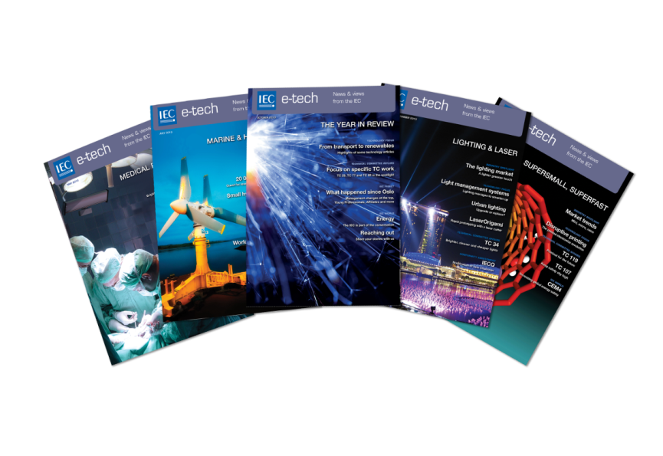
Involvement in JTC 1
IEC collaborates very closely with ISO to ensure JTC 1 plays a leading role in international IT standardization
Administrative support of newly created SC 41 (IoT and related technologies)
Active participation in emerging standardization activities (e.g. JTC 1 Emerging Technology & Innovations, SG 3 on 3D Printing & Scanning)
Strong pipeline of marketing and communication activities to promote JTC 1 (e.g. IEC e-tech)

Slide 7
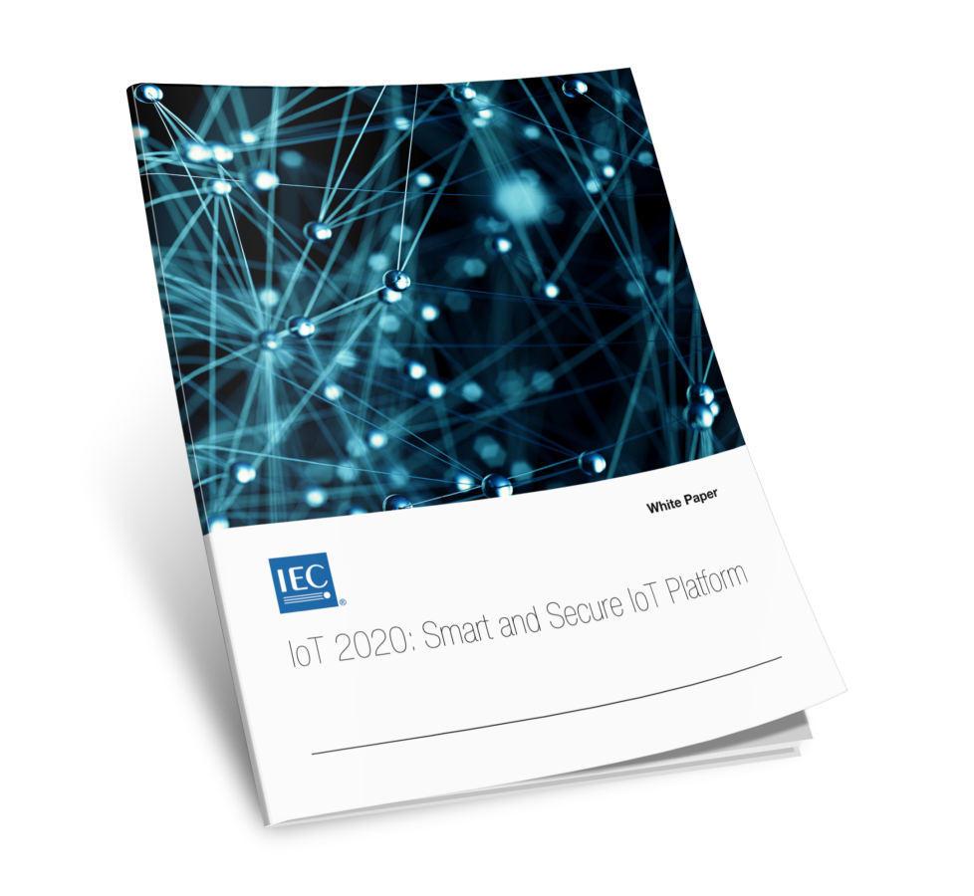
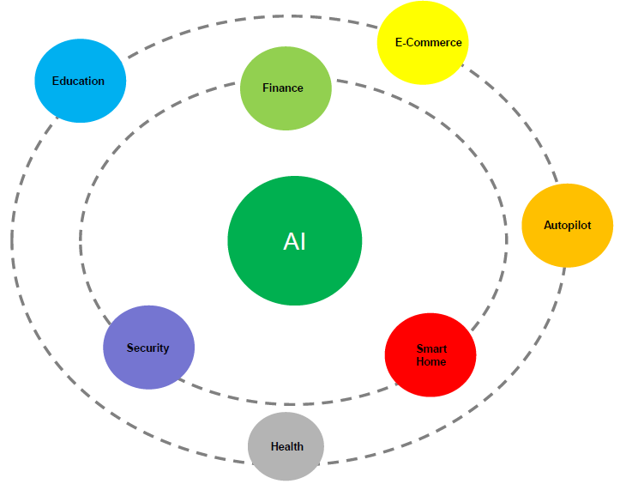
Market Strategy Board (MSB) Activities
MSB identifies strategic technology directions and market needs in the IEC’s area of activity
It consists of 15 executive level technology officers and publishes 1 to 2 white papers annually
Vertical Edge Intelligence white paper to be released during IEC GM (PL: Huawei)
New white paper on Application of Artificial Intelligence across Vertical Industries planned for mid 2018 (PL: Haier)

Slide 8
Thank you
For more information, please contact: Frans Vreeswijk
frvr@iec.ch
Affiliation Name: IEC
www.iec.ch

