Slide 1
Document No: | GSC-21_040
Source: | ATIS
Contact: | Susan Miller, ATIS
Agenda Item: | 2.02
ATIS Priorities and Initiatives
Susan Miller, President & CEO, ATIS
26-27 September 2017
HOSTED BY

Slide 2
Advancing the Information and Communications Industry Transformation
In a rapidly changing industry, innovation needs a home. ATIS is where technology companies convene to find solutions to their most pressing shared challenges.

Slide 3
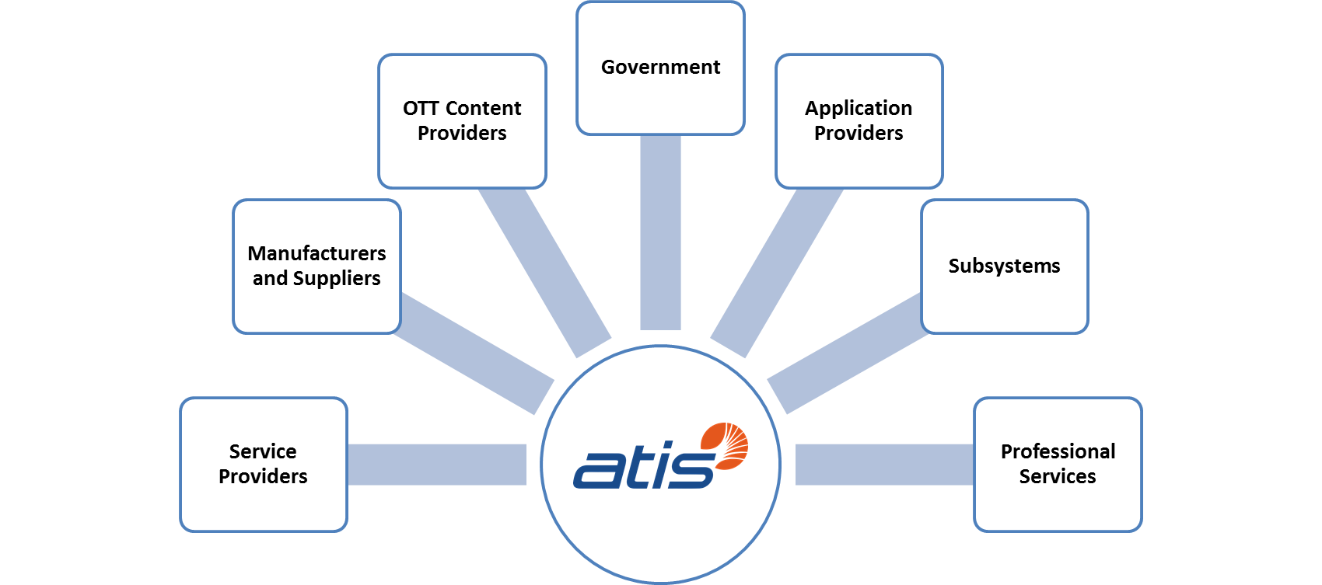
ATIS - The Entire ICT Ecosystem

Slide 4
The ATIS Landscape
Innovation Agenda (2-5 years)
Standards/ Solutions (perpetual)
TOPS Council (near-term to 2 years)
The Innovation Agenda: Identifies forward-looking business and technology opportunities and collaboration with other industries
The TOPS Council: Addresses potential implementation challenges and promotes widespread adoption of new technologies
Standards/Solutions: Develops broad industry and core network solutions to ensure interworking across the ICT industry

Slide 5
ATIS’ Innovation Agenda
Innovation Topic | Summary
Smart Cities* | Technology Roadmap was published in May 2017: includes a technology framework, an assessment of key technology enablers and an analysis applied to city application sectors Phase II addressing Smart City data sharing frameworks
Connected Car – Cybersecurity* | Improving Vehicle Cybersecurity: ICT Industry Experience and Perspectives published in August 2017; will foster dialog with the automotive industry
Evolution of Content Optimized Networks | Developed use cases to evaluate information-centric networking (ICN) with respect to IP-based solutions to assess incremental value: (1) augmented reality; (2) more efficient video delivery; (3) multi-access collaboration; and (4) Smart Mobility IoT applications Findings to be published in 3Q 2017 as part of a Phase II eCON Report
Unmanned Aerial Vehicles | Unmanned Aerial Vehicles Utilization of Cellular Services: Enabling Scalable and Safe Operations released in September 2017 Next steps will be to evaluate the scope of work for Phase II
5G | Optimizing User Experience in 5G report to be published in October 2017 Published two white papers capturing North American perspective and disruptive use cases
Cybersecurity | Published two white papers in May 2017 addressing IoT Security and Architecture Risk
Launching | Next Gen Identity Management and Artificial Intelligence
* To be presented in more detail in ATIS’ strategic topic presentations

Slide 6
Evolution to Content Optimized Networks
eCON is focused on the evolution path to ICN-based solutions.
Phase 1 Report (released in early 2017) is a comprehensive assessment of market and technology drivers, early trials, standards and deployment scenarios.
Phase II work (underway) will provide a detailed comparative assessment of IP and ICN solutions to key use cases:
Augmented and virtual reality
Video delivery
IoT (Smart Mobility)

Slide 7
Unmanned Aerial Vehicles
UAVs, or "drone" technology, is advancing to provide a diverse set of applications.
ATIS’ UAV initiative defines how to advance this technology for market introduction and develop consensus industry positions to educate regulatory and legislative audiences.
Focus on Low Altitude UAVs for near term applications (recovery, reconnaissance, etc.).
Providing cellular communications to and from drones is a key work area; Next phase “CoWs” – Cells on Wings.
Coordination with government agencies and adjoining industries.

Slide 8
5G
Developed high-level use cases from users’ perspective to identify key high-level requirements for standardization.
White papers providing North American perspective include:
5G Reimagined: A North American Perspective, concisely captures the North American vision and goals for 5G (released in 1Q 2017).
Network aspects of Optimized User Experience (OUx), explores new service concepts and technical approaches to enhance services and operations (planned for October 2017).
Subscriptionless Devices and Services in Service Provider Networks, investigates new architectural models that can be applied to enhance IoT network solutions (planned for end of 2017).

Slide 9
Cybersecurity
Broad effort focused on enhancing security capabilities for service provider networks and services.
Developed white papers addressing key security concerns:
Architectural Risk Analysis (ARA) Process, defining overall process designed to evaluate security risks and mitigations in network architectures.
Securing Internet of Things (IoT) Services Involving Network Operators, identifying relationships and levels of partnering between a network operator and an IoT service provider.
Current activity includes an Architectural Risk Analysis for IoT Services.

Slide 10
ATIS Strategic Initiatives
Solving technical and operational challenges…
Calling Party Anti-Spoofing
oneM2M Open Source Community
Wi-Fi Emergency Calling
Neutral Host
Intelligent Programmatic Peering
Testbeds
NFV Characterization and Capacity Planning
Open Source IoT
Reliability Implications of Emerging Technologies

Slide 11
ATIS Solutions/Standards
Leading the industry to solve complex issues, including:
Robocalling
Top industry and gov’t priority
Partnership with SIP Forum to develop SHAKEN
Emergency Services
Wireless Emergency Alerts
Real-Time Text
Synchronization
GPS vulnerability and alternatives
Location Accuracy
Earthquake Early Warning
Builds on ATIS Anti-Spoofing report
Time & Money workshops for financial markets
Annual Workshop on Sync and Timing Systems

Slide 12
In Closing…
…thank you for your time and attention.
For additional information, please visit:
ATIS | www.atis.org
ATIS White Papers | http://www.atis.org/whitepapers

