Slide 1
Document No: | GSC-21_007
Source: | IEEE Standards Association
Contact: | Rudi Schubert
Agenda Item: | 3.05
IEEE Initiatives in Artificial Intelligence and Autonomous Systems
Rudi Schubert, Director – New Initiatives IEEE Standards Association
26-27 September 2017
HOSTED BY

Slide 2
IEEE Initiatives in Artificial Intelligence and Autonomous Systems
Intersection of technology, policy and standards
An emphasis subject for IEEE Standards Association (IEEE-SA)
Brief overview on Ethics Initiative, Digital Trust & Identity, Internet Initiative
IEEE Global Initiative for Ethical Considerations in Artificial Intelligence and Autonomous Systems
Ethically Aligned Design; Global Engagement; Standards Projects
Portfolio of standards working groups are underway – IEEE P7000™ Series
Applications in Autonomous Systems
Focus on technology enablement of connected cars and autonomous vehicles

Slide 3
IEEE-SA and Technology Policy
Technology Policy = one of four IEEE 2015-2020 Goals:
Leverage IEEE’s technology-related insight to provide governments, NGOs and other organizations, and the public with innovative and practical recommendations to address public policy issues
Connect technologists with policy makers/venues to amplify the voice of the technical standards community
Working at the intersection of technology and policy to advocate for and inform policy makers and other stakeholders about the IEEE standards development paradigm of collaborative, bottom up, technical, consensus-based open standards development
Facilitate and promote technology policy environments that promote open, inclusive and transparent standards development
Goal is to foster global competition, provide building blocks for innovation, enable global interoperability, scalability, stability and resiliency, and contribute to the creation of global communities that advance technology to benefit humanity.
Develop and advocate contributions, positions and policies that promote best practices for open consensus and collaborative activities, including global standards and open participation

Slide 4
Trust: Digital Inclusion, Digital Identity & AS/AI
Integrated approach
Trust
Digital Inclusion
Artificial Intelligence
Autonomous Systems
Digital Identity
Internet Inclusion
Optimizing the relationship & work of initiatives & programs
Global Initiative on the Ethical Considerations in the Design of Autonomous Systems IC
Digital Inclusion through Trust and Agency IC
IEEE Internet Initiative/Internet Inclusion
Encouraging privacy & ethical responsibility in technology development & use
Educating & informing developers & users
Identifying opportunities for technical oriented outputs that support interoperability & trustworthy solutions and models
Advocating for & bolstering collective action for a trust agenda

Slide 6
Overview
Discussions / Ad Hoc Work begun in late 2015
Public launch as an Industry Connections Group, April 2016
Currently more than 200 AI / Ethics experts involved from the US, EU, Australia, India, China, Korea, and Japan
13 Committees creating content plus groups supporting outreach, visibility, etc.
Actively working on Ethically Aligned Design, version 2
Eleven approved Standards Working Groups so far
Events featuring Ethically Aligned Design in India, Japan, China, World Economic Forum, EU Parliament, and UN/ITU in Geneva

Slide 7
Mandate
Create “Ethically-aligned” autonomous and intelligent systems:
Incorporate ethical aspects of human wellbeing that may not automatically be considered in the current design and manufacture of AIS technologies
To reframe the notion of success so human progress can include the intentional prioritization of individual, community, and societal ethical values

Slide 8
Ethically Aligned Design
A Vision for Prioritizing Human Wellbeing with Artificial Intelligence and Autonomous Systems

Slide 9
IEEE P7000™ Series Standards Projects
IEEE P7000™: Model Process for Addressing Ethical Concerns During System Design
IEEE P7001™: Transparency of Autonomous Systems
IEEE P7002™: Data Privacy Process
IEEE P7003™: Algorithmic Bias Considerations
IEEE P7004™: Standard on Child and Student Data Governance
IEEE P7005™: Standard on Employer Data Governance
IEEE P7006™: Standard on Personal Data AI Agent Working Group
IEEE P7007™: Ontological Standard for Ethically driven Robotics and Automation Systems
IEEE P7008™: Standard for Ethically Driven Nudging for Robotic, Intelligent and Autonomous Systems
IEEE P7009™: Standard for Fail-Safe Design of Autonomous and Semi-Autonomous Systems
IEEE P7010™: Wellbeing Metrics Standard for Ethical Artificial Intelligence and Autonomous Systems

Slide 10
Media Coverage

Slide 11
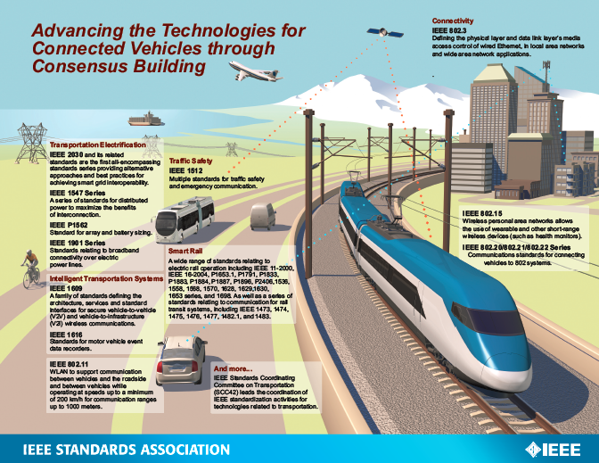

Slide 12
Digital Inclusion through Trust and Agency Industry Connections Program
INDUSTRY CHALLENGE
A clear and imminent threat to the security to everyone’s (already online and those coming online) digital identity within the digital universe
Lack of industry-recognized definition for ”what is digital identity.”
The Desired Outcome via the Industry Connections Program
Developing a framework for placing parameters on different “priority” levels of digital identity
Trust and Agency – Using the “Digital Identity Framework Discussion” as a roadmap combined with the robustness of distributed ledger and other emerging technologies that provide a platform to support the digital citizen self-managing their data with the desired outcomes
The ability to be forgotten online and offline
Having the option with which (entity) to transact
Protecting and securing one’s data
Developing frameworks that equally benefit the privileged and the underserved

Slide 13
IEEE-SA: Intersection of Technology & Policy
Trust
Digital Inclusion
Artificial Intelligence
Autonomous Systems
Digital Identity
Internet Inclusion

Slide 14
Thank you
For more information, please contact:
Rudi Schubert
r.schubert@ieee.org
Affiliation Name:
IEEE-SA
standards.ieee.org

