Slide 1



Document No: | GSC-21_015
Source: | ATIS
Contact: | Michael Nawrocki, ATIS
Agenda Item: | 3.01
ATIS Initiatives in Support
of Artificial Intelligence and Autonomous Systems
Michael Nawrocki,
Vice President of Technology and Solutions
ATIS
26-27 September 2017
HOSTED BY

Slide 2
Background
ATIS identified the need to spearhead direct industry-to-industry dialog with vehicle OEMs to improve cybersecurity.
Connected Car-Cybersecurity initiative was launched in June 2016.
ATIS joined the Automotive Information Sharing and Analysis Center (Auto-ISAC, managed by Booz Allen) as a strategic partner.
Objective is to leverage ICT leadership in state-of-art cyber development and standards and begin an industry-to-industry dialog with the OEMs to:
  Provide enhanced security for connected vehicles
  Identify ICT industry opportunities
  Supplement company to company dialogs

Slide 3
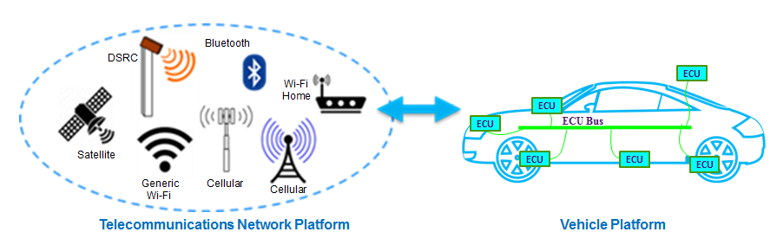
Industry Platform-to-Platform Collaboration

Slide 4
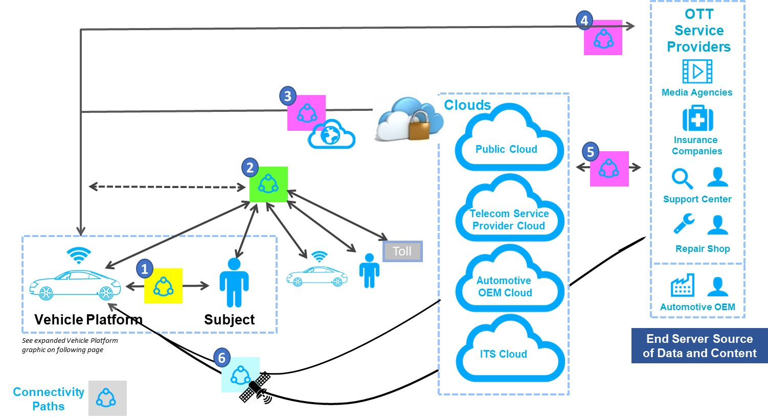
Connectivity Paths

Slide 5
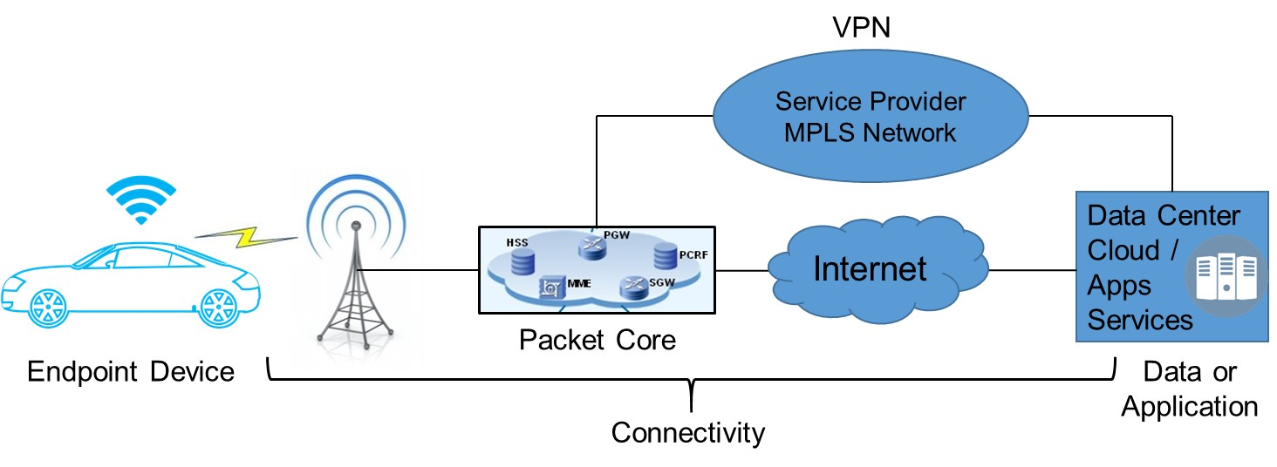
Security Framework

Slide 6
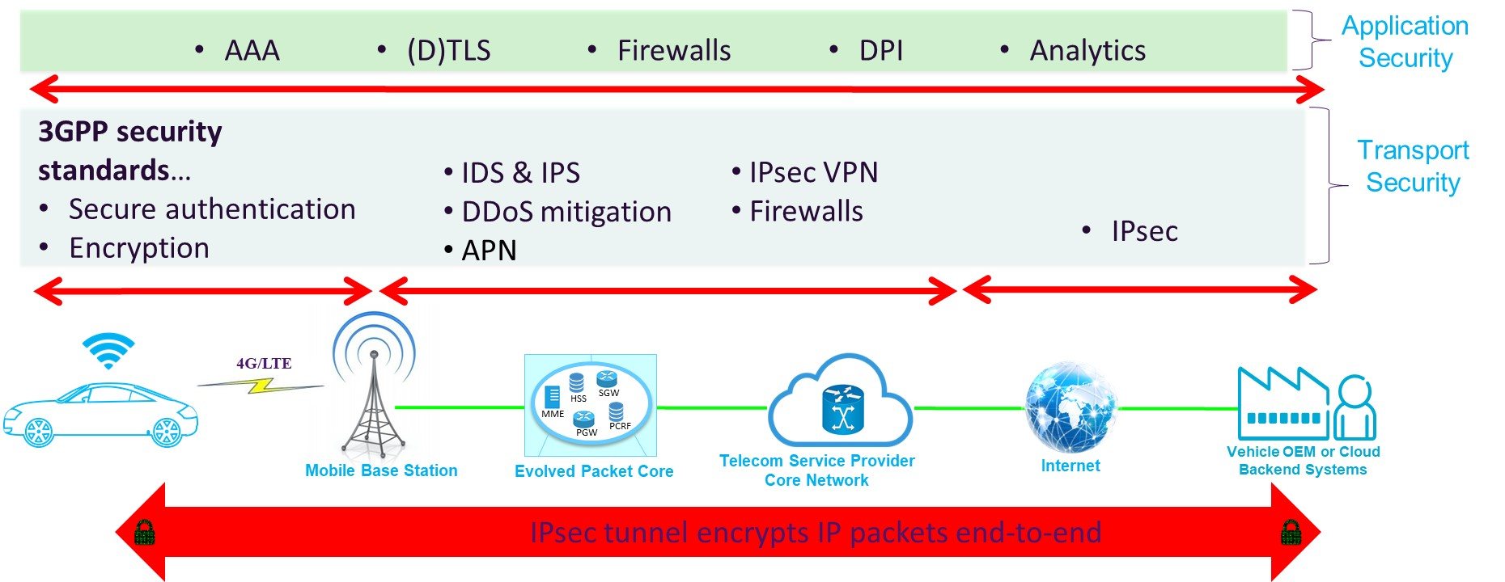
Layered Security Model

Slide 7
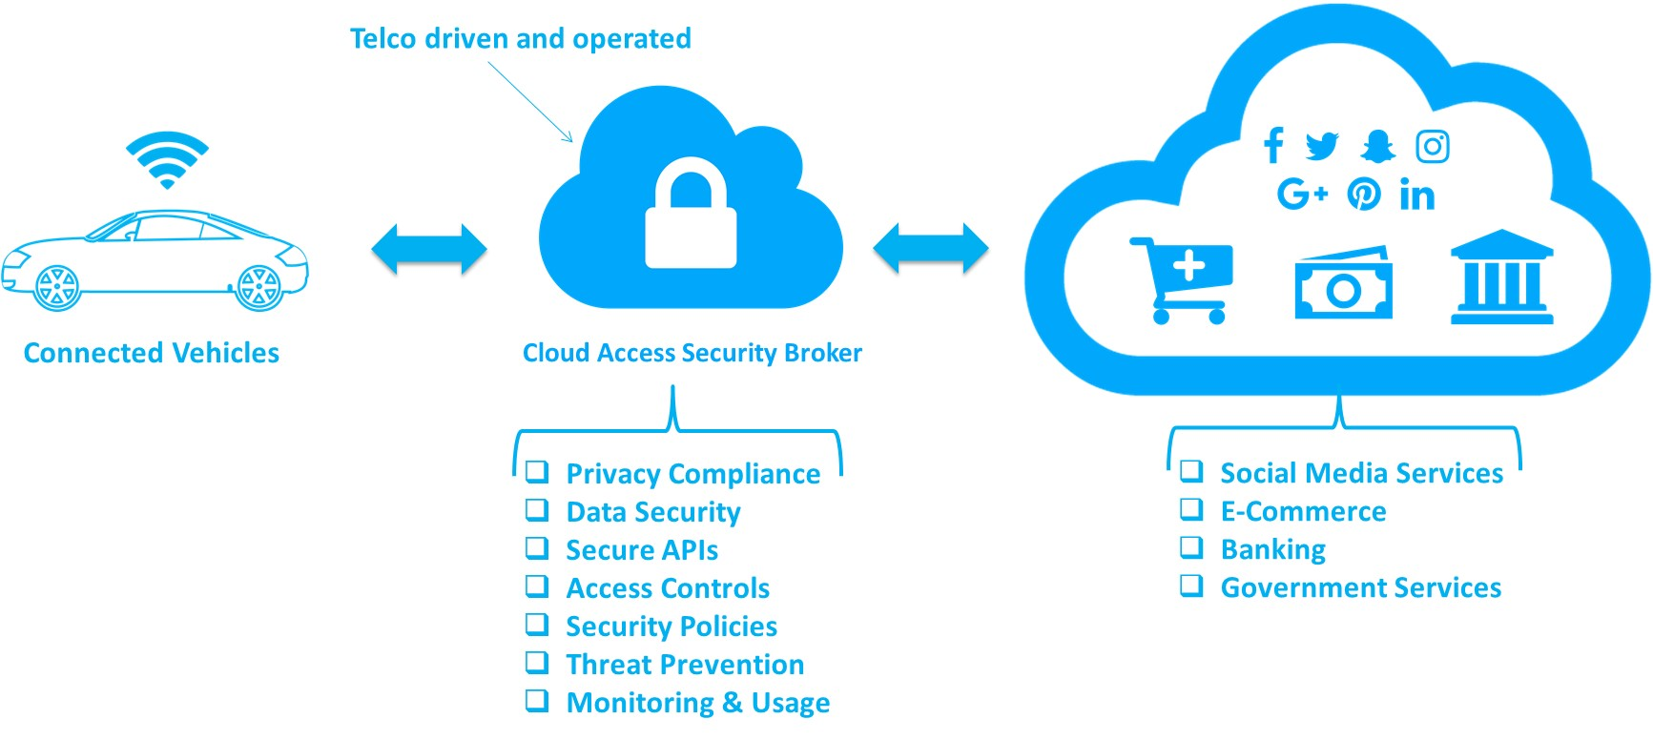
Cloud Access Security Broker

Slide 8
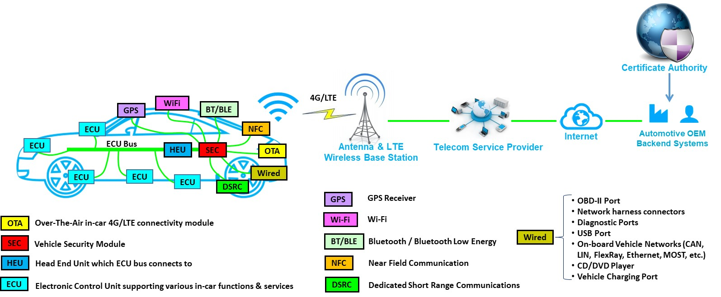
Potential Work Item:
Centralized In-Vehicle Security Model

Slide 9
Conclusion
White paper published Aug 2017
  Significant interest in this Report across industry segments
  Communicates the complexity surrounding connected car cybersecurity
  Establishes the foundation for continued engagement on this topic
Identified potential topics for industry-to-industry collaboration
  Potential topics range from in-network security approaches to vehicular-based solutions
  Cooperation between industries can open up additional opportunities
Goal is to continue collaboration with Auto-ISAC

Slide 10
Thank you
For more information, please contact:
Michael Nawrocki, ATIS
mnawrocki@atis.org
ATIS:
www.atis.org

