Slide 1


Document No: | GSC-21_021
Source: | International Telecommunication Union
Contact: | Bruce Gracie
Agenda Item: | 3.07
Briefing on AI for Good
Global Summit
26-27 September 2017
HOSTED BY

Slide 2
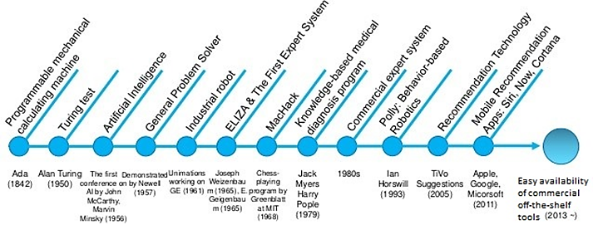
AI Timeline: AI is not new
http://www.slideshare.net/kepark07/ai-history-tomlearning
  1997: IBM’s Deep Blue beats chess world champion Kasparov
  2009: discovery that GPUs (graphical processing units in video games) are well suited for running deep-learning algorithms
  2012: Breakthrough at ImageNet Challenge
  2016: Google’s AlphaGo beats world class Go player - Mr Lee Sedol

Slide 3

AI can help solve humanity’s grandest challenges
Notes:
Example:
Combining statistics, mobile, and internet data to provide a better real time understanding of the connected world and interdependencies between SDGs

Slide 4
Every government, every company,
every academic institution and every one of us should consider how AI will affect our future.
Notes:
This is something that concerns everyone: Industry, governments, academia and people of all backgrounds and not just 25 year old, male programmers.
AI experts stress that discussions around AI’s implications for society should not be confined to specialists.

Slide 5
A multi-stakeholder approach…
Government
Industry
UN Agencies
Civil Society
International
Organizations
Academia
Notes:
What we need is a multistakholder, global approach that involves all voices.
Government, industry, academia and civil society need to work together to mitigate the risks posed by AI, ensuring that AI benefits all of humanity.
Discussions should not be confined to AI specialists and programmers…

Slide 6


AI for GOOD GLOBAL SUMMIT
7-9 June 2017, Geneva
organized by
In partnership with 20 UN agencies
Notes:
So you’re probably asking why ITU?
First of all its important to say we can’t do this alone which why we are here today.
At this point in time we have 10 confirmed UN partners.
Through this journey we have seen many of our partners are using AI or thinking of using AI
Data is the fuel of AI and the UN is one of the richest sources of data in the world.
This is a chance to show that the UN isn’t lagging behind but ahead of the curve on using Ai for good.
Each agency has their own reason for joining and will be heavily involved in the sessions.
Later in the Q&A I hope to hear from some examples in the audience as some of our partners are here today.

Slide 7
Promote dialogue on safe, ethical and equitable development of AI for all segments of society
Notes:
Simply put: The goal of the Summit is to help ensure safe, ethical, equitable and beneficial development of AI for all segments of society
More specifically the event will aim to identify and propose near-term, practical applications of AI SDGs leading to an AI road-map

Slide 8




















20 partnered UN agencies + ITU

Slide 9











Breakthrough Sessions – the heart of “AI for Good”
Enhancing Privacy and Security
Investing for Impact with AI
Education
Ending Hunger
Equality in AI
Roadmap for Collaboration
AI for
Prosperity
Al KPIs
for success
Impact on work
Promoting
healthier citizens
Smart cities
and communities

Slide 10
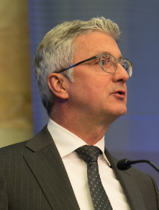
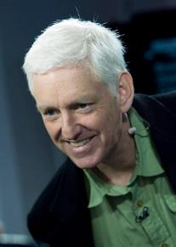
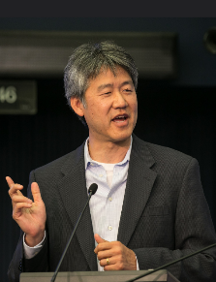
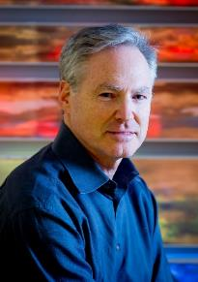
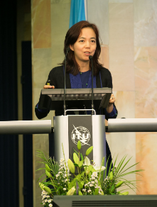
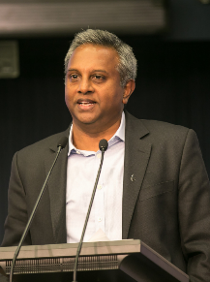
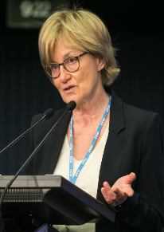
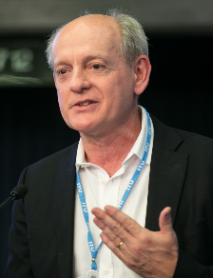
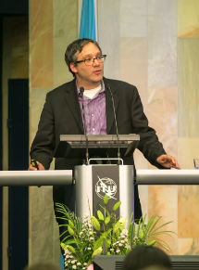
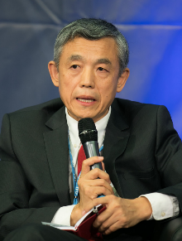
Industry and Academic Experts
Rupert Stadler, Audi AG
Peter Lee, Microsoft
Eric Horvitz, Microsoft
Fei-Fei Li, Google & Stanford University
Peter Norvig, Google
Salil Shetty, Amnesty International
Mady Delvaux-Stehres, European Parliament
Stuart Russell, University of California - Berkeley
Lan Xue, Tsinghua University
Gary Marcus, New York University

Slide 11
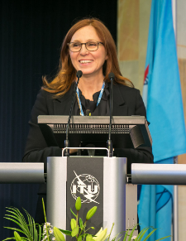
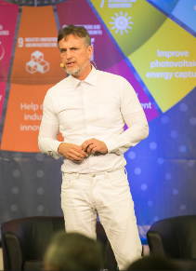
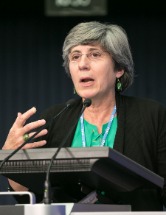
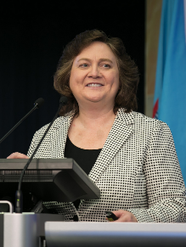
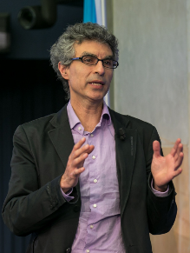
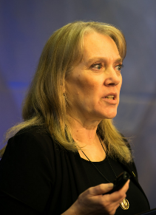
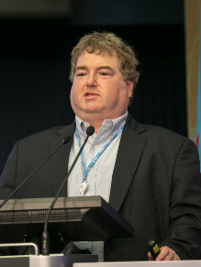

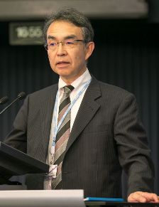
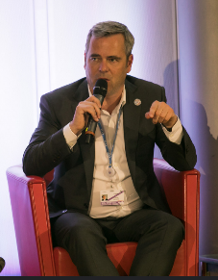
Industry and Academic Experts
Francesca Rossi, IBM Watson
Jürgen Schmidhuber, Swiss AI Lab
Manuela Veloso, Carnegie Mellon University
Lynne Parker, University of Tennessee-Knoxville
Yoshua Bengio, University of Montreal
Pedro Dominigos, University of Washington
Katsumi Emura, Japan Industrialization Roadmap Task Force
Vicki Hanson, ACM
Joseph Konstan, University of Minnesota
Thomas Wiegand, TU Berlin

Slide 12


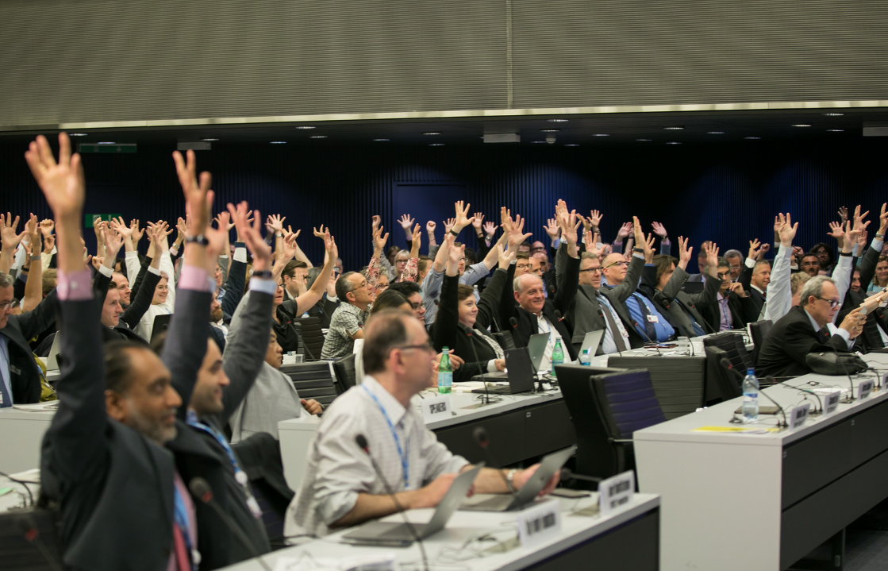
Any questions?

Slide 13
Thank you
For more information, please contact: ai@itu.int

