Slide 1
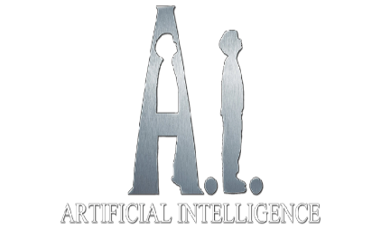
Document No: | GSC-21_024
Source: | ISO/IEC JTC1
Contact: | Yi Zhao
Agenda Item: | 3.04
Artificial Intelligence and Autonomous Systems
Yi Zhao, PhD
ISO/IEC JTC 1 JETI
Huawei Technologies
26-27 September 2017
HOSTED BY

Slide 2
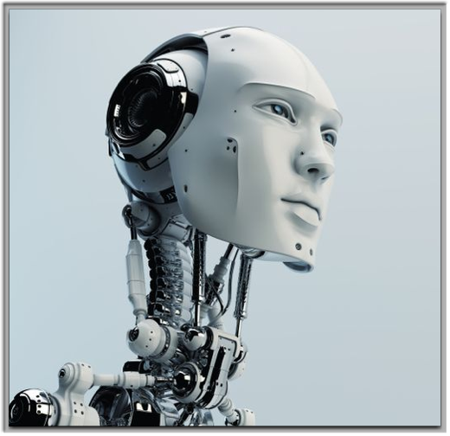
Table of Contents
Prologue
AI in JTC 1
Why Standardization?
New AI Initiatives in JTC 1
Relevant Activities
AI in Huawei

Slide 3
Artificial Intelligence
not a new term …

Slide 4
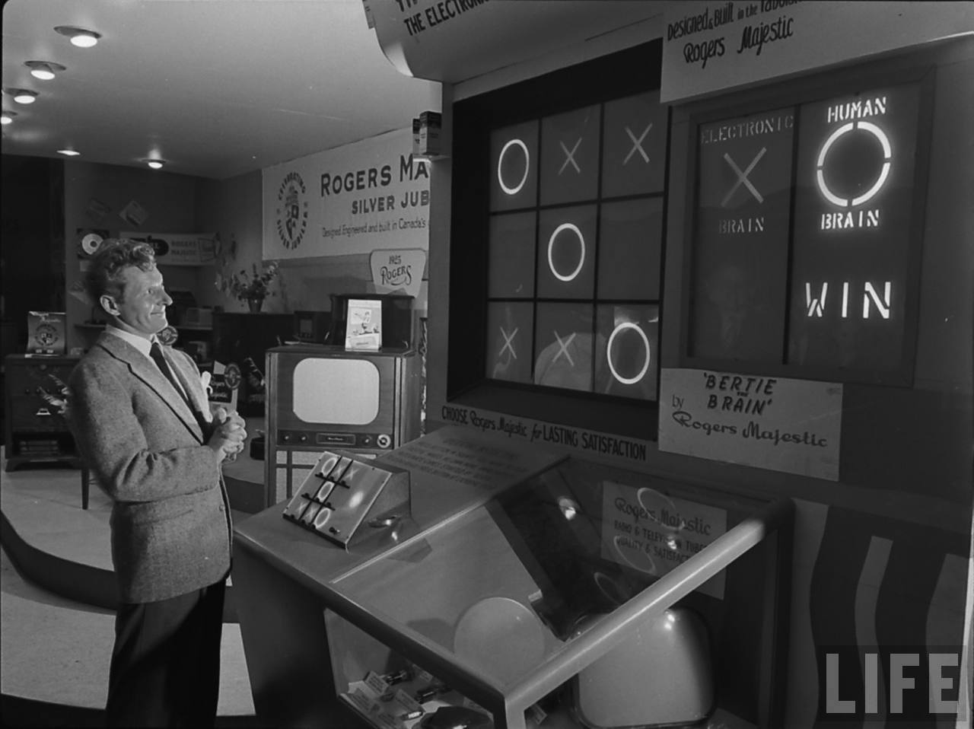
Artificial Intelligence in 1950

Slide 5
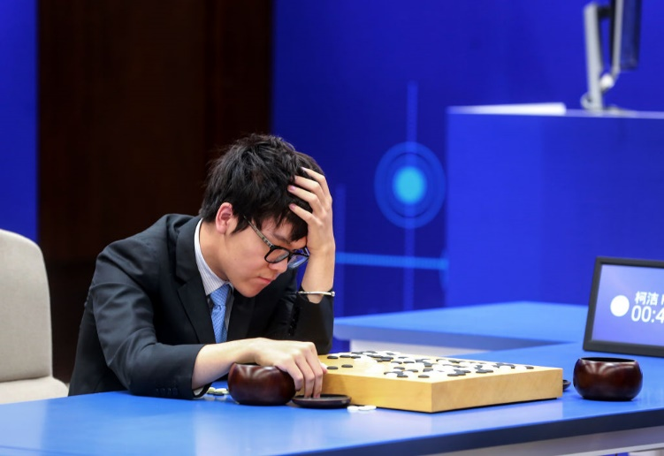
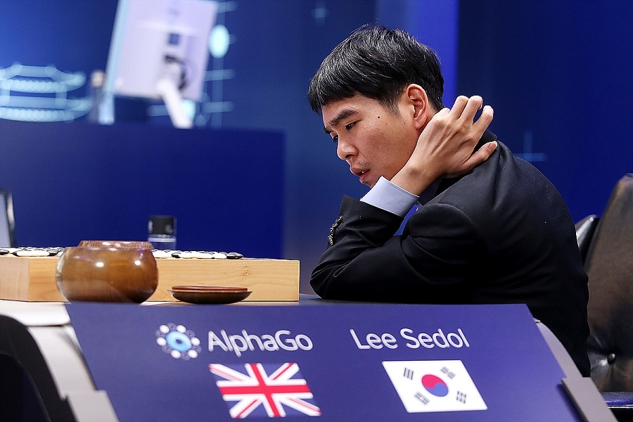
Artificial Intelligence in 2016 - 2017

Slide 6
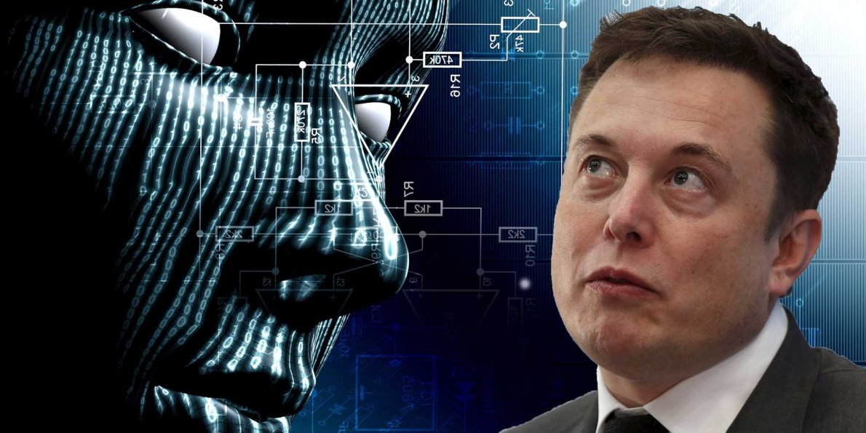
Elon Musk says:
Artificial Intelligence is like Summoning the Demon

Slide 7
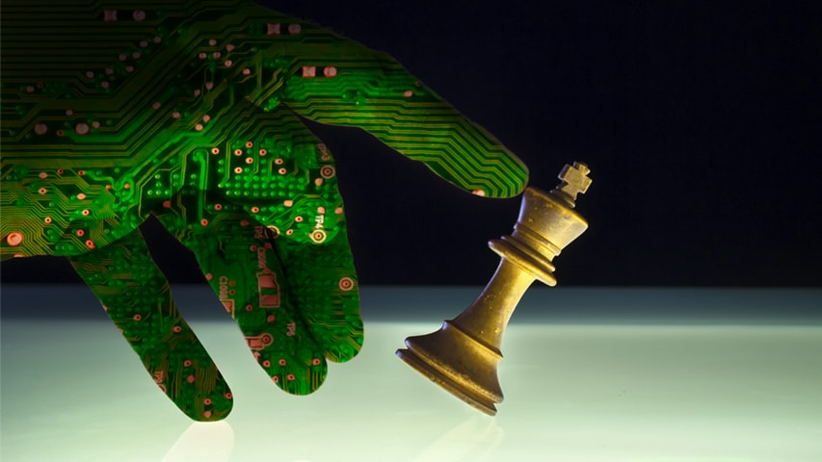
Carnegie Mellon Receives $10 Million From K&L Gates To Study Ethical Issues Posed by Artificial Intelligence
(November 01, 2016)

Slide 8
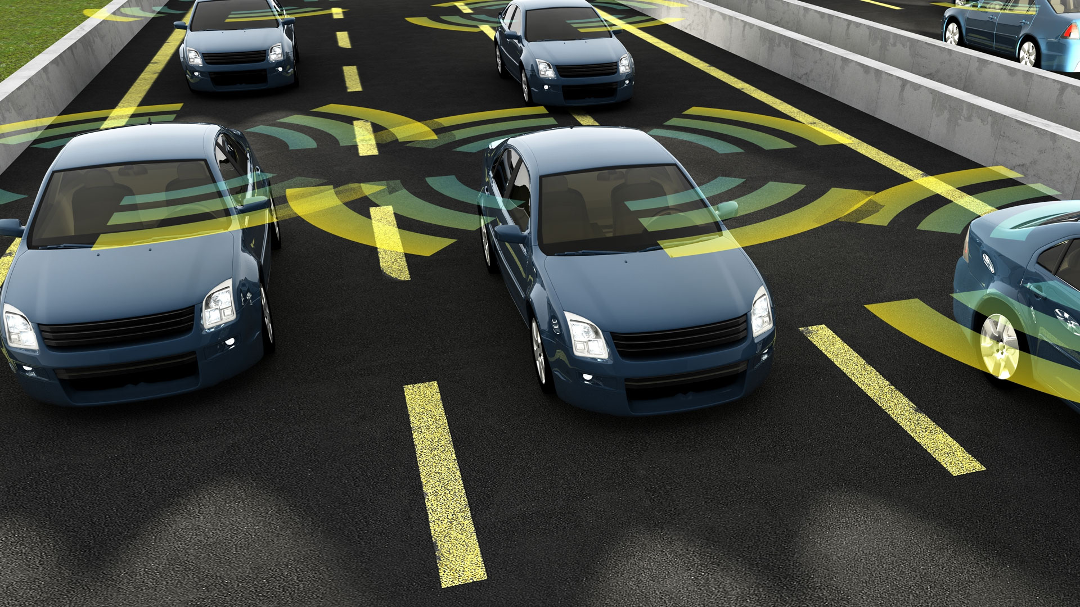

Slide 9
AI in JTC 1
JTC 1 has a 20 years history with working on standards in AI technology area (ISO/IEC 2382-28:1995 Information technology -- Vocabulary -- Part 28: Artificial intelligence -- Basic concepts and expert systems, 2382-31: Artificial intelligence — Machine learning, 2382-34: Artificial intelligence – Neural networks, all of which have been consolidated and revised into ISO/IEC 2382:2015.)
The JTC 1 Advisory Group (JAG) establishes a permanent group JETI (JTC 1 on Emerging Technology and Innovations) at JAG meeting in August 2016.
JETI recognizes the urgency of standardization on Artificial Intelligence (AI) and Autonomous Systems (AS) as AI has been rapidly applied to various industry verticals.
A landscape study/gap analysis and an internal survey have been conducted by JETI to provide the basic information necessary for AI and AS standardization with the relevant justifications.

Slide 10
Definition
Artificial intelligence (AI) is intelligence exhibited by machines. In computer science, the field of AI research defines itself as the study of "intelligent agents”
Artificial intelligence is technology that appears to emulate human performance typically by learning, coming to its own conclusions, appearing to understand complex content, engaging in natural dialogs with people.
The capability of a functional unit to perform functions that are generally associated with human intelligence such as reasoning and learning. (ISO/IEC 2382-28:1995)

Slide 11
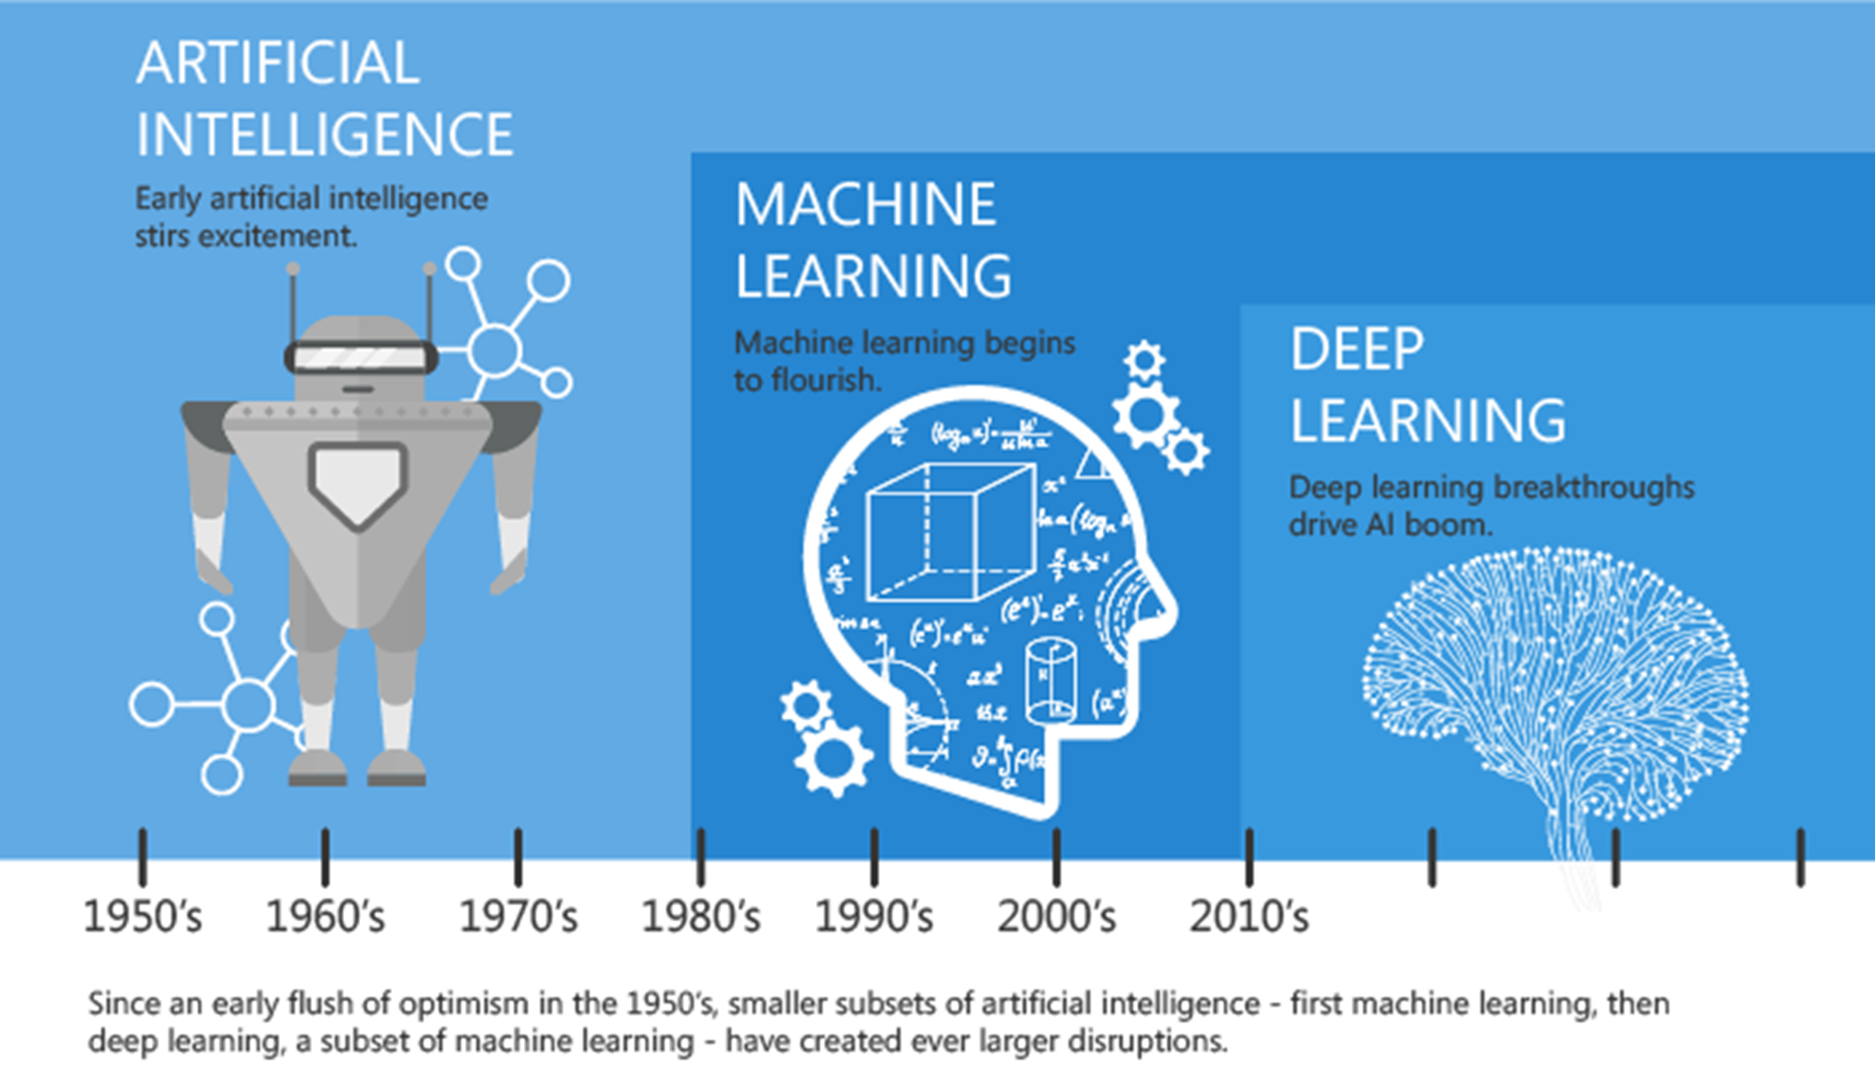
https://blogs.nvidia.com/blog/2016/07/29/whats-difference-artificial-intelligence-machine-learning-deep-learning-ai/

Slide 12
Why Standardization?
While AI has been around for many years with active research and development over the last 10 years, we have seen an increase in the number of products and services implementing AI effectively, which has led to an increase of interest by new/existing organizations to look into standardization of AI.
Countries and regulators have begun taking an interest in many aspects of AI with an increase in the application of AI into a wider set of domains and the possibility of new regulation.
There is a need for standards to facilitate communication about Artificial Intelligence, to enable acceptance of approaches and concepts that support future development and to address the interests and concerns of governments and society.
Standards provide requirements, specifications, guidelines, or characteristics that can be used consistently to ensure that AI technologies meet critical objectives for functionality and interoperability, and that they perform reliably and safely.

Slide 13
The Area of Standardization
Domains
Software engineering
Performance
Metrics
Safety
Usability
Interoperability
Security
Privacy
Traceability
Risk Analysis
Ethics
Add image here

Slide 14
New Initiatives on AI in JTC 1
New AI initiatives in JTC 1/SC7 (SG Autonomous Systems and Ambient Intelligence Environment Engineering), SC34 (AI investigation), SC36 (AI investigation), SC40 (governance of AI/AS), and WG9 (data analytics).
NWIP ballot on “AI Concepts and Terminology” (NP 22989).
USNB has proposed JTC 1 the establishment of a Systems Integration entity in the form of a new Subcommittee on the Artificial Intelligence with initial focuses on Foundational Standards, Big Data, AI Computational Methods, Trustworthiness, and AI Societal Concerns.
The new SC serves as the focus and proponent for JTC 1's standardization program on Artificial Intelligence, and provides guidance to JTC 1, IEC, and ISO committees developing Artificial Intelligence applications.

Slide 15
Other Related Activities
ISO/IEC: Published the standards for vocabulary on Artificial Intelligence (ISO/IEC 2382:2015, formerly ISO/IEC 2382:1995) which will be basis of AI standards.
IEC Market Strategy Board (MSB) is developing a new white paper titled "Application of Artificial Intelligence (AI) across Vertical Industries"
IEEE: The IEEE Global Initiative for Ethical Considerations in AI/AS; IEEE Symbiotic Autonomous Systems Initiative.
ITU-T: Studies on “Artificial Intelligence and Internet of Things” (ITU-T Y.AI4SC) and “Requirements of machine learning based QoS assurance for IMT-2020” (ITU-T Y.qos-ml).

Slide 16
Other Related Activities
National Strategy on AI:
[China] China to launch national AI strategy
[France] France already has one of the strongest AI
[Japan] Japan’s Role in Establishing Standards for Artificial Intelligence Development
[UK] £17 million boost for the UK's booming artificial intelligence sector
[US] The National Artificial Intelligence Research and Development Strategy
Industry Collaboration: Partnership on AI
Open Source on AI
[TensorFlow] https://www.tensorflow.org/
[CaffeOnSpark] https://github.com/yahoo/CaffeOnSpark
[Cortana] https://www.microsoft.com/en-us/windows/cortana
[OpenAI] Open Source AI API: http://openai.sourceforge.net/docs.html
[H2O.ai] bringing AI to enterprises: https://www.h2o.ai/gartner-magic-quadrant/

Slide 17
AI in Huawei
As an enabling technology, Artificial Intelligence is widely applied to various Huawei current businesses.
Networks in the age of Artificial Intelligence. Intelligent decision making to manage complicated network resources and dynamic traffic, automation to improve network efficiency and reduce cost, and on-demand service provisioning.
Launched Huawei Kirin 970 chipset with AI processing capabilities – marking the first time a Neural Processing Unit (NPU) has been used in a smartphone. The chip will help Huawei make phones that can anticipate the actions and interests of their owners.
Noah’s Ark Lab is working on the research topics including App Recommendation & Search Engines, Deep Learning for NLP, Intelligent Banking Solutions, Intelligent Assistance, Learning to Match, Mining from Big Graph Data, Natural Language Dialogue, Stream Data Mining, Telco Big Data, and Educated Artificial Intelligence.

Slide 18
Thank you
For more information, please contact: Yi Zhao
zhao.yi@huawei.com
Affiliation: Huawei Technologies
www.Huawei.com

