Slide 1
Document No: | GSC-21_006
Source: | CCSA
Contact: | Li Li (Thomas Li), thomas.lili@huawei.com
Agenda Item: | 4.02
Smart City - Achieving Better Life
Thomas Li, Standardization & Industry
Huawei Technologies Co., Ltd.
26-27 September 2017
HOSTED BY

Slide 2
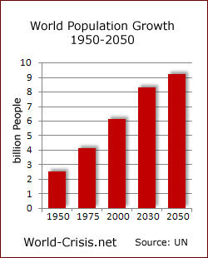
Global Urbanization is speeding up
Increasing Urbanization
Now 50% of population is in cities
In 2025 there will be 57%
Source: United Nations
GDP Growth 2007-2025
70% global GDP comes from cities
30% of GDP growth comes from top 75 cities in 2025.
Source: McKinsey

Slide 3
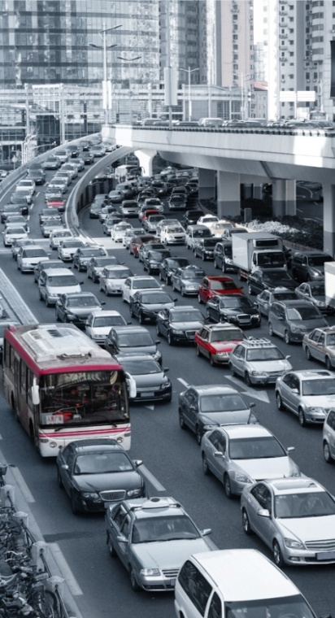
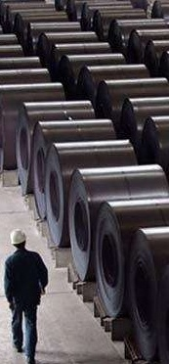
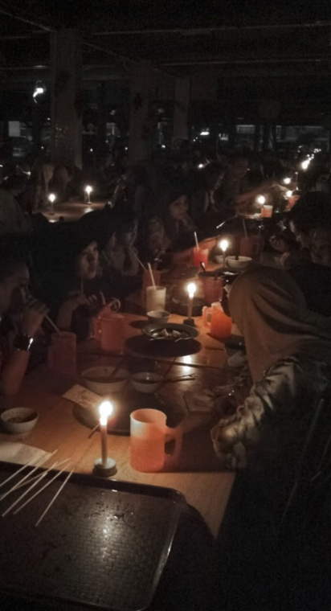
Challenges of Urbanization
Overall pressures on Infrastructure, Sustainability and Livability
Public safety
Heavy traffic
Pollution
Surplus capacity
Energy shortage

Slide 4
Global Smart City Market forecast
Global Smart Cities Market to Reach US$ 3.482 Trillion by 2026
The US$ 622 Bn smart cities market is anticipated to surpass US$ 1 Tn in 2019 and take a leap to US$ 3.48 Tn by 2026 end.
Over a period 2016-2026, the market will showcase CAGR of 18.8%.
APEJ to Outpace North America
Key Drivers
Backed by favorable government initiatives, brisk urbanization will continue to popularize the concept of smart cities worldwide.
Exploding electric vehicle market and soaring need for improved energy infrastructure are also grasped among the top drivers to the global smart cities market growth.
Although developing countries will continue to face challenges with proper networking infrastructure and funding, rapid digitization and integration of new technologies in existing infrastructure, are likely to gradually provide an optimistic outlook to the overall market growth.
The market is currently driven by public-private partnerships, crowd funding, and other emerging funding options.
Source: Persistence Market Research Pvt. Ltd., Jan 04, 2017

Slide 5
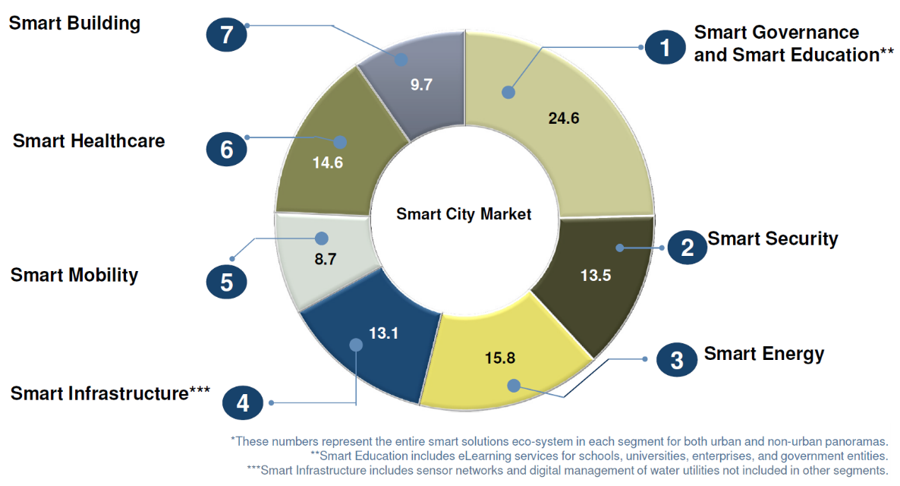
Global Smart City Market Segmentations
Source: Smart City Market, Global, 2012-2020, Frost & Sullivan

Slide 6
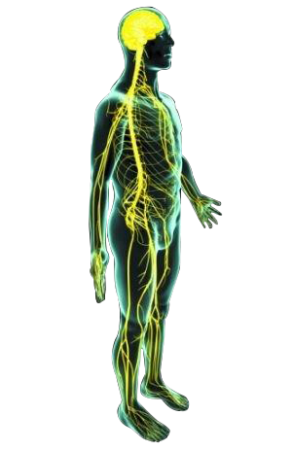
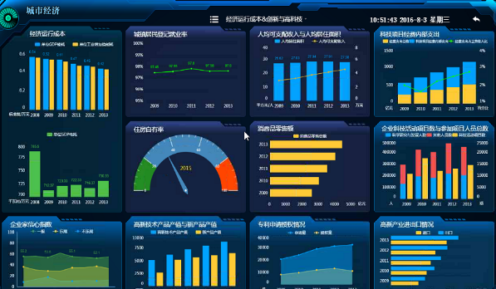
ICT “Neural Networks” for Smart City
City operation center
Cloud data center
(Central Nervous System) - Brain
＋
(Peripheral Nervous System) - Body
City IoT network
City communication network
＋

Slide 7
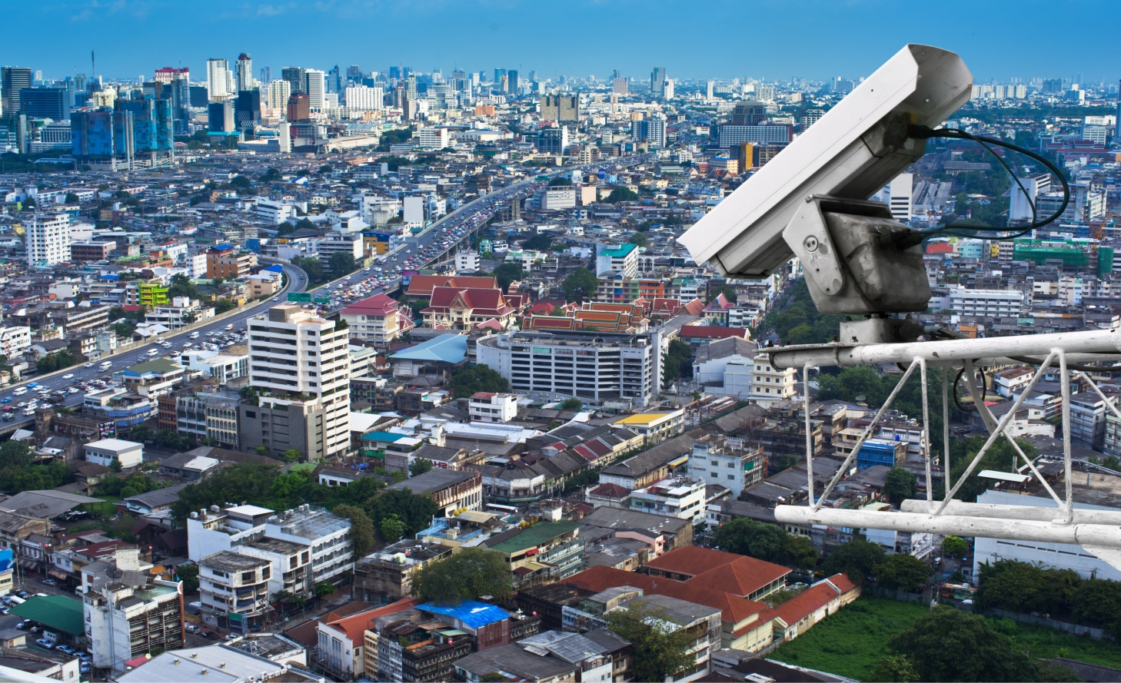
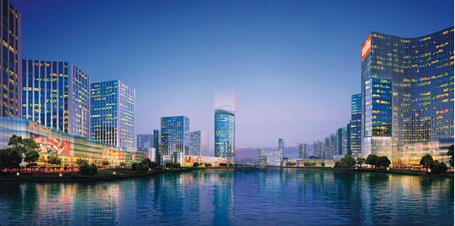
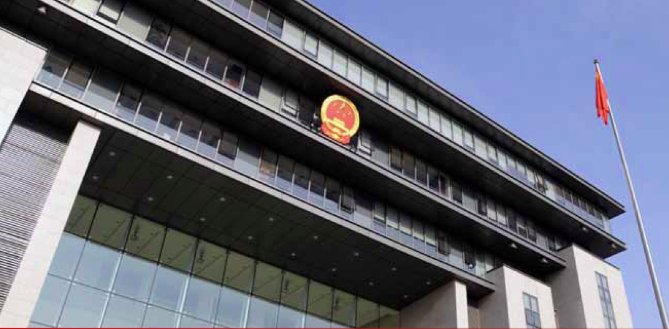
Huawei Smart City Solution set
Smart Infrastructures
Smart Applications
Public Safety
Smart Campus
Big Data
platform
City O&M
Platform
Enabling
Platform
Smart Government
Smart Education
City Cloud DC
Smart Traffic
Smart Healthcare
City Comm.
City IoT

Slide 8
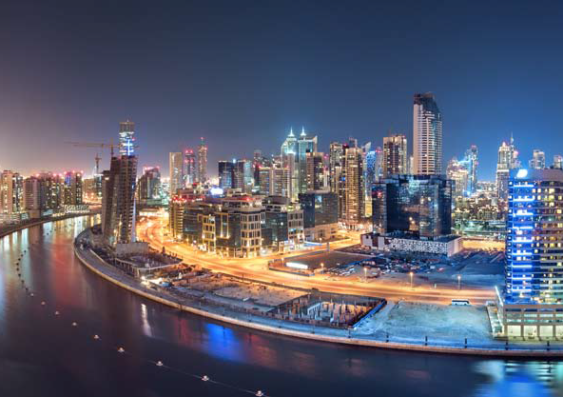
Smart Dubai - Sustainability
Background
Dubai Silicon valley Oasis, 7.2 square kilometers, Population 162,400
1920 companies managed by DSOA, 71% of them are IT companies
Smart City Project investment: 1 billion USD in 2015, additional 350 million USD in 2018
Figure
Target
As a Smart City test bed, DSOA will develop:
Agile and repeatable Dubai mode for Smart City
A center capable to converge technologies, thoughts and cultures
A smart, sustainable and livable environment
Dubai Silicon valley Oasis will be crucial for the whole countries‘ economic development. It’s helpful for developing high-tech manufacturing and local human resource.
- H.H. Sheikh Ahmed bin Saeed Al Maktoum
DSOA Chairman

Slide 9
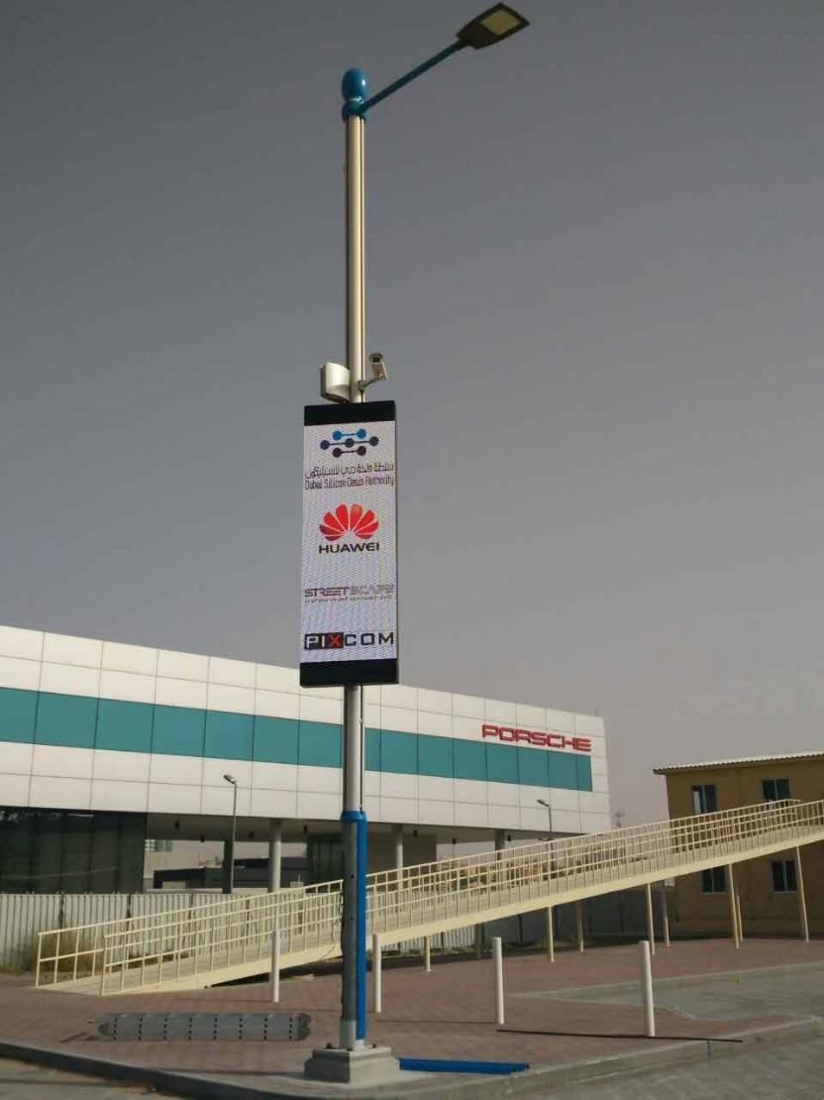
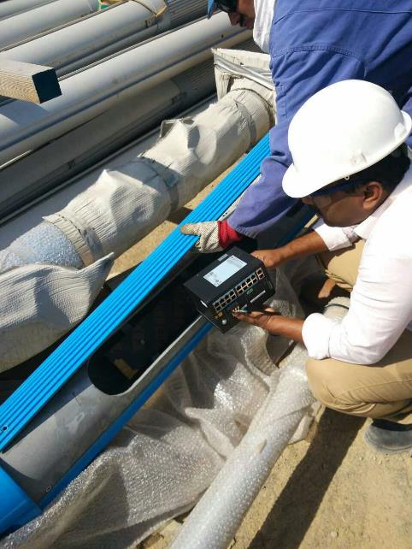
Smart Dubai - Sustainability
Solutions
Smart Lamp: Lampposts become multi-usage assets. Embedded sensors enable lambs smart controlling and energy saving. Multi-functions of lamps, like digital labels, outdoor wireless coverage and environment monitoring, achieved.
Smart Sewage Disposal: 3 billion gallons sewage disposed to be clean per year.
Smart Garbage Disposal: Automatically triggered when garbage can is full. The best route of the dumpcarts designed consequently.
Maintenance cost
Benefits
Energy cost
42% maintenance cost and 35% energy cost of lamps saved.
70% operational cost of sewage disposal decreased.
65% operational cost of garbage disposal decreased.

Slide 10
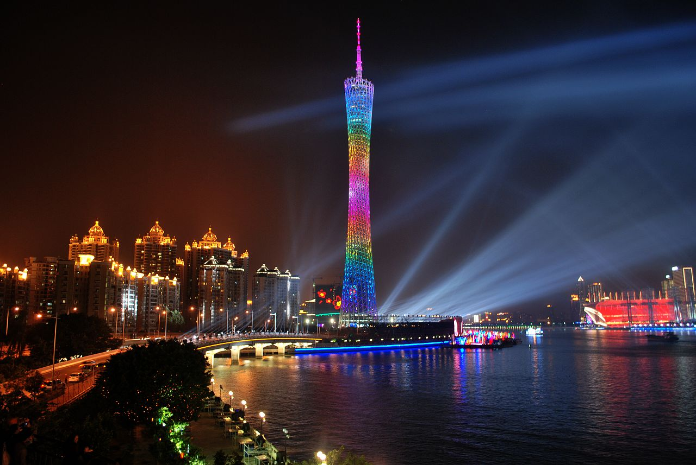
Smart Guangzhou - Governance
Challenges
Traditional IT has very low usage efficiency. The speed of new services launching is slow towards 3-6 months.
Building governance resource with high cost, complex operation and poor security and stability.
Solutions
Virtual Data Center enables leasing on-demand, minutes level service launching and multiple IT resources and services.
Intensive platform enables unified O&M and service launching.
Business-based E2E security isolation and reliability design.
Benefits
150 +
Services across 60 agencies
We need an intensive mode to unify smart governance platform to mitigate the problems. Huawei provided high quality and implementable solutions and services.
--- Guangzhou Technology & Information Agency
70%
Service go-to-market
40%
Device usage
30%
O&M efficiency

Slide 11
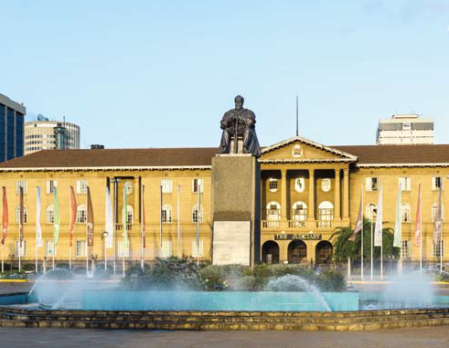
Smart Kenya - Healthcare
Challenges
Low level healthcare: 1/3 of patients can’t be correctly cured, 65% clinics lack of basic medicines.
Very few specialists: 86% of patients have more cost on road than on cure; every doctor is responsible for 10000 people in average.
Low efficiency: medical institutions consume 2-4 days per month on report; 50% budget wasted because of low efficiency and corruption.

Slide 12
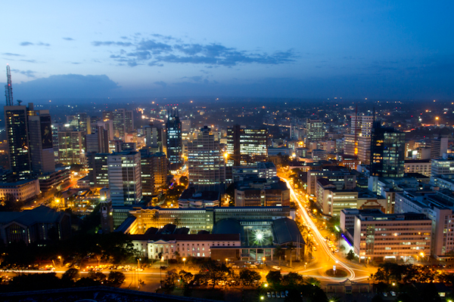
Smart Kenya - Healthcare
Solutions
New fiber networks cover major cities, 3G cover small ones.
Sharing medical records and patient information through cloud.
Huawei Matebook and Microclinic ZiDi software achieve high efficiency.
Huawei real-time video system enables remote diagnosis and remote medical training.
Benefits
30% revenue increased for Digital clinics.
More than 50% (at least 4000 people) patients per year enjoy high quality healthcare services.
More than 300 doctors per week get medical training.

Slide 13
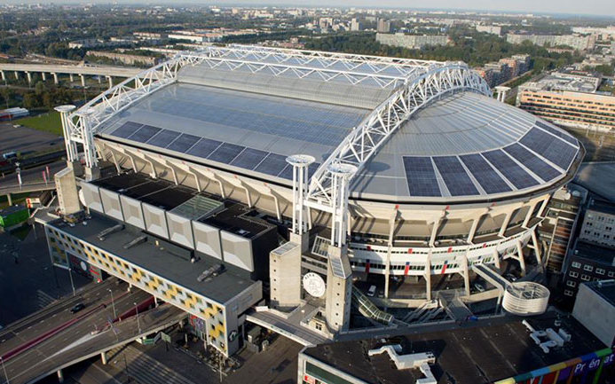
Smart Amsterdam - Gymnasium
Challenges
High density users: many APs needed for 100% Wi-Fi coverage; serious interference when adding new APs.
Large scale network: massive terminals bring in security risks; high throughput achieves network bottleneck. Securing reliability and scalability is challenging.
Many kinds of applications: Wi-Fi networks need to identify different applications to provide differentiated services; VIP users should have high quality services; Surveillant video service should be guaranteed.

Slide 14
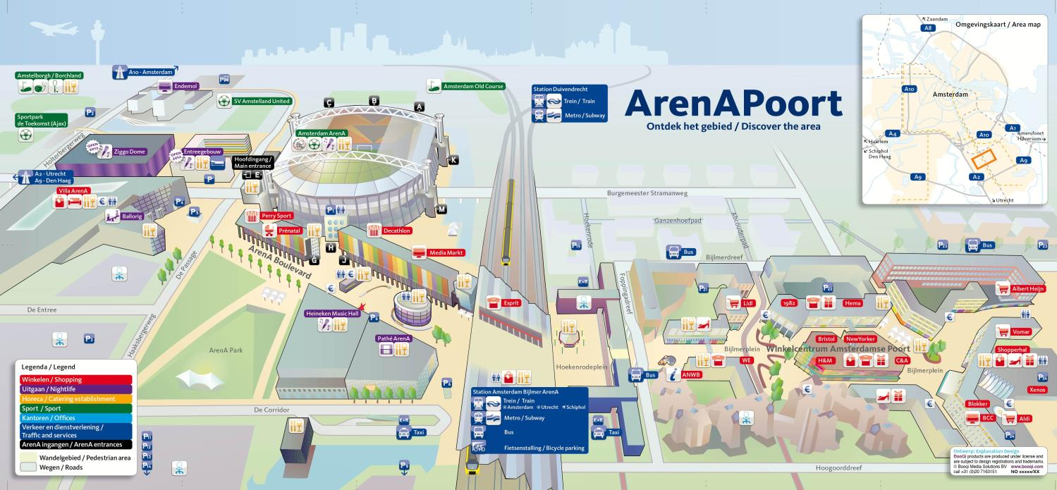
Smart Amsterdam - Gymnasium
Solutions
High density Wi-Fi network optimization: 100% coverage of the whole Gymnasium; 100% online users supported at the same time; 25% users can enjoy video services simultaneously.
SDN-based policy control: experience and security engaged; QoS for VIP users and key applications guaranteed.
AC functions supported on chip level: innovative features of agile campus achieved; large scale access requirement fulfilled.
Benefits
User experience and participation promoted
Good connection enables competition advantage of the Gymnasium
More revenue caused by higher attendance rate
Remote control on the field, roof and light achieves better management

Slide 15
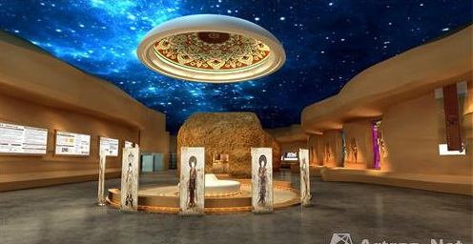
Smart Dunhuang - Tourism
Background
Dunhuang is a world famous tourism site of cultural legacies.
Resident population in Dunhuang is 50 thousands, but tourist population on season could be 40 thousands per day.
案例配图
Challenges
Public safety and cultural legacy protection have great challenges when it’s on season.
In the off season the tourism resources are wasted in idle mode.
Wide range changing of the population challenges city management and public services, including transportation, education, healthcare and catering etc.

Slide 16
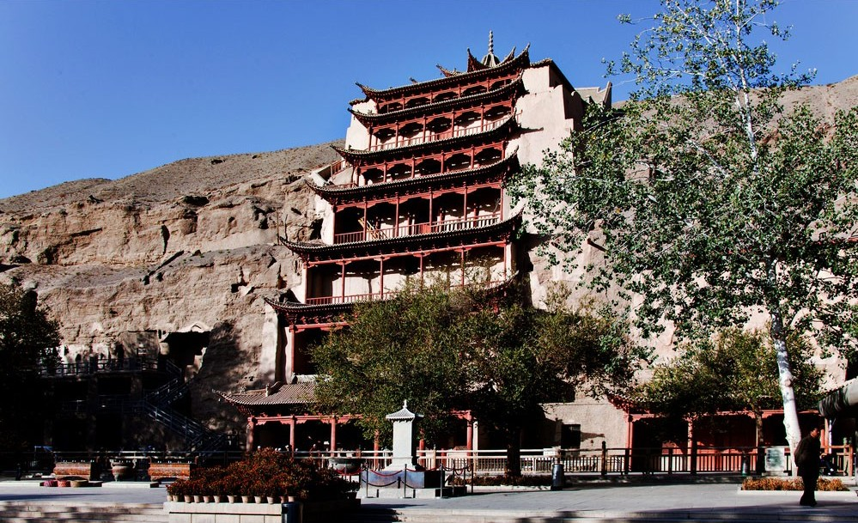
Smart Dunhuang - Tourism
Solutions
IoT system for traffic analyzing and conduction.
VR/AR/3D exhibition centers increasing experiences and decreasing traffic.
Big data system achieving accurate marketing.
Cloud DC for information sharing and collaboration.
Smart home, smart education and smart healthcare developed depending on smart tourism.
Benefits
32% YoY tourist increase
6.6 Millions of tourists / year

Slide 17
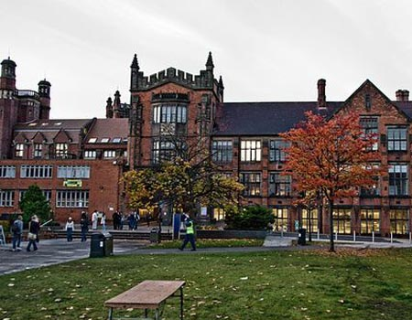
Smart Newcastle - Education
Challenges
20000+ students and 5000+ staffs in Newcastle University now and still rapidly increasing
High requirement on throughput brought from integrative education, Video on demand, online exam etc.
Solutions
Huawei CloudEngine 12800 switcher-based 100GE core network
Anywhere anyone can enjoy free Wi-Fi service in the campus
High density Wi-Fi access at hotspot
Benefits
E2E super broadband campus network and 100GE core network fulfills rapidly increasing requirement for future 5 years
Seamless wireless/wire-line access facilitates service experience
Full virtualization decreases TCO dramatically

Slide 18
Conclusion of the success stories
Before the readiness of standards related to Smart City, many deployments are already done and more are coming.
Cloud and basic communication infrastructure are fundamental.
Standardization should absorb the requirements from the deployments, test-beds, as well as creative usage ideas of ICT.
Existing common ICT standards could be directly used for Smart City, e.g. NB-IoT, eLTE, oneM2M, etc. There is no need to invent wheel.

Slide 19
Landscape of Standardization in Globe
Technology, Product, Service | Process, Management, Collaboration, Implementation | Strategy, Guidance, Roadmap
ISO/IEC JTC1 WG11
Smart City
ISO/TMB/AG on Smart Cities
ISO/TC268/SC1
Smart Society Infrastructure
ISO/TC268/SC1
Society Sustainability
IEEE
CEN、CENELET、ETSI
Smart City cooperation
ITU-T/FG-SSC – Sustainability of Smart City
ITU-T/SG20 - IoT
IEC/SyC Smart Cities
Smart City System Committee
BSI
National Standardization General Working Group on Smart City, China
(SMCSDT)

Slide 20
Technical Committees supporting SAC & SMCSDT
Landscape of Standardization in China
SMCSTD
Established in 2014, National Level:
Strategy, Standard System, Evaluation, Intermediation
Coming: Mirror TC of ISO TC268 SC1
信安标委
智标委
全国智慧城市基础设施计量标准化技术委员会
Pg 20 |

Slide 21
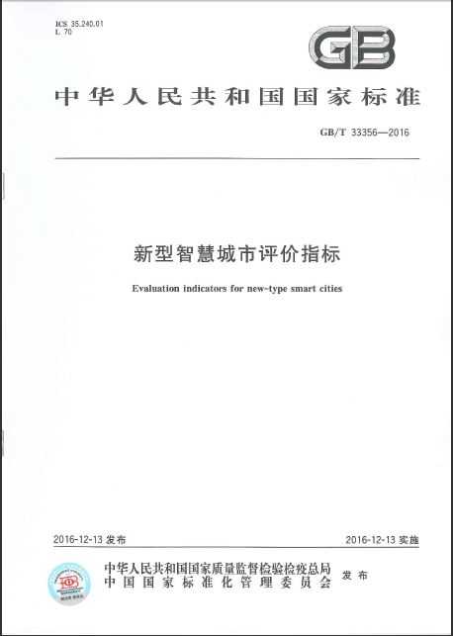
Landscape of Standardization in China
GB/T 33356-2016
Innovative smarter city indicators
Dec. 2016
Smart City Standard System in China
Pg 21 |

Slide 22
Smart City projects in CCSA TC10_Part I
CCSA Technical Committee 10: Ubiquitous Network;
Scope of TC10: Internet of Things, Smart City, Sensor Networks, etc.;
Active Members: 40+ companies including: China Mobile, China Telecom, CAICT, Huawei, ZTE, Nokia, Qualcomm, etc.
Projects | Category | Editor | Status
City Operation Part I: Architecture and Requirement of Operation Center | National Standard | Research Institute of City Science | Drafting
Cross-system Interaction Part I: Architecture | National Standard | CAICT | Drafting
Cross-system Interaction Part II: Technical Requirements and Testing Specs | National Standard | CAICT | Drafting
Cross-system Interaction Part III: Interface Protocol and Testing Specs | National Standard | CAICT | Drafting
Smart Health Part II: Mobile Healthcare | National Standard | CAICT | Drafting
Data Convergence Part III: Specification of Data collection | National Standard | Shandong Standard Institute | Drafting
Data Convergence Part IV: Requirement of Data Sharing | National Standard | CAICT | Drafting
Smart City: Architecture of Data Sharing | Industrial Standard | Jiangsu IoT Research Center | Finished for Publication
Smart City: Definition and category of Information Protection | Industrial Standard | CAICT | Finished for Publication
Pg 22 |

Slide 23
Smart City projects in CCSA TC10_Part II
Projects | Category | Editor | Status
Smart City: Architecture and Technical Requirement | Association Standards | CAICT | Published: YDB 134-2013
Smart City: Technical Requirement of information exchange | Association Standards | CAICT | Published: YDB 145-2014
Smart City: Standard Guideline | Association Standards | Fiber Home | Drafting
Smart City: Terminology and Definition | Association Standards | Fiber Home | Drafting
Smart City: ICT Architecture and Reference Model | Association Standards | Fiber Home | Drafting
Smart City: Research of Standard System | Research Report | Fiber Home | Finished
Smart City: Architecture and Function requirement of Public Support Platform | Research Report | Fiber Home | Finished
Smart City: Analysis of Security requirement | Research Report | China Telecom | Finished
Smart City: Research of Information Resource sharing requirement and technologies | Research Report | China Telecom | Finished
Pg 23 |

Slide 24
Key questions up to be answered
How to collect and converge disperse requirements of Smart City?
How to have Standardization to fulfill these requirements and achieve values?
How to avoid standards confliction or duplication, and industry fragmentation?
How to build a low cost, globally adopted certification mechanism for Smart City customers and vendors?
Pg 24 |

Slide 25
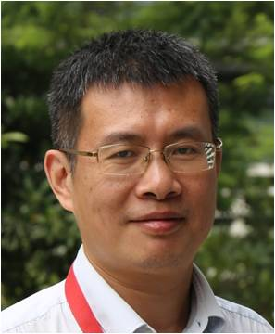
Thank you
For more information, please contact: Thomas Li
Email address: thomas.lili@huawei.com
Affiliation Name: Huawei Technologies Co., Ltd.
www.huawei.com
Pg 25 |

