Slide 1

Document No: | GSC-21_009 (R1)
Source: | ETSI
Contact: | Keith Dickerson
Agenda Item: | 4.03
ETSI Strategy on Smart City Standards
Keith Dickerson, Director, Climate Associates
26-27 September 2017
HOSTED BY

Slide 2
Scope
What do Smart Cities need from Standards?
ETSI Groups working on Smart City Technologies
ETSI work with External Smart City Groups
Further work

Slide 3
What do Cities need to Scale up Smart City Solutions?
Best Practises
Common (Cross-Domain) Use Cases / PoCs and Demos
Benchmarking / KPIs
Interoperability (infrastructure and data)
Unified standards-based Platform Approach
Standards (vertical and horizontal)
Profiling to allow for gradual deployment of key services
Notes:
So how do your scale-up smart city solutions?
They key to this is the ability to replicate solutions and there aren’t many examples of a smart city solution that has been replicated and is interoperable across two or more smart city platforms (apart from uber and google maybe)?
Building blocks of making solutions replicable include:
Best practises – there are many of these emerging from the Large Scale Pilots and other H2020 projects
Use cases – defining what can be common across cities and what needs to be changed to meet a particular city’s requirements. And in particular cross-domain use cases which need to access data that is normally kept in different silos in order to provide results
Benchmarking and using KPIs to define targets that solutions should meet
Defining the elements of interoperability - both vertical and horizontal
Using a platform approach – preferably a standards-based platform approach to allow city solutions to work from a common platform.
Unfortunately there isn’t s single standard for smart city platforms but bodies such as oneM2M are working on the standardised APIs that can be used to allow any app to access any platform (hopefully anyway)
And finally profiling of standards so you can procure a smart city solution to a common set of specifications but tailor it to your particular city.
Following up from this mail tread it looks to me that the main message for GSC (conveyed with (a new) slide 4) would be something like the following:
- At all levels in the global standardisation ecosystems there are activities that contribute relevant standards and specifications for smart cities. This world can be complex. It is, therefore, important for standards bodies to further strengthen close relations and cooperation for setting up the proper instruments to support cities in their work in defining standards based approaches towards smart cities solutions and in promoting a fast and rapid deployment. This must go across the full standardisation ecosystem including global fora/consortia as well as formally recognised standards bodies.
- Open Source also play a key role complementing standardisation work with open source technologies and platforms relevant for smart cities deployments. A next step should be to develop a good understanding of open source projects relevant in the area of smart cities and to establish linkages with standardisation where it makes sense and is possible.
- In order to promote the uptake standards based technologies for smart cities and to provide guidance to cities also "promotional" organisations play a key role, e.g. in contributing use cases or in bridging between standardisation and technology work and market deployments and needs. Relations should be built up or strengthened with such organisation in order to educate about standardisation and to support reach out and advocacy for open technologies.

Slide 4
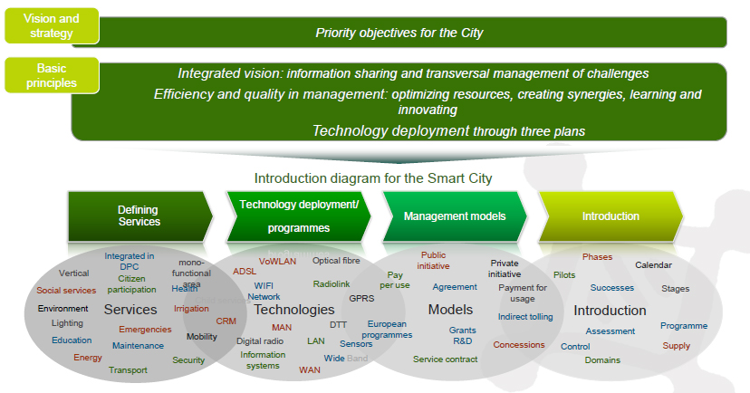
Cities need reduced uncertainty to invest
“Connecting” “users” &“services” across “multiple domains” to share “information”
... a Smart City builds on (standardized) enabling technologies
Desired city services + Enabling technologies + Business Models → Deployment

Slide 5
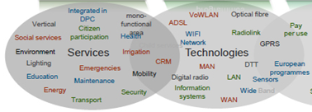
Standards shrink risks in Enabling Technologies
Fixed:
xDSL, Fibre, PoF, PLT, NGN, SDN/NFV, co-axial (cable)
Wireless:
Wi-Fi, Digital Radio, Wide band, Narrow band, LTE -> 5G, Satellite, NFC, RFID
Horizontals / Platforms:
Security/privacy, Energy efficiency, M2M, QoS/QoE, Interconnect & Interop, Secure IT platform & data management, semantics, Human Factors

Slide 6


Smart City-related Groups in ETSI
ETSI TC SmartM2M (supporting AIOTI WGs):
  Developed two releases of M2M specifications.
  Used as one of the initial baseline proposal for the oneM2M initiative
ETSI TC SmartM2M currently working on:
  Supporting the European industry and institutions on the identification and adoption of standards, in particular regarding the oneM2M framework
  Bridging the European needs in the area of M2M/IoT towards oneM2M
  Smart Appliance REFerence ontology SAREF / oneM2M IoT Semantic Interoperability

Slide 7
ETSI TC ATTM Working Group on Sustainable Digital Multiservice Cities
New Working Group, chaired by eG4U (City of Bordeaux CIO, chairman of the standardization group of EuroCities)
Works on deployment of ICT systems, and networks, and sites allowing interactions for data capture (both data consumers and providers) and management of data within each service and between different functions and services and will produce:
Standardization work on specific engineering of ICT for Sustainable Digital Multiservice Cities
Specifications of topology and functional requirements
Specifications of functional and physical characteristics of interfaces
Standardization work on operational sustainability management

Slide 8

ISG OEU “Operational energy Efficiency for Users”
eG4U (www.eg4u.org): An NGO of ICT users working together to improve Energy Management & Waste monitoring in domains of ICT Sites, Smart Cities and Electrical and Electronic Equipment.
ETSI specifications
ETSI GS OEU 001 Global KPIs for ICT sites
ETSI GS OEU 006 Referential specification to define sustainable levels of ICT Sites
ETSI GS OEU 018 Waste management of ICT equipment
ETSI TS 105 174-2 Broadband Deployment and Energy Management; Part 2: ICT sites
Notes:
These specifications are aimed at helping companies and public administrations to match the new regulations for measuring and monitoring energy effectiveness and waste for ICT sites & networks. eG4U started its works in accordance and in compliance with the European Commission mandate M/462 on ICT energy sustainability.

Slide 9
ETSI Human Factors Task Force
Working on standards requirements of users / citizens living in and interacting with the smart city.
For example, activities related to accessibility of mobile devices having a direct impact on the user experience in smart cities (e.g. accessibility of intelligent transport information for the blind or visually impaired).
3 new work items arising from CEN/CLC/ETSI SSCC-CG requirements on accessibility.
Proposed STF awaiting evaluation for funding by EC.

Slide 10
ETSI’s Smart City Cooperation Initiatives
ETSI is active in and/or cooperating with:
  SF-SSCC: CEN-CENELEC-ETSI Sector Focus - Smart and Sustainable Cities and Communities (ISO, IEC, UN, ITU-T..) + SM-CG + SEG-CG
  AIOTI www.aioti.eu: WG3 (IoT Standardization) and AIOTI WG08 (Smart Cities) with many SDOs (ITU-T, W3C, IEEE, ISO, IEC, JTC1, ETSI, oneM2M, 3GPP..), OSS, Industry/Verticals and IoT Alliances, IERC, IoT-EPI, IoT LSPs…
  FIWARE / OASC.. in the new ISG CIM (next slide)
ETSI is a partner in the H2020 Smart City project ESPRESSO (OGC, CITYKEYS/Eurocities, Sharing Cities, EIP-SCC, Urban Platforms), IoT-EPI/UNIFY-IoT and IoT LSP CSA CREATE-IoT

Slide 11



Cross-cutting Context Information Management for Smart City Interoperability
User Apps
Open Data
Stakeholders
Public Authorities
EXAMPLE:
Citizen
Complaints
Photo-App
Application
Context Information Models
C
I
M
Context
Information
Management
Data Publication Platforms
CIM-API
[JSON-LD]
CIM-API
[JSON-LD]
Applications
Applications
Mca
Linked Data experts
Information
Systems
Smart City
organisations
IoT
OpenSource developers
System
Integrators
Citizens!
Goal = interoperable exchange of data & metadata between systems

Slide 12

ETSI involvement in I-ES City Project (NIST)
ETSI and NIST have signed a partnership agreement (early 2016) to explore opportunities for cooperation in the domains of Smart Cities and IoT (Internet of Things)
ETSI hopes that through this collaboration with NIST and other partners we may encourage global cooperation and knowledge sharing as well as the development of global technical specifications and recommendations to help accelerate the numerous Smart City deployments around the globe.
Three workshops in both US and Europe have progressed the work on identifying potential “Pivotal Points of Interoperability (PPIs)” between numerous IoT frameworks
https://pages.nist.gov/smartcitiesarchitecture/
Notes:
Standards bodies have a responsibility (as part of the mission of interoperability) to explain and collaborate on their work.
Smart Cities need more such activity, due to the nature of the domain.
NIST I-ES and ETSI/CEN/CENELEC SF-SSCC should be highlighted as a step in the right direction.

Slide 13
Are other initiatives required?
Key Issues on Smart Cities (as identified in ETSI IoT week - November 2016):
  Lack of guidance for Cities wishing to make RFPs for Smart City projects
  Complexity and fragmentation of Standards
  Long time-scales for introduction of smart city services
  Need to address concerns about Security, Privacy and Trust
  Data Semantics and interworking
Possible ways forward:
  Define a smart city RFP template
  Define a roadmap for introduction of smart city services
  Bring together major IoT and city stakeholders
  Host regular showcases of smart city trials/demos/PoCs, identify best practicies
  Hold Plugtests on interoperability of smart city services
  Encourage different standards groups to work together to avoid fragmentation and confusion to the City users

Slide 14
Thank you
For more information, please contact:
Keith Dickerson keith.dickerson@mac.com
David Boswarthick David.Boswarthick@etsi.org
Affiliation Name:
ETSI
www.etsi.org

Slide 15
Background slides

Slide 16














Work Process
oneM2M Partnership Project
Over 200 member organizations in oneM2M
www.oneM2M.org
All document are publically available

Slide 17
Work Process
Key findings/trends «City 2.0»
Smart city platforms bring significant efficiencies when the number of applications grows
  Shared data
  Single API set and data formats are beneficial for developers
Initial cost of platform investment tends to be marginal compared to economies of scale, OPEX options can alleviate initial costs
Connectivity, plenty to chose from
Machine learning and analytics create great benefits (e.g. traffic management, parking management)
Living labs for research and innovation
Open standards are crucial for sustainable success

Slide 18
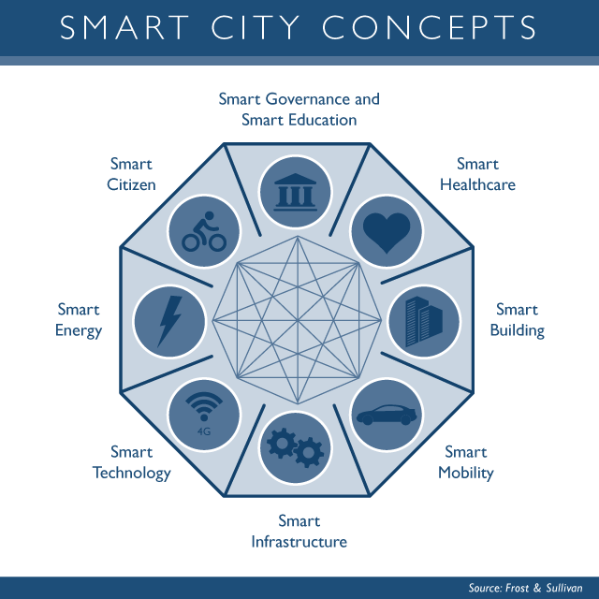
Work Process
Key findings/trends «City 2.0»
2. Digitalize and «sensorise»
1. Build a vision
3. Build Dashboards
4. Expand the vision, Integrate and Innovate
Source: Based on discussions with Dr. Martin Serrano,
OASC and Insight centre

