Slide 1


Document No: | GSC-21_013
Source: | TTA & Sejong University
Contact: | Prof. Song JaeSeung
Agenda Item: | 4.10
Development of
Sustainable Smart Cities based on IoT
JaeSeung Song, Prof. and TTA
(Sejong Univ.)
26-27 September 2017
HOSTED BY

Slide 2
Presentation Title
Introduction to IoT-enabled smart cities in Korea
    Busan, Daegu, Goyang
    Applications and services
Sustainability and Interoperability
    Roles of IoT standards
    Certification for IoT devices and services
Global smart cities interworking
    Various IoT-enabled smart city projects and their interworking
    Integration of various IoT platforms
Lessons learned for sustainable smart cities
How to collaborate among GSC members

Slide 3
Introduction to IoT Smart Cities in Korea
Three smart city large scaled pilot projects
  Duration: 3 years (2014 ~ 2017)
  Budget: around $18 million per project
  Keywords: Sustainability, Interoperability, Global standards
  Busan: global smart city
  Daegu: convergence services
  Goyang: daily healthcare services
Services
  Busan: currently 26 services (incl. Smart streetlights, Maritime safety services)
  Goyang: smart eco city services, air quality mgt. services, etc.
  Daegu: Gene analysis based HC, Pregnant woman care, etc.

Slide 4
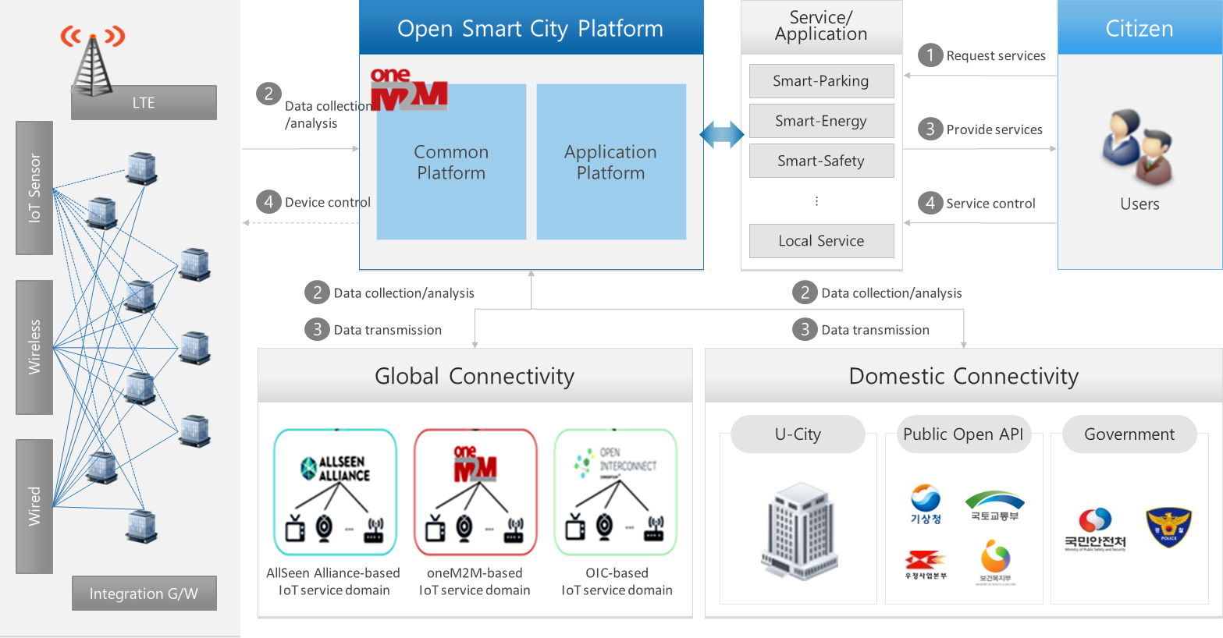






Busan Smart City Architecture
Smart City Architecture

Slide 5
Sustainability and Interoperability
Sustainability:
  Consortiums are composed of city government, telco operators, device manufacturers and service providers
  Developer portals and testing labs
  Provides testing and certification programs
  Strong oneM2M open source community (e.g. http://www.iotocean.org/main/ )
Interoperability:
  oneM2M is mandated as ’THE’ standards for IoT service layer platform
  Provides horizontal platform for different services
  Supports interoperability over standards interfaces

Slide 6

Certification for Devices and Services
oneM2M Certification is intended to create an ecosystem of certified products that ensures interoperability among certified products.
www.onem2mcert.com
TTA was agreed the first oneM2M Certification Body
oneM2M Certification Program was officially launched at Feb. 9, 2017.
oneM2M Certification represent to consumers that oneM2M products and services meet oneM2M Specification and Test requirements which ensure interoperability. .

Slide 7












Std. interworking
Using Proxy
Using Semantics
Dashboards
City Apps
Dashboards
City Apps
3rd party apps
Analytics apps
3rd party apps
Analytics apps
REST
APIs
REST
APIs
SPARQL or
REST APIs
Global
Smart Cities
Interworking
Models
oneM2M
oneM2M
FIWARE
Meta Cloud
Proxy
Semantic Proxy
oneM2M
oneM2M
Testbed
Gateway
Device
Gateway
Device
Device
Device
Alpensia
Ski resort
Chamrousse
ski resort
KETI
Testbed
Surrey
Testbed
Busan
Santander

Slide 8
Integration of various IoT platforms
Integration:
  oneM2M
  FIWARE
  GS1
  Samsung Insator
  OCF
  CEA sansiNact
  LoRa
www.wise-iot.eu

Slide 9
Lessons Learned
Standardized IoT platform and data model
    Standards for smart city reference architecture
    Implementable standards for common IoT platform
    Integrating various IoT technologies
    Standards for data model and semantics
Strong certification program
    Certify devices, gateways, platforms and services
    Global certification program
    Certification of smart cities
Global collaborations
    Joint large scaled projects
    Interoperability between standards (e.g. JOOE – oneM2M & OCF)

Slide 10











Global Smart Cities Collaboration Model
Reference architecture
Provide vision and direction for Global Smart City
Market views
Services views
Technology views
Verticals views
De jure standards
City states
Global Smart City Partnership Project (GSCPP)
    Collaborations among GSC members
    Involvement of various stake holders (incl. city states)
    Define from reference arc. to strong implementable standards
    Certify globally recognized Smart City
Development of implementable specifications
Protocols
Profiles and data model
Define evaluation criteria
Build experts group for evaluation
Testing and Certification
De facto standards
Certification bodies

Slide 11
Thank you
For more information, please contact: Prof. Song JaeSeung
jssong@sejong.ac.kr
Affiliation Name: Sejong University
http://www.sejong.ac.kr

