Slide 1
Presentation for Autonomous networks workshop
Orange, TIM, Huawei, Futurewei
Autonomous networks workshop
December 2019
V 1.0

Slide 2
Introduction
From the kick off call (Nov. 5)

Slide 3
What / Why / How?
WHAT
A complete network and services business architecture for new innovative and disruptive Autonomous Networks
WHY
Fast network and service configuration, new business requirements, flexibility in generating new services according to Verticals needs, dynamic and efficient resource allocation, measurable Security and Safety requirements are pushing the Autonomous Networks to be the most challenging Transformation in the ICT industry. The objective to achieve a Full Autonomous Network is the final goal of the activity and requires a strong engagement and coordination of the whole new ecosystem (SDOs, Cross Industry Associations, Open Source Communities).
HOW
Leveraging the significant inputs from its current ISGs and TCs and launching a new collaborative initiative with other relevant SDOs, ETSI can bring a key contribution in developing the disruptive, realistic and operational ecosystem for Autonomous Networks, based on an agreed technical framework/blueprint architecture, business and ecosystem components and open APIs

Slide 4
Autonomous networks definition - Proposal
(Note: open to refinement and alternative when the work starts, taking into account other SDO studies):
Networks having the freedom to act independently, to govern themselves or control their behaviour thruogh previosly defined policies. In other terms self-governing, no external humans or machine are acting upon it
The Autonomous Networks comprise of simplified network architecture, virtualized components, automating agents, intelligent decision engines and self dynamic capabilities to create intelligent business/network operations for the closed-loop of new digital business, which,
offer disruptive services for innovative user experience, critical services based on fully automated lifecycle operations and self organizing, dynamic optimized resource.
aim to provide fully automated zero wait, zero touch, zero trouble innovative, critical network/ICT services for vertical industries users and consumers, and
support self-configuration, self-healing, self-optimizing and self-evolving telecom network infrastructures for telecom business such as planning, marketing, operations and management.

Slide 5
Our promise
We will develop the disruptive, realistic and operational ecosystem for Autonomous Networks based on
TMForum, business and ecosystem components, interoperable framework and open APIs,
the ETSI technical framework/blueprint/architecture
This will define a complete network and services business architecture for new innovative and disruptive AN.
It requires:
Technical network propositions, frameworks and standards
Virtualization of the network functions, Implementation of the network functions as software components
Fragmentation of the networks into domains, encapsulation of the network complexity within the relevant domains
Technical and business flexible Capabilites on demand
Exposure of the networks & services from the domains using industry standard Open APIs
It uses
Automated closed loop control of the network across all domains of the architecture
Data driven models, AI (DL, ML) analytics and decision models
Big data lakes and engines
Cloudified and virtualized infrastructures
It will deliver :
Simplified network architectures for optimal innovative or critical services
Autonomous levels of agile, flexible delivery of network services and capabilities
Ease of operate infrastructure and services
Self-optimizing networks, Self organising, Self-healing ICT/networks
Intent based operations , data driven
An ecosystem that goes beyond the boundary of Telco and enables digital transformation across many industries

Slide 6
Proposed Objective, SoW and Work Plan for Autonomous networks

Slide 7
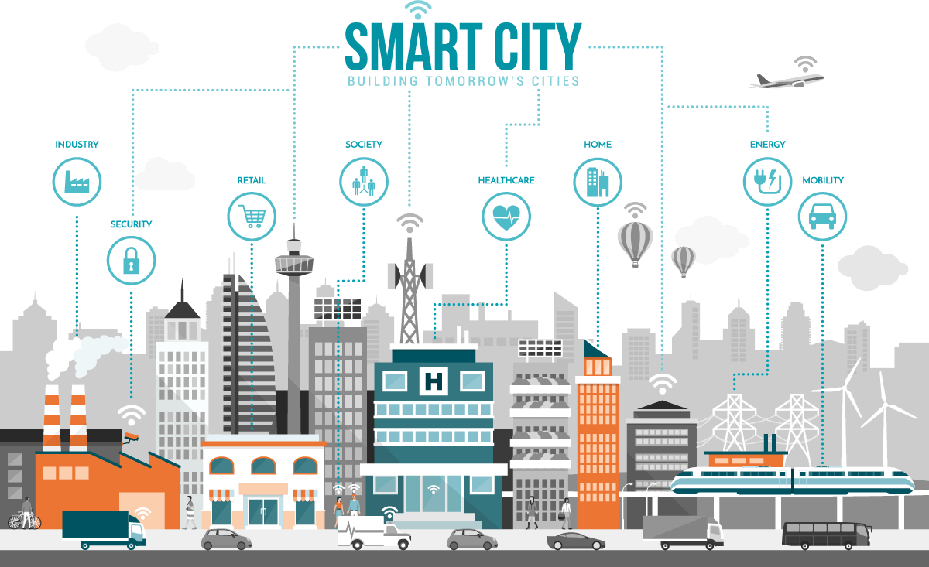
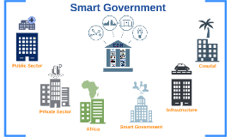
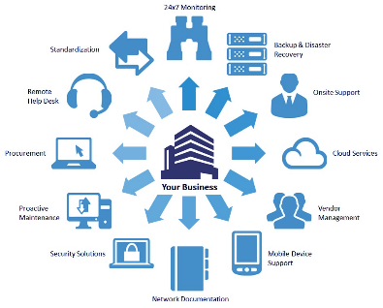
Vision: Autonomous Networks/ICT Services for Intelligent Digital Society Transformation
Smart city
Smart industry
Smart government
Smart xxx…
As a Service
As a Platform
“Zero X” Experience
One stop, real-time, on demand, automated，E2E full lifecycle network/ICT services
Enablement of business collaboration & ecosystem between verticals and network/ICT service providers
Make the simplicity to the users
Leave the complexity with the providers
ICT
Zero Wait
Zero Touch
Zero Trouble
Launch
Delivery
Care
Simplified
Operations
Development
Maintenance
Self-healing
Business
Services
Infrastructure
Swift
Autonomous
Network
Agile
Operations
All-inclusive
Services

Slide 8
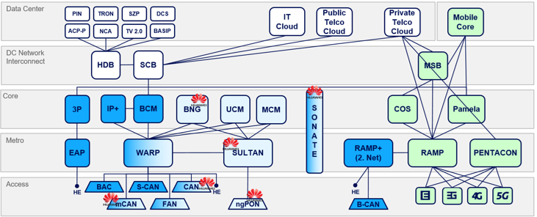
Simplified architecture, autonomous domain
AS-IS
TO-BE
Simplified architecture
Less layers
Less hops
High efficiency nodes
Infrastructure
E2E SR/SRv6
Broadband
vRG
EdgeDC
vEPC
Regional DC
2B
vBRAS
vIMS
4G/5G
Backbone/DCI
Simplified network architecture
CO Fabric
MAN Fabric
IGW
OTN pro
Mobile
OTN pro
Simplified Optical Transport
Siloed，complicated, many CRs, many faults, reactive, long timeframe of closed-loop
E2E 100% available, flex scale out, proactive, open easy integration, NOC free, No CRs, RPA
Autonomous domain
Highly integrated domain: Integrated network autonomous domain for one RFS closed-loop
Loosely coupled domains: collaboration at autonomous domain level
IT
Consumer
Portal
Enterprise
Portal
CRM
Billing
… …
Business Operations
Isolated Data & Process
Data / Service
Cross domain Operations
Tightly Coupled
OSS
BSS
Assurance
Tickets
WFM
Domain operations
Domain operations
Domain operations
Autonomous Domain x
Autonomous Domain y
Autonomous Domain z
NMS
Data / Service
3rd-party controller
EMS
Silo
Controller
Silo
Controller
EMS

Slide 9
Intent driven network operations: Knowledge as a service
Utilize the knowledge of network operations for efficiency, experience, performance and service management
Operator
IoT
Business
Home
Design
Rollout
Assurance
Aggregation of the knowledge for various network operations
Network Full lifecycle
Service Full lifecycle
Provisioning
Planning
Network operations as a Service
Fulfillment
Sharing of the knowledge as the operator of the operators
Optimization
Service Cloud
Monetization of the knowledge of network operation as SaaS Cloud
Network A
Network B
Network C

Slide 10
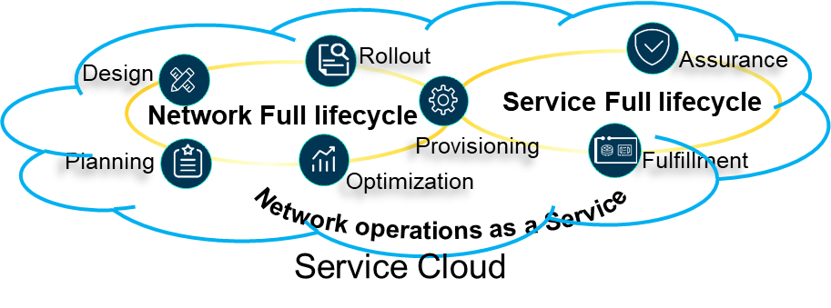
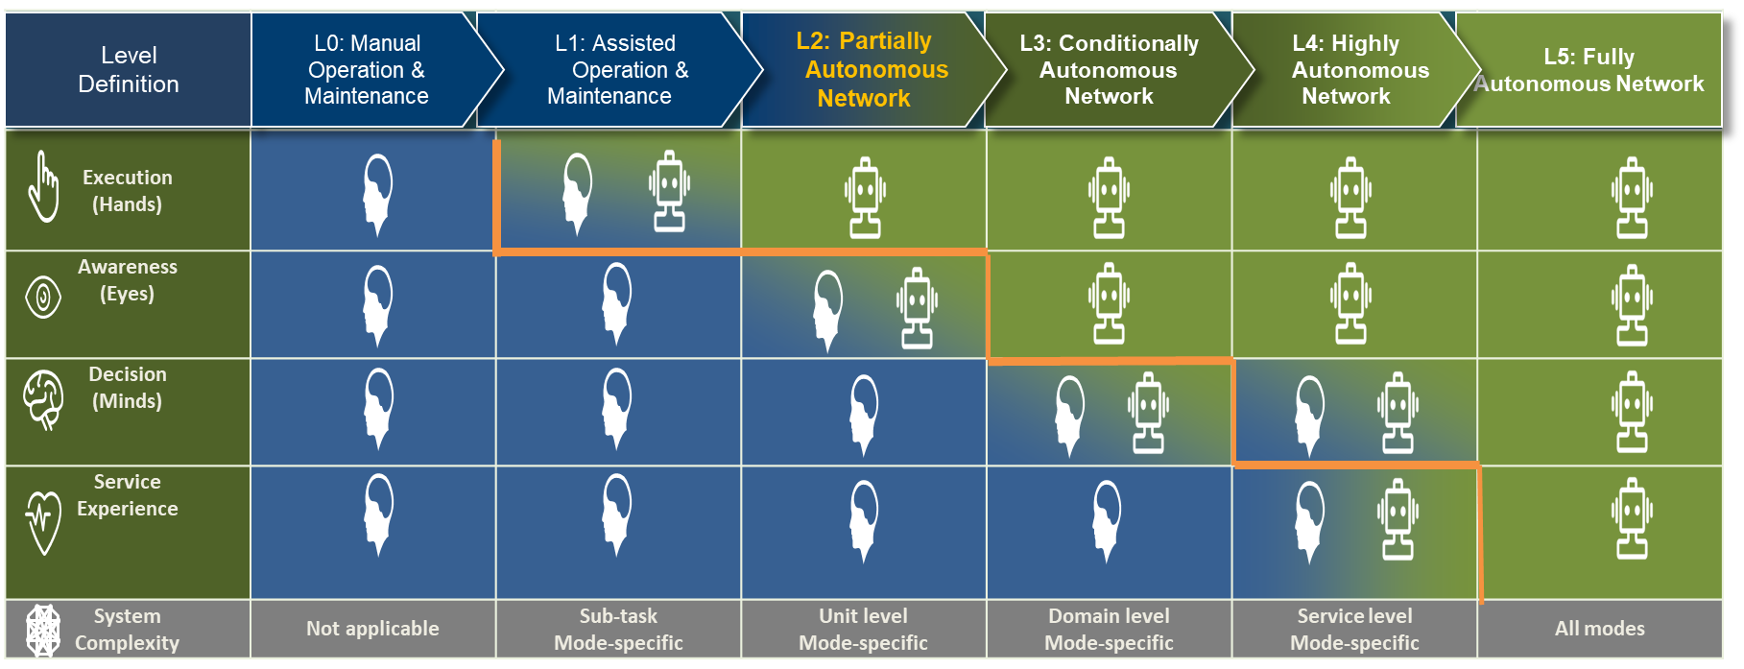
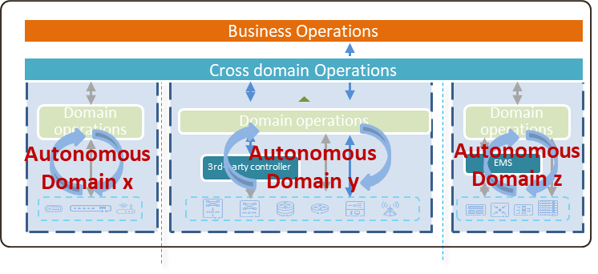
Autonomous Networks: Data & knowledge driven intelligent, simplified networks architecture and operations
Knowledge as a Service
Self-configured, self-healing, self-optimized
Full lifecycle closed-loop
Simplified architecture
Best user experience, full lifecycle automation, maximum utilization

Slide 11
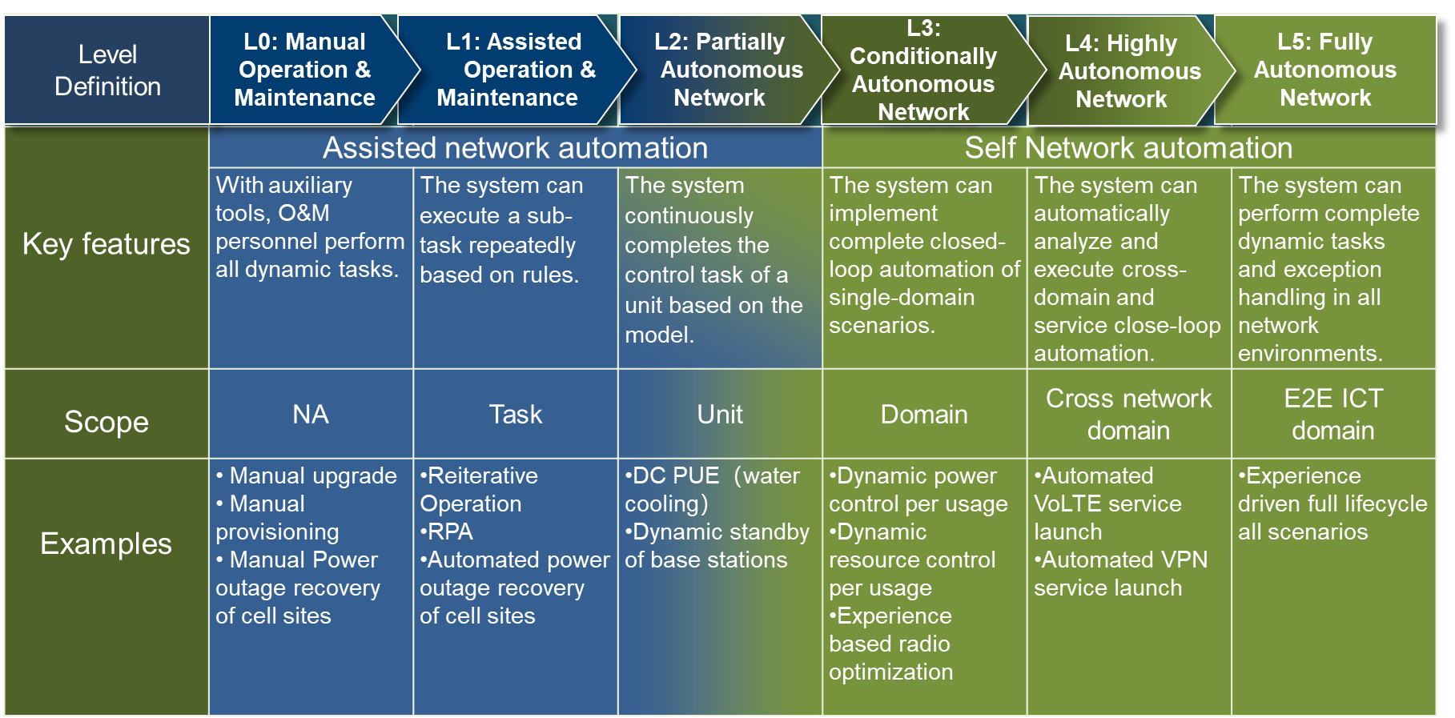
Levels of Autonomous Networks: explanation and examples
Static
Simple
Automation
Dynamic
Sophisticated
Autonomy

Slide 12
Objective: Promotion of Autonomous networks industry consensus, definition of simplified network architecture and intent driven network automation
Personalized Services
Automated O&M
Real time experience
Smart City
Self-driving
Smart Manufactory
Efficiency:
Agile operations
Revenue:
Digital enabling
Overall framework & cross domain closed loop
- Industry consensus of framework & autonomous levels
- User stories & use cases
- Overarching business & technical architecture
- Cross industry org collaboration (TMF, ETSI, LFN,…)
Customer, ecosystem, partner operations
Business automation
Intent driven network automation
- New model: Knowledge as a Service, Data/Knowledge based
- Capabilities: Innovative full lifecycle automation of network service & operations e.g. AIOps
Network, Customer Facing Services operations
Network automation
RFS operations
RFS operations
Simplified Network architecture & Autonomous domain
- Extremely Simplified Architecture design
- Autonomous domains definition & development
- Enablement of on-demand production, support for collaborative production
Autonomous domain
x
Autonomous domain
y
NE
NE
Cloud NE
Cloud NE

Slide 13
SoW: A collaborative ecosystem to define the business value proposition
Visionary industry whitepaper
Challenges and opportunities
Overarching framework and autonomous levels
Definition and key mechanisms of autonomous networks
Simplified network architecture and autonomous domains
Use case scenarios for enabling verticals business and telecom operations efficiency
Best practices
Cross industry collaborations
Cross telecom industry orangizations (ETSI, TMF, GSMA, 3GPP, BBF, LFN etc.)
Cross vertical industries (5GAA, 5GSA, IIC, oneM2M, etc)
Business and technical specifications
Simplified network architecture/autonomous domains for overall and specific network domains e.g. access, core, service
Pertinent intent driven network automation, innovative operations models e.g. AIOps & TOOLS
Corresponding key technical items including
open interfaces and APIs between autonomous domains and network operations
maturity and measurement metrics of autonomous levels of network automation and services
PoCs
to implement and showcase the key new use cases (service innovation & operation efficiency) that will disrupt the operations automation systems, simplified network architecture and autonomous domains
Notes:
See comments to previous slide

Slide 14
SoW: A collaborative ecosystem to define the business value proposition
Organizations of Vertical Industries
Cross-Industry Organizations
Beyond ETSI:
Industry level consensus and collaboration for the future of the networks (ETSI + TM Forum, GSMA, 3GPP, Linux foundation, and vertical enabling standard associations)
to evangelize new collaborative production models through digital partner ecosystem – autonomous ICT/network services (in conjunction with digital partnership, operations automation and simplified network architecture/autonomous domains)
to incorporate for user stories/use cases, business requirements/framework/architecture and autonomous levels definition, as well as key technical specs (autonomous domains, intent driven interfaces, modeling)
to prototype and showcase the key new types of functions that will disrupt the networks models (operations automation systems and simplified network architecture/autonomous domains ) for business needs
5G-ACIA
Telco Organizations
1
Open Source
3
2
Telco SDOs

Slide 15
A partnership to define the whole business value proposition
Simplified network architecture
Definition of simplified network architecture that can provide the ability to enable automated, easy & less complicated planning, design, integration, operations & maintenance of network infrastructure and services
Autonomous Domain Definition
Definition of autonomous domain that represent the closed loop of various network domains, which supports the ability to combine a set of network elements to decouple, build or deliver a higher-level network capability/service at domain level via Open APIs to upper layer or other domains
Network operations Ability
Develop the ability to deliver E2E full lifecycle of network service/capability using a combination of flexible network services and resources that can be automatically orchestrated, configured, monitored and repaired
Business operations Ability
Develop the ability to deliver E2E full lifecycle of business service/capability using a combination of flexible IT&network services and resources that can be automatically orchestrated, configured, monitored and repaired
Intent driven interaction
Definition of business intent to enable the interaction between network operations layer & various autonomous domains. The intent interfaces or open API will instruct/control a set of standard resource services operations at the domain level instead of element or function level
Business Rule Specification
Enable the ability to specify a set of rules at the business level that can be automatically monitored and effected across all domains of the architecture
Network Capability Model
Model the exposure of a set of network capabilities at domain level to enable higher level business services to utilize network services

Slide 16
Autonomous Networks @ETSI: Proposed Work Plan
Consensus
Overarching
Specifications
~2019.12
~2020.06
~2020.12
Objective, SoW, work plan
Extend partners
Visionary white paper
Public High Profile Workshop
Set up the Project/ ISG
Extend to ETSI LTS
Define requirement/UC, high-level framework/ architecture and common functions
- Collaborate and streamline with existing ISGs (e.g. ENI, ZSM, NFV, MEC)
Collaborate / Synchronize with TMF
Start to Develop technical specs of key functions, autonomous levels and interfaces
Collaborate with other industry organizations (GSMA, 3GPP etc.) , open source organizations (e.g. LFN) and with vertical industry organizations e.g. IIC

Slide 17
Thanks
For your attention

