Slide 1
ETSI:
Acting local, being global
Cooperation is transformation
Presented by: Simon Hicks, Vice Chair ETSI Board
26 April 2023

Slide 2
Acting local, being global
ETSI meets the world
We are European in origin, but serve the globe and our continent
Many of our activities lead to global standards
Industry led, i.e. complying with WTO principles
We are a unique public/private partnership - we were created with defined ways of working and access for government and industry
Counsellor role for the European Commission and EFTA Secretariat, along with specific support and finance
Standards work to support regulatory and societal needs
Engagement by a range of stakeholders gives us a good geopolitical focus, but also gives some tension
Easy engaged by global business
Societal involvement
Stakeholder balance works, but there are tensions
From GSM to 3GPP….

Slide 3
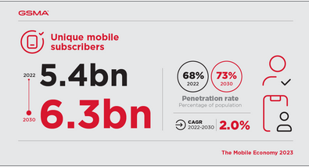
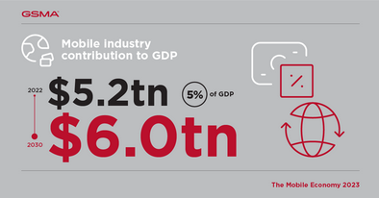
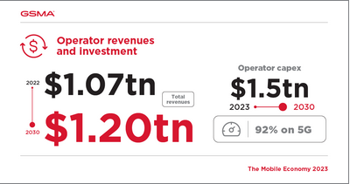
3GPP - a transformation, but what next?
The main standards body for mobile communications
Starting from ETSI, working with other regional SDOs - collaboration and concession
You cannot have it all your own way, but you can keep your identity
Your tools and organisation can be good, but they need to work for your members
Getting a wider circle of friends, without conflict
Can we build new ways of working that are more effective, better and faster?
The challenge of the software environment
Source: https://www.gsma.com/mobileeconomy/#key_stats

Slide 4
Thank you for your attention
Follow us on:

Slide 5
Any further questions?
Contact me:
simon.hicks@dcms.gov.uk

