Slide 1
ICT Standards Enabling Global Sustainability Goals – The All-Electric and Connected Society (AECS)
Presented by: Johannes Stein, DKE, Germany
26/04/2023

Slide 2
Notes:
Motivation for the AECS

Slide 3
The Energy Challenge
The world needs more and more energy so that the growing population can live in prosperity and security.
On the other hand, we must reduce CO₂ emissions in order to survive.
→
Huge demand for clean energy globally
And this clean energy will be electrical
Adobe Stock
Datei-Nr.: 163734655
Landschaft im Grünen: VDE-Stock_Landschaft-mit-Windkraftanlagen_163734655
Source: Adobe Stock ABCDstock

Slide 4
Unlimited availability
Picture Licence on 05.02.2022
Sonnenaufgang: VDE-Stock_Sonnenaufgang_86169584_akumak / stock.adobe.com
Source: stock.adobe.com akumak

Slide 5
Economically producible
Picture Licence on 05.02.2022
Windturbinen und Solar: VDE-Stock_Windturbinen-Energieerzeuger_292330684
Source: VDE-Stock_Windturbinen-Energieerzeuger_292330684

Slide 6
Storable and transportable
Picture Licence on 05.02.2022
Pipelines: VDE-Stock_Pipelines-bei-Sonnenuntergang_113099715_bht2000 / stock.adobe.com
Source: VDE-Stock_Pipelines-bei-Sonnenuntergang_113099715

Slide 7
Applications with fossil fuels are being electrified – examples of electric cars or heat pumps
Picture Licence VDE DAM: Ladestation-fuer-Elektrofahrzeuge_337790119.jpeg
Source: Adobe Stock Noel
Notes:
One characteristic will be the electrification of applications using fossil fuels today

Slide 8
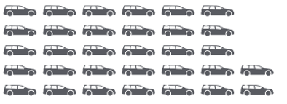
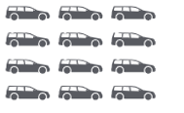
Comparison of the supply capacity of a wind turbine for different drive technologies - The electric car with battery is the most efficient
Energy source
Energy carrier
Drive system
Locally
emission-free
a 3 MW wind turbine supplies ...
e.g. Wind turbine
3 MW, 2.000 h per year
Electrical power
1.600 cars
Source: VDE Study Powertrain portfolio of the future
H₂
600 cars
eFuels
250 cars

Slide 9
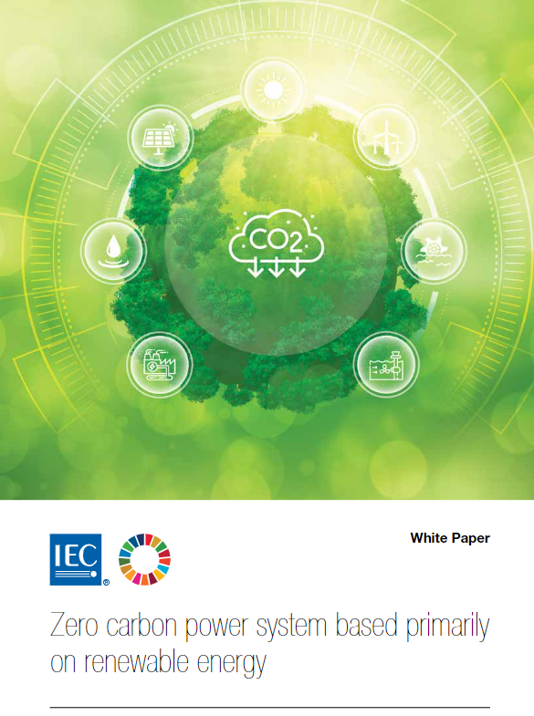
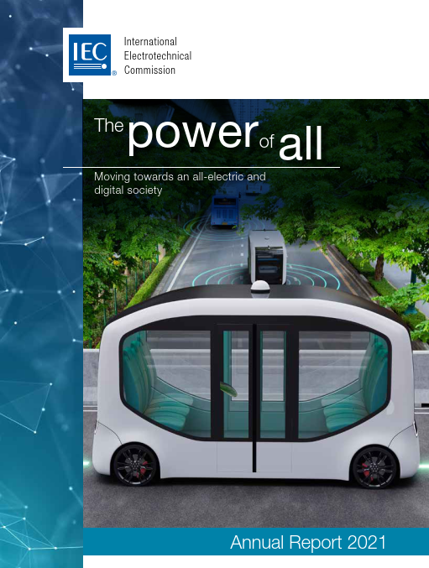
All-Electric and Connected Society - IEC current activities
Notes:
IEC is already active and well positioned for the AECS

Slide 10
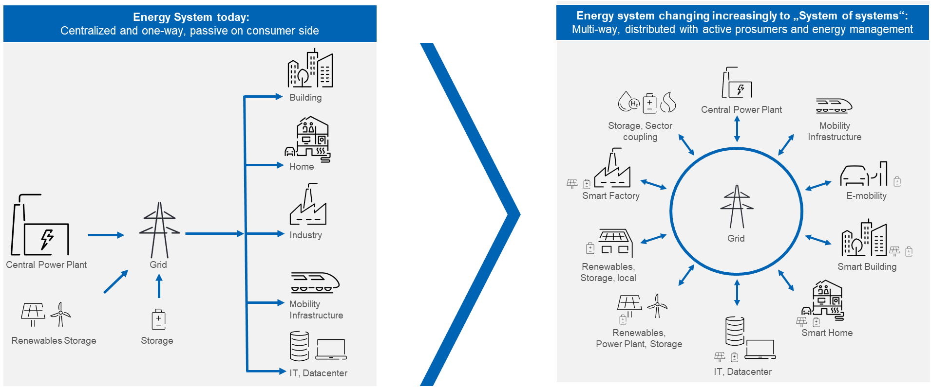
From todays linear value chain in the energy system to a network with various possible interactions
Notes:
Starting point for the definition

Slide 11
Electrification
Picture Licence on 05.02.2022
AI-City: VDE-Stock_Intelligente-Stadt-und-Kommunikationsnetz_215448798_metamorworks / stock.adobe.com
Connectivity
Source: stock.adobe.com - metamorworks
Automation
Notes:
But the all-electric system needs also connectivity and automation which will be shown later on. Therefore IEC called is the all-electric and connected society (AECS).

Slide 12
Definition of the All-Electric and Connected Society (AECS by IEC SMB/ahG 95)
The All-Electric and Connected Society (AECS) is a
human-centric, sustainable, resilient, economically & socially vibrant global community empowering its citizens to lead a
healthy, safe, secure, and meaningful life by virtue of
the intelligent & green electrical energy and
cutting-edge communication & digital technologies creating
a decarbonized environment and conducive living conditions.
Notes:
Suggested definition in the ahG 95

Slide 13
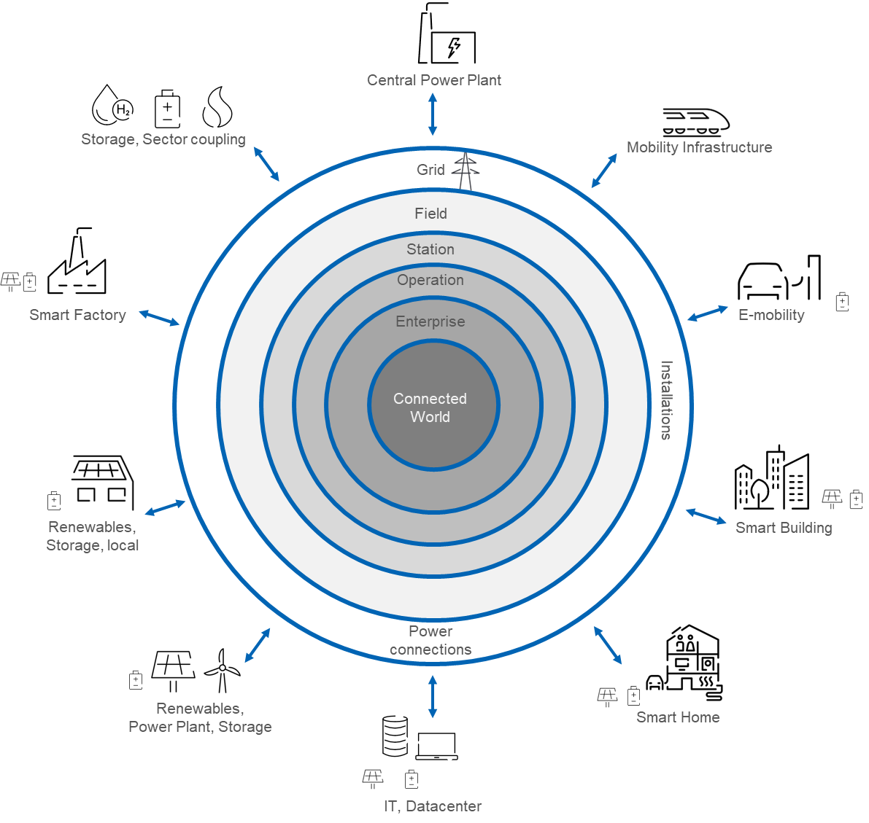
On the way to the All-Electric and Connected Society
Use case: Sector coupling
Energy efficiency
Balancing of generation and consumption
Flexibility thanks to energy storage
Notes:
The graphic already shows that automation and connectivity to contral this network is needed. Some of the uses cases are menitioned here.
Sector Coupling means intelligent energy management cross different sectors and energy carriers (power-to-X)

Slide 14
On the way to the All-Electric and Connected Society
Sector coupling requires
connectivity
data and information models
unified semantics
Notes:
For this we need semantic interoperability to exchange data between different sectors.

Slide 15
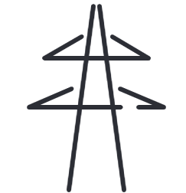
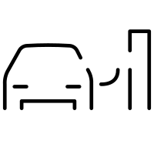
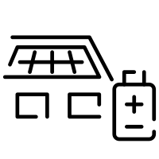
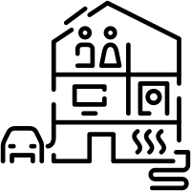
Connecting data spaces of different sectors simplified presentation
Applications access semantically defined data via registries for their task
Use Case B
Use Case A
Mobility
Mobility
Industry
Mobility
Industry
Energy
Industry
Energy
Energy
Building/House
Building/House
Power-to-X
Building/House
Power-to-X
Decentralized "digital twins", e.g. in the company's cloud or a sector-specific, cross-company "Cloud-X"
Power-to-X
Infrastructure
Real world with devices, sensors, applications (edge)
Power-to-H2/Gas Electrolysis + Storage
Power-to-Heat + Speicherung

Slide 16
On the way to the All-Electric and Connected Society
Standards are key
to connect sectors
to create the architecture of the green transformation
… and soon these standards will be digital as well
Notes:
And for this we need standards

Slide 17
From todays linear value chain in the energy system to a network with various possible interactions
Notes:
Starting point for the definition

Slide 18
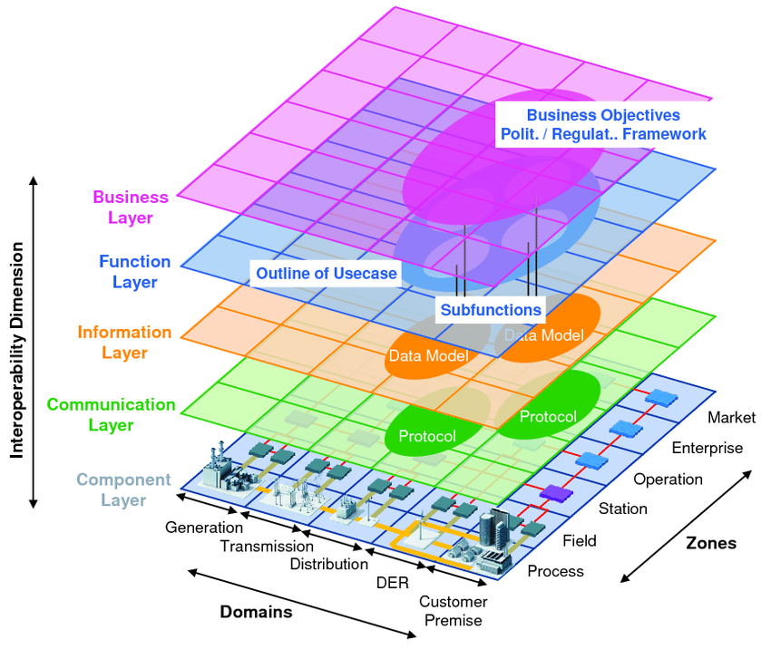
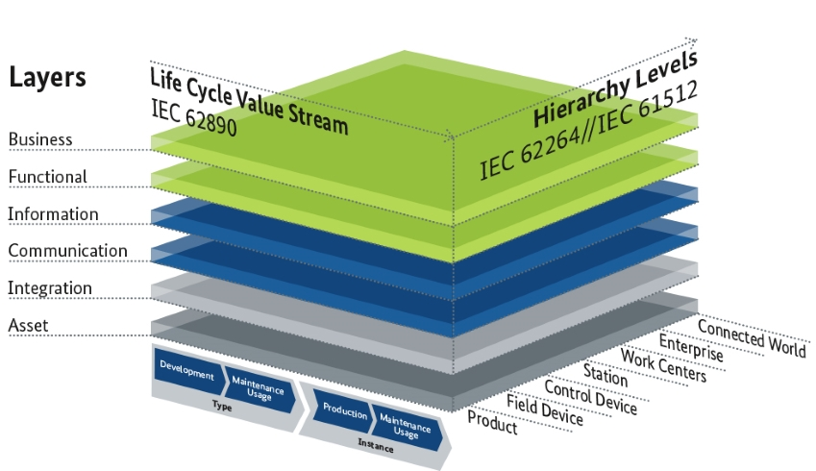
Smart grid architecture model SGAM
Reference architecture model of industry 4.0 or smart manufacturing
Z
Y
X
Notes:
These we now e. g. from industry 4.0 or SGAM
But here it is still considered that the X achis is a linear value chain.

Slide 19
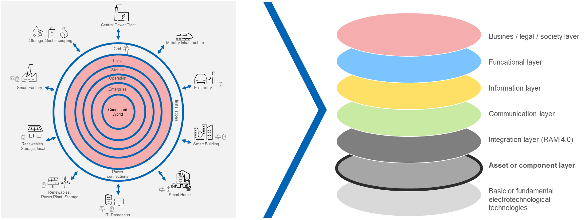
All-Electric
Draft AECS Architecture Model
Connected
Notes:
But we have a value network now which will be an own layer. So the Y-achsis was moved to radial circles.
We added the societal aspect in the top layer and added an layer for basic technologies.
But this is only a first consideration which might be further discussed and improved.

Slide 20
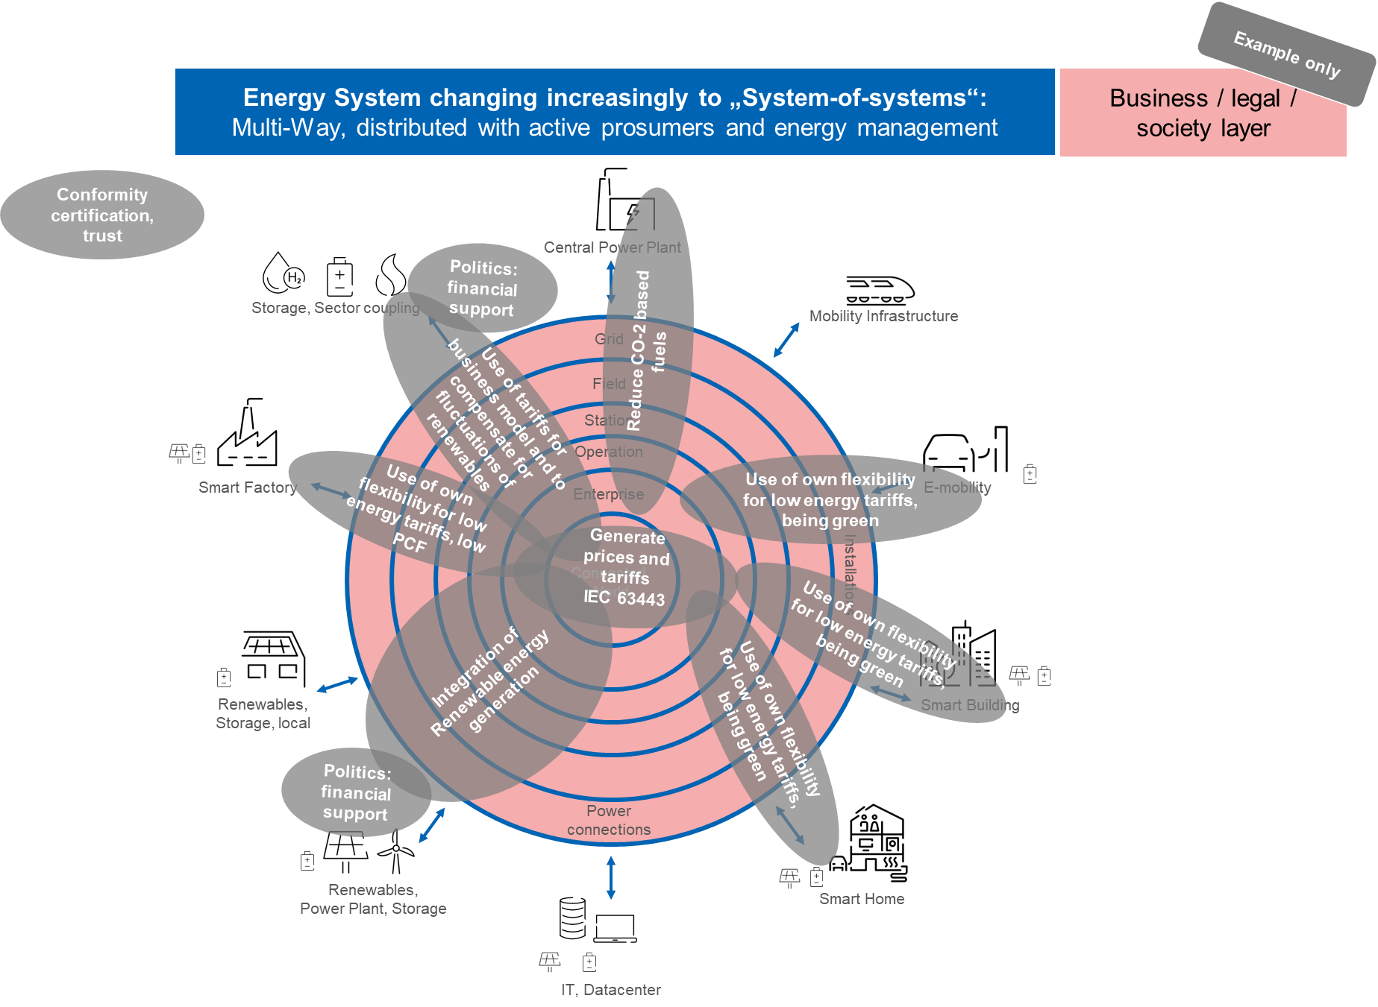
Notes:
Example how to use the top layer

Slide 21
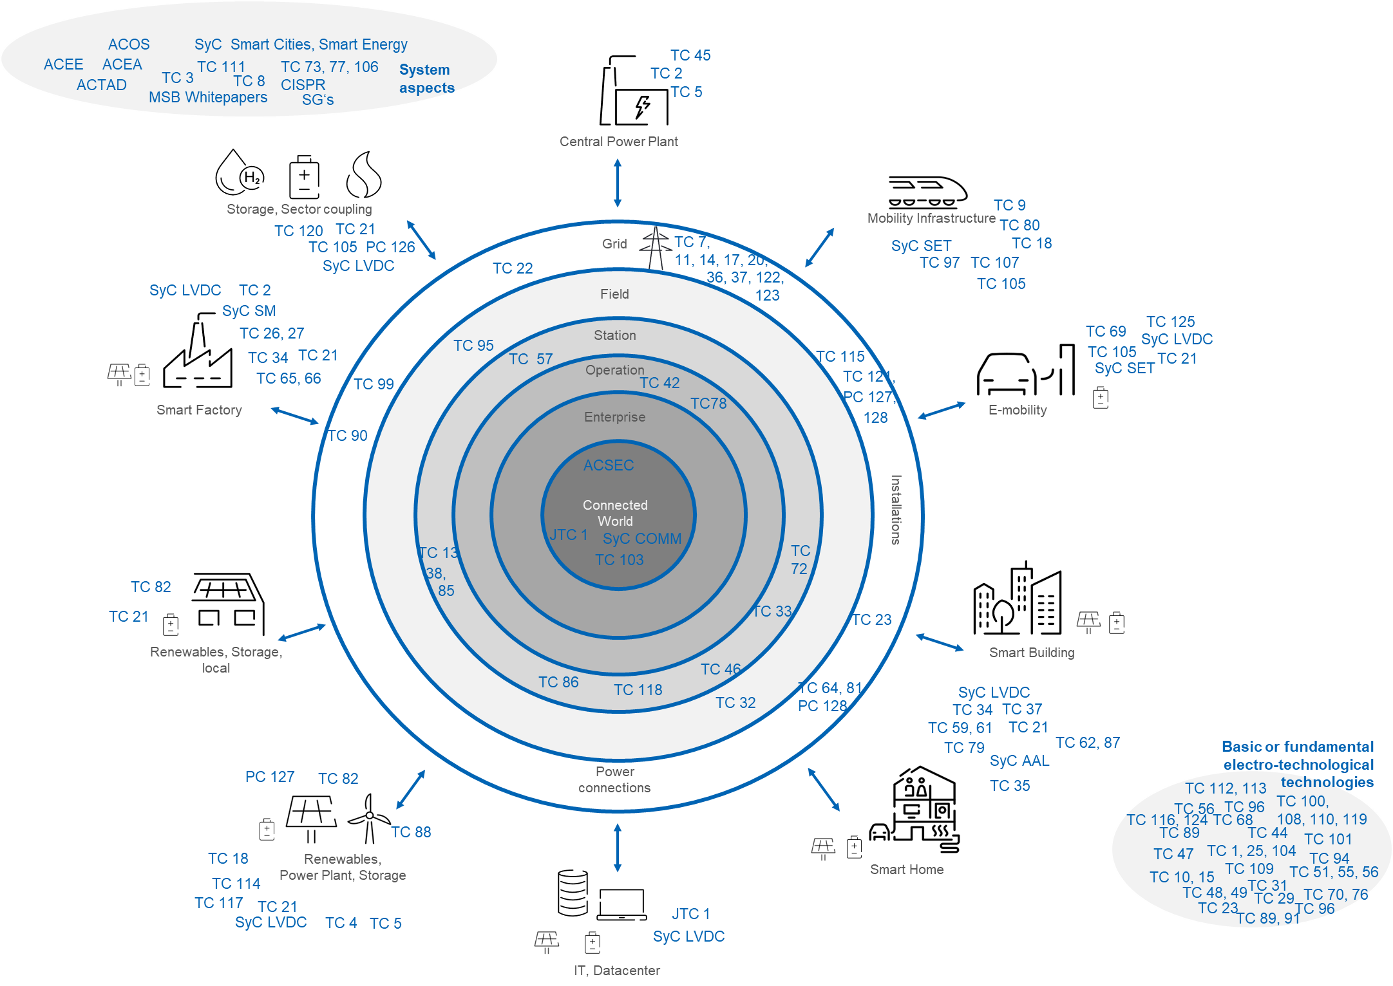
Mapping Example – IEC committees to the Draft AECS Architecture Model
Might be used as well to map use cases with prototype architectures and related standards

Slide 22
IEC and UN SDG
https://www.iec.ch/sdgs

Slide 23
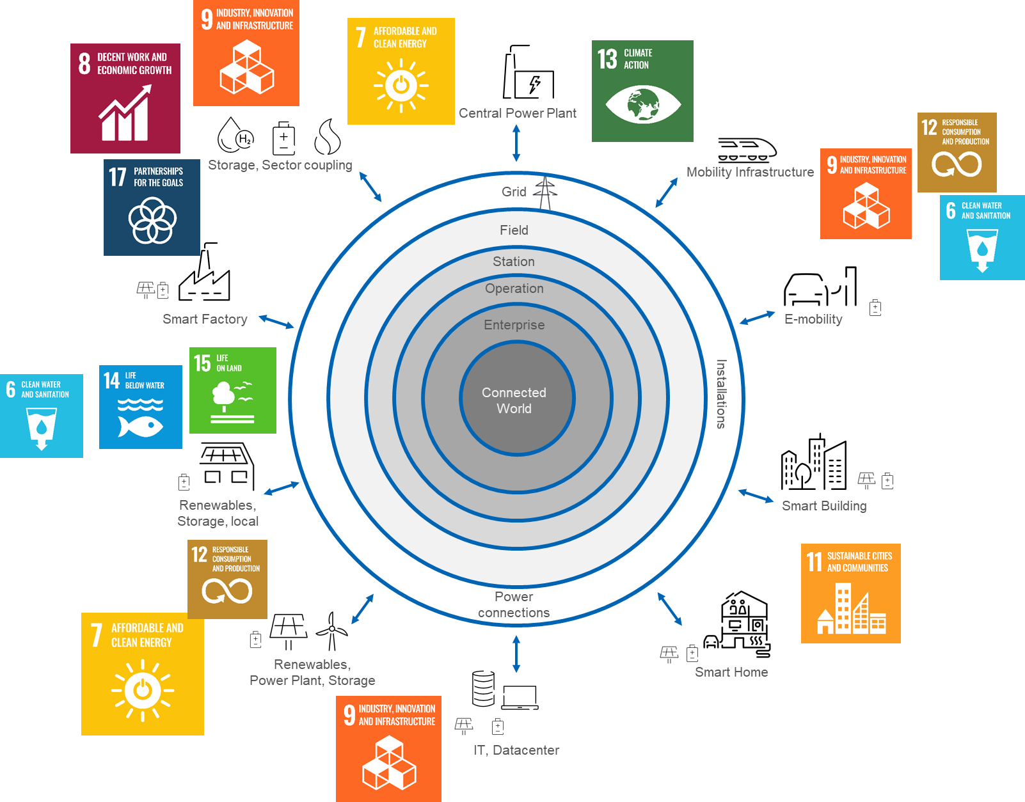
AECS and UN SDG Mapping

Slide 24
Thank you for your attention
… we can only succeed together …
Johannes Stein
Senior Principal Expert
Horizontal Topic Development
DKE German Commission
for Electrical, Electronic & Information Technologies
Merianstraße 28
D-63069 Offenbach am Main
Phone: +49 151 163 45 944
Johannes.Stein@vde.com
www.dke.de

