Slide 1
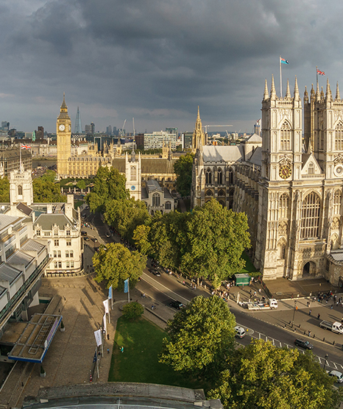
Closure of GSC 23 - takeaways
Presented by: Bettina Funk, GSC 23 Chair
27/04/2023

Slide 2
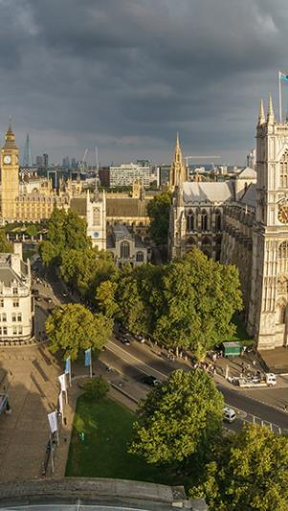
Session 1A: Value of Global Standards in the environment of global geopolitical fragmentation
The PSOs presented
  Some examples highlighting the value of global standards
  Their experience on how to address national / regional needs with global standards
There was consensus amongst the participants about
  the value of global standards for economy and society.
  the importance of raising awareness and appreciation for global standards, especially among governmental and societal stakeholders
  the need to better inform and educate about standards and its values
Some potential actions
  create common initiatives (e.g. a document stating the value of global technical standards) to achieve a bigger impact together (”same messages”)
  create and raise awareness and appreciation for global technical standards, especially with governmental and societal stakeholders
  develop a game which shows the value of standards in an easy-to-understand way
  potential joined PSO action for COP28

Slide 3
Session 1B: Digital Transformation
  Summary
  Digitalization is rapidly changing the way we live, work and interact with each other.
  The session explored how digital transformation is influencing the development and distribution of international standards.
  Participants shared their experiences and those of their organizations.
  The discussion was engaging and interactive, with the audience challenging existing paradigms and sharing their digital transformation journeys.
  The panelists agreed that effective digital transformation requires an open mindset (“embrace change”), should facilitate personal connection, requires to break down silos and needs piloting of new technologies to evaluate the potentials and to limit unintended consequences.
Call to Action
  The session concluded with a call to action, urging entities to collaborate on digital transformation projects to be able to create interfaces between the tools developed and to leverage digital technology's potential to drive innovation, efficiency, and growth.
  Keeping pace with digital transformation is critical to creating a better future.

Slide 4
Session 2: ICT Standards Enabling Global Sustainability Goals
Summary
  We take the issue seriously!
  Impact on personal level, economic level, business models, …
  ICT can help reduce the carbon footprint of verticals.
  Need for standardised methods to measure (also to support legislation).
  Work ongoing but can be aligned even better to avoid overlap and gaps.
  ICT has brought socio-economic development and will continue doing so
  Trade-offs need to be addressed, we need to look at the full picture
  Systematic approach and mapping can help
  Enable consumers to make sustainable choices (we are humans!)
Call to Action
  We have to get out of our comfort zone!
  Integrate more with the verticals to show the benefits of using ICT.
  Collaborate earlier.

Slide 5
Session 3: Technical Standards to Support Metaverse/XR
Summary
  Common definitions can help, but maybe one-size-does-not-fit-all
  Different types (consumer, industrial, business/e-commerce, governmental, …) of metaverse and more than one metaverse of the different types as well as different levels of Metaverse
  Interoperability between the different metaverses required (e.g. ommon avatars across the metaverses)
  Privacy & Safety are important aspects of the Metaverse (e.g. protection of children)
  Ethical aspects need to be considered
  Metaverse is a long-term project (not just a hype)
  Collaboration is needed e.g. on the topic secure metaverse
  How to regulate the Metaverse?
  Sustainability aspects of Metaverse – where are the gains?
Call to Action
  Collaborate continuously to share information e.g. to use in gap analysis

Slide 6
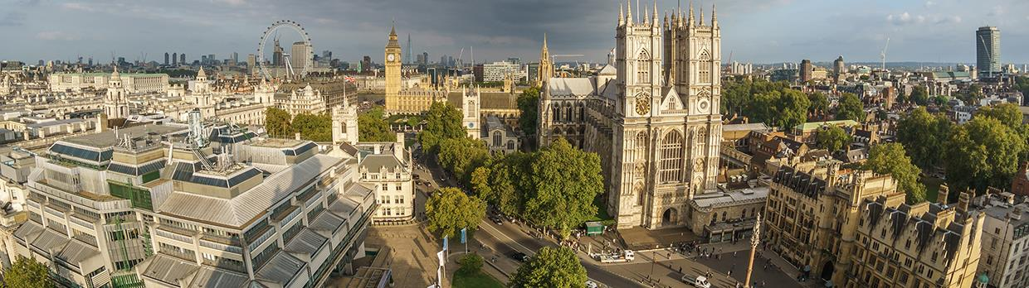
Thank you for coming and your active contribution!
Follow us on:

Slide 7


See you at the next GSC
(probably around April 2025), but hear you many many times before!

